Slide 1

Mission Overview II: The Decadal Survey
Dr. Tiffany Kataria
Jet Propulsion Laboratory, California Institute of Technology
Sun, Jul 21, 2024

Slide 2
What is a Decadal Survey?
Decadal Surveys are community-driven, bottom-up studies produced by the National Academies of Sciences, Engineering, and Medicine (NASEM) that aim to formulate a community consensus about the most compelling science questions for the decade [or more] ahead. Decadal surveys play a vital role in helping NASA define and align research to uniquely advance scientific knowledge, meet human and robotic exploration mission needs, and benefit humanity. https://science.nasa.gov/biological-physical/resources/decadal-surveys/
NASA’s Science Mission Directorate (SMD) engages the science community in identifying and prioritizing leading-edge scientific questions and the observations required to answer them through the National Research Council (NRC), the operating and principal programmatic arm of NASEM.
What does the NRC do?
  Conducts studies that provide a science community consensus on key questions posed by NASA and other U.S. government agencies. The broadest of these studies in NASA’s areas of research are decadal surveys.
  NASA and its partners ask the NRC once each decade to look out 10 or more years into the future and prioritize research areas, observations, and notional missions to make those observations.

Slide 3
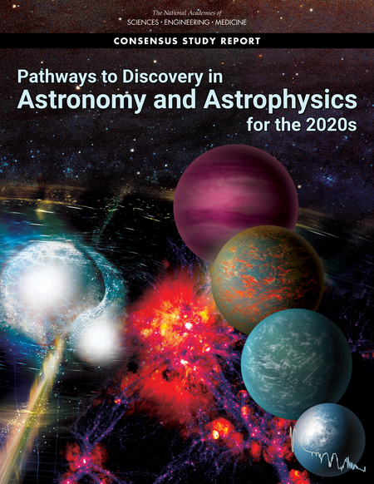
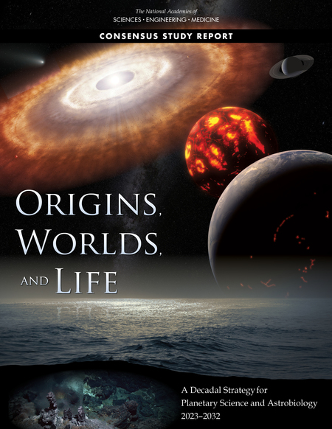
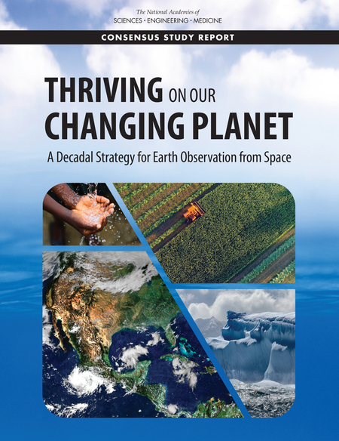
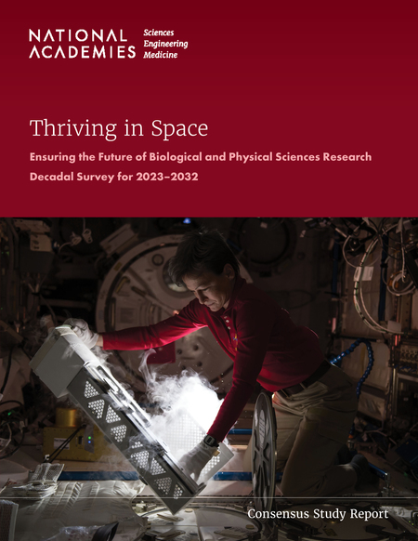
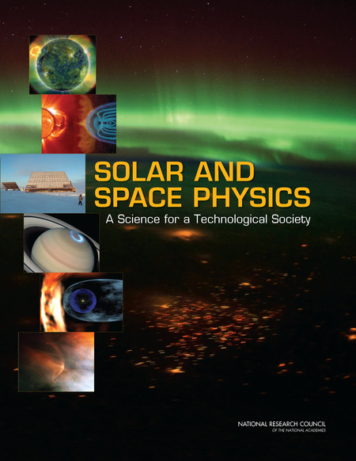
Decadal Surveys most relevant to NASA:
Astronomy and Astrophysics Pathways to Discovery in Astronomy and Astrophysics for the 2020s (2021)
Planetary Science and Astrobiology
Origins, Worlds, and Life: A Decadal Strategy for Planetary Science and Astrobiology 2023-2032 (2022)
Earth Science Thriving on Our Changing Planet: A Decadal Strategy for Earth Observation from Space (2018)
Biological and Physical Sciences Thriving in Space: Ensuring the Future of Biological and Physical Sciences Research (2023)
Heliophysics
Solar and Space Physics: A Science for a Technological Society (2013)
2024 report coming soon!
Notes:
Biological and Physical Sciences used to be housed under HEOMD. Formerly known as Space Life and Physical Sciences Research and Applications (SLPSRA) Division

Slide 5
APC: Activities, Projects, and State of the Profession Considerations
SoPSI: State of the Profession and Societal Impacts

Slide 9
How can you participate in the Decadal Survey process?

Slide 11
Large Mission Decadal Concept Studies
How I participated in the Decadal Process

Slide 12
How I participated in the Decadal Survey process (1): Participated in a Large Mission Concept Study
NASA initiated large mission concepts as candidate for prioritization within Large Missions category in Astro2020 Decadal
NASA Astrophysics Program Analysis Groups (PAGs) [COPAG, ExoPAG, PhysPAG] solicited community input for large mission concepts, and unanimously endorsed the four concepts to study.
For each of the four concepts, NASA appointed Science and Technology Definition Teams (STDTs)
  Develop science case
  Flow science case into mission requirements
  Vet technology gap list
  Direct trades of science vs cost/capability

Slide 15
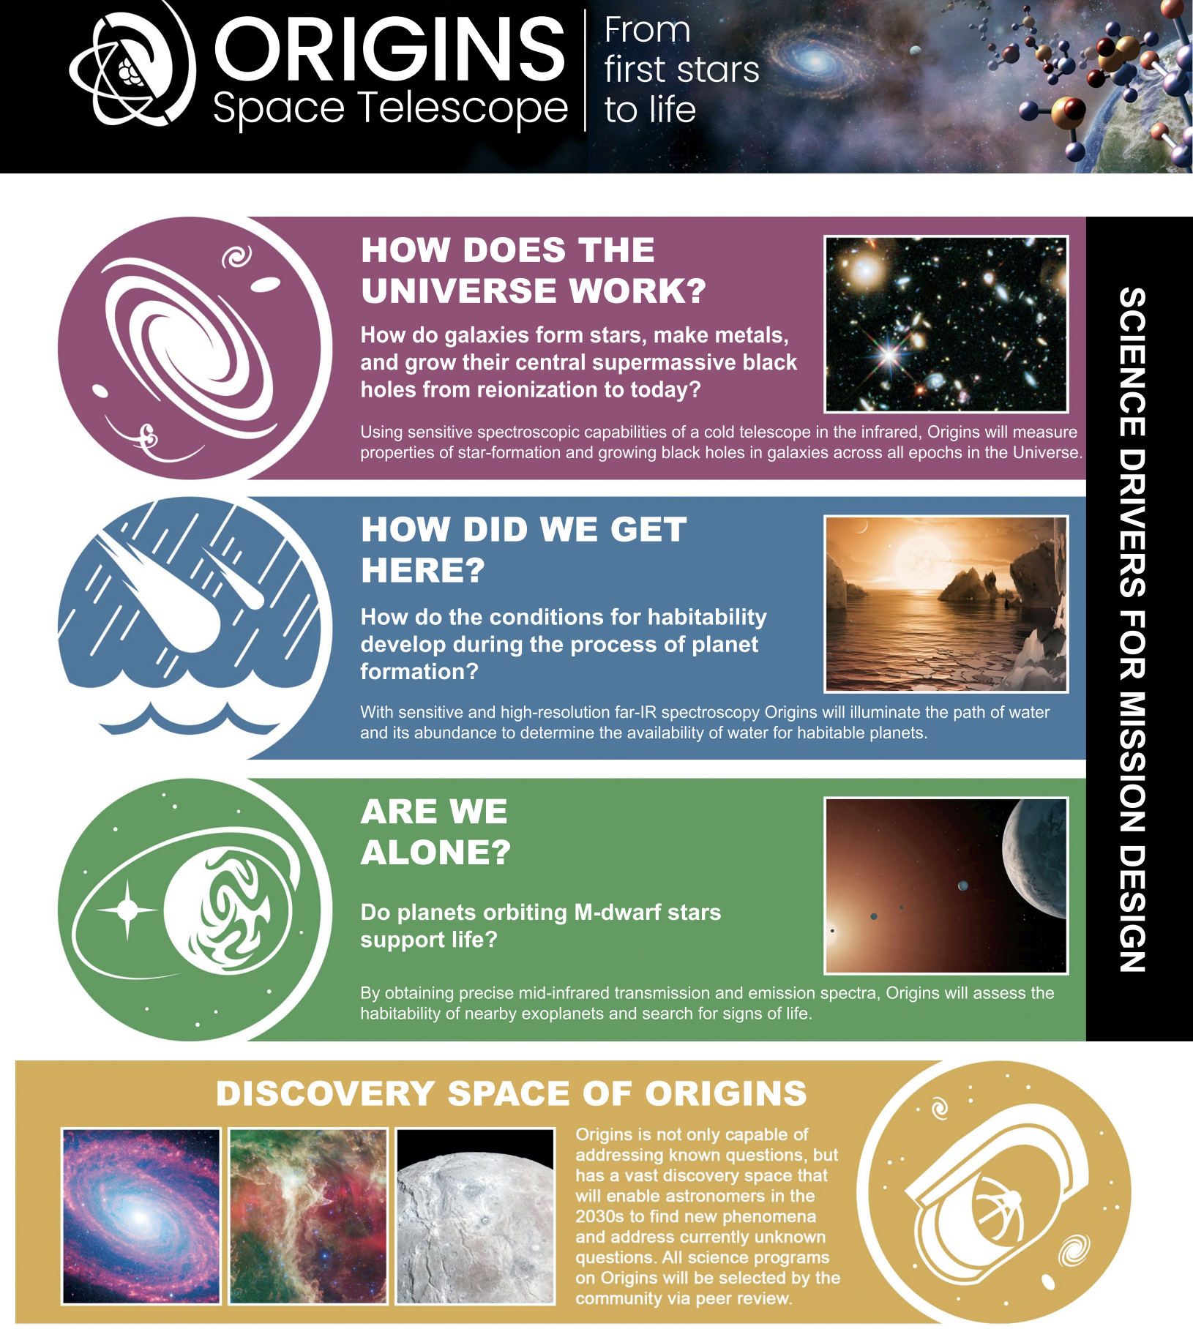
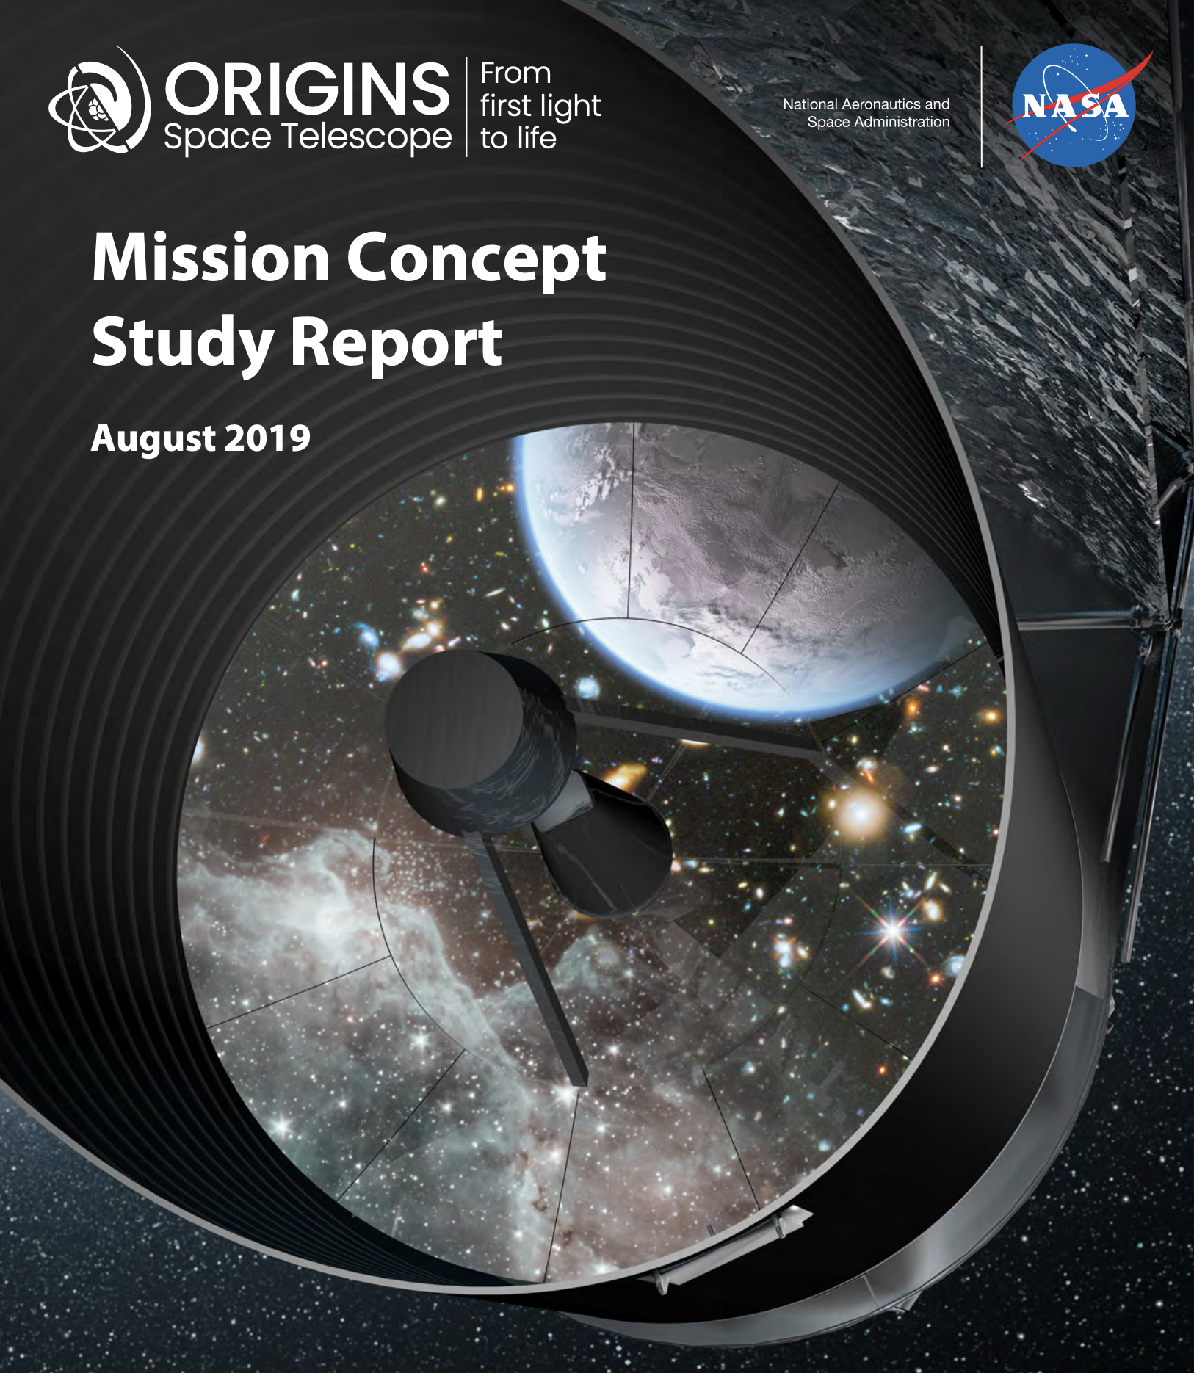
How I participated in the Decadal Survey process (1): Participated in a Large Mission Concept Study
Origins Space Telescope: Evolution of the FIR Surveyor concept
Key characteristics:
  Wavelength coverage: 2.8-588 µm
  Telescope diameter: 5.9m
  Suite of 3 instruments
    OSS: Origins Survey Spectrometer
    FIP: Far-infrared Imager Polarimeter
    MISC-T: Mid-Infrared Spectrometer
    Camera Transit
Served as STDT Member and
co-led science working group for
Exoplanets

Slide 16
How I participated in the Decadal Survey process (1): Participated in a Large Mission Concept Study
Origins Space Telescope: Evolution of the FIR Surveyor concept
Key characteristics:
  Wavelength coverage: 2.8-588 µm
  Telescope diameter: 5.9m
  Suite of 3 instruments
    OSS: Origins Survey Spectrometer
    FIP: Far-infrared Imager Polarimeter
    MISC-T: Mid-Infrared Spectrometer
    Camera Transit
Served as STDT Member and
co-led science working group for
Exoplanets

Slide 17
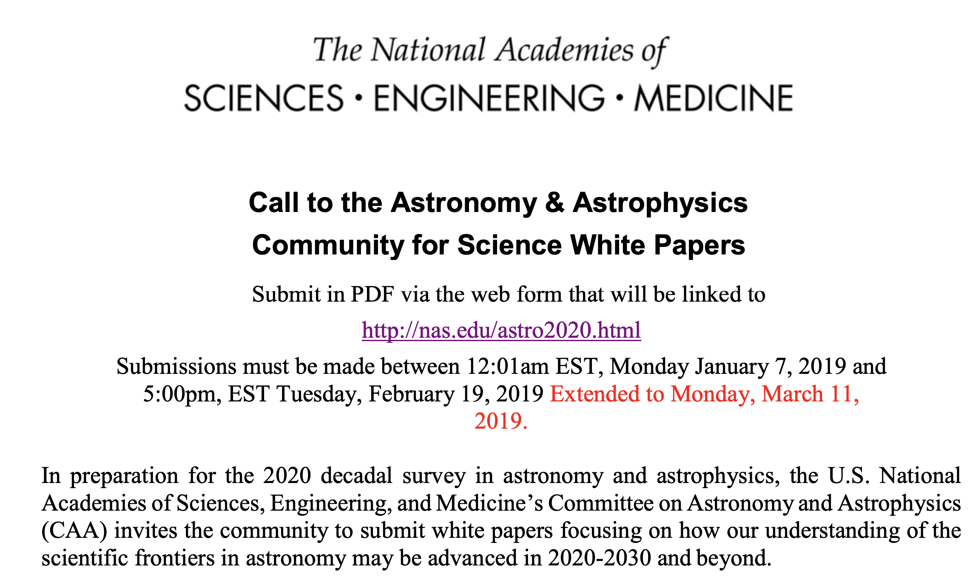
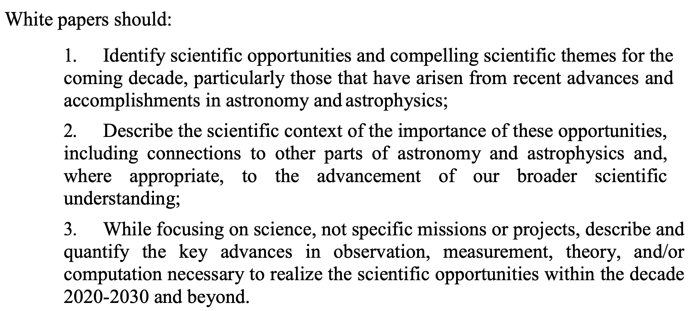
How I participated in the Decadal Survey process (2): Wrote community science whitepapers
The survey received 573 science whitepapers contributed by >4500 authors from the astronomical community
A second call for APC whitepapers elicited 294 whitepapers
Every whitepaper was assigned to and read by one or more of the decadal panels
I contributed to white papers related to the Origins study and to my research in exoplanet atmospheres.

Slide 18
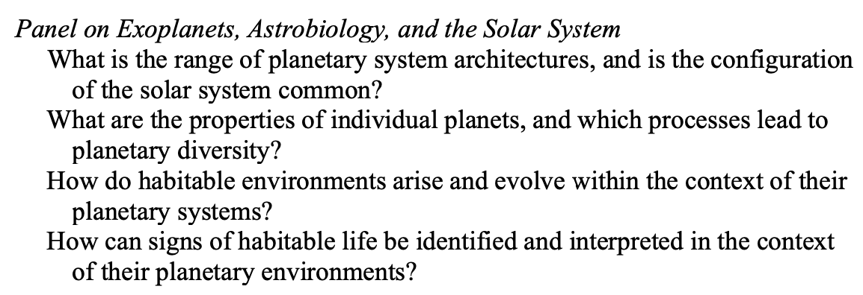
How I participated in the Decadal Survey process (3): Served on a Science Panel
National Academies solicited a Call for Nominations for Survey Committee and Panels. I was nominated and selected for the Science Panel on Exoplanets, Astrobiology and the Solar System
Using community whitepapers, two National Academies Reports (Exoplanet Science Strategy and An Astrobiology Strategy for the Search for Life in the Universe), and other input from the community (e.g., talks given to the committee), we were tasked with developing four main science questions that we identified as the most compelling areas for addressing in the next decade, and one especially compelling general area with unusual discovery potential.
Science Questions:
Discovery Area:

Slide 19
How can you get involved in the Decadal Survey Process?
Write whitepapers
  If you have a science topic you feel passionate about, rally your colleagues as authors and cosigners
Get involved in mission studies
  Apply to be an STDT member, working group member, etc.
  Think about what science could be done with one of these concepts and write/talk about it!
Apply to be part of a panel
  You can nominate or self-nominate—there is no harm in applying if you are eligible!
Participate in science and technology research
  Communicate your results via papers, conferences, and talks
Relatedly, pay attention to the advances in science and technology around you.
  The research and technology development taking place will set the foundation for the next Decadal!

