Slide 1
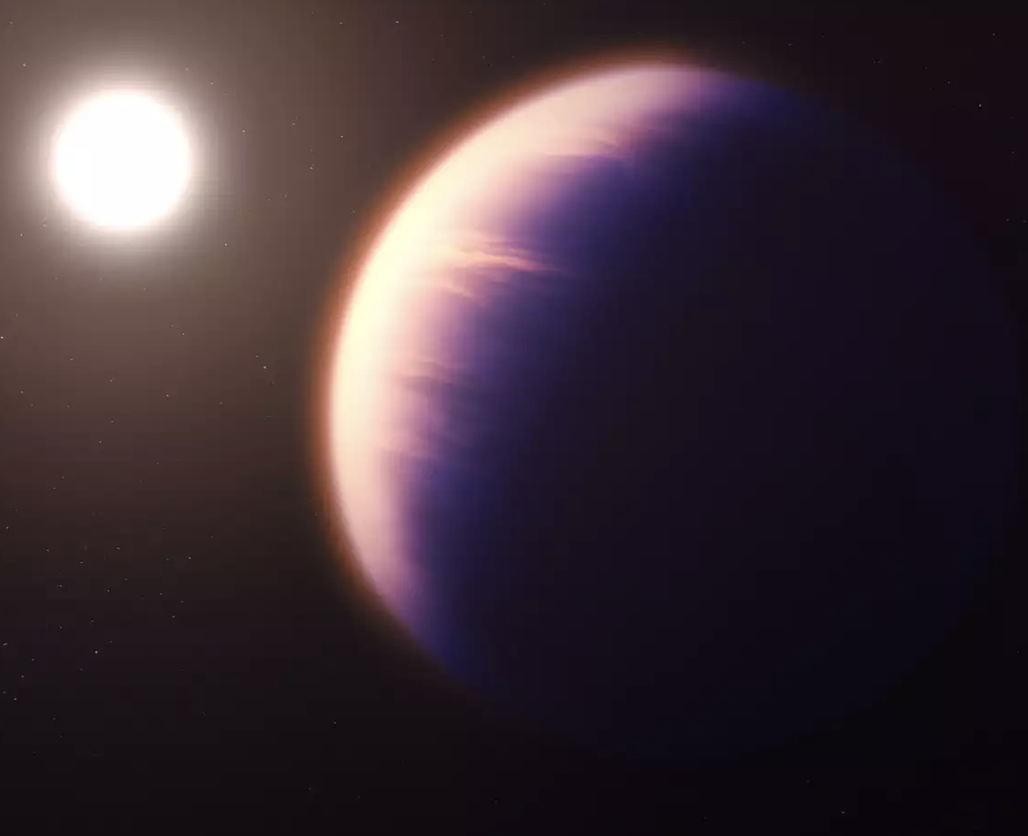
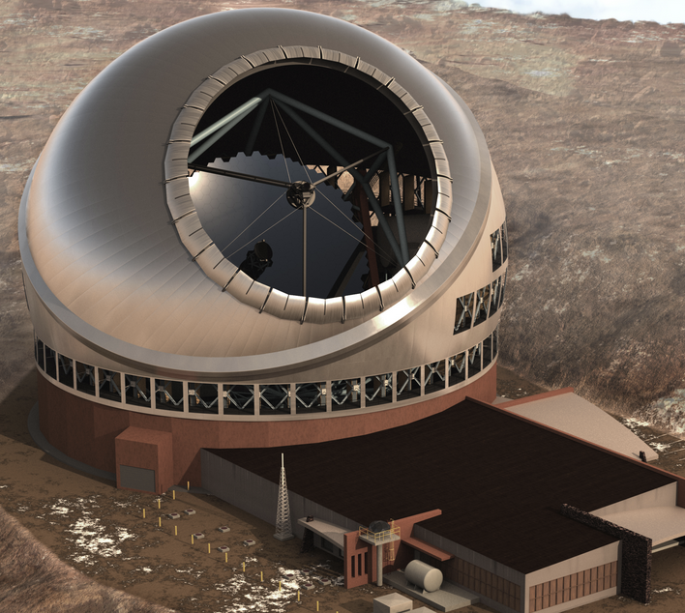
High Contrast Imaging in Space vs. from the Ground: JWST Case Studies
Kimberly Ward-Duong
Assistant Professor, Smith College
Science Member, JWST Telescope Scientist GTO Team
Sagan Summer Workshop 2024 – NExScI/Caltech

Slide 2
Some motivating questions:
What do we achieve by going to space, anyway? (We can build much larger telescopes here on Earth!)
Which lessons learned from ground-based imaging are relevant?
What are we learning from HST and JWST?
What might this mean for an era of JWST and ground-based ELTs operating simultaneously?
⭐️ # relevant poster number where you can learn more!

Slide 3
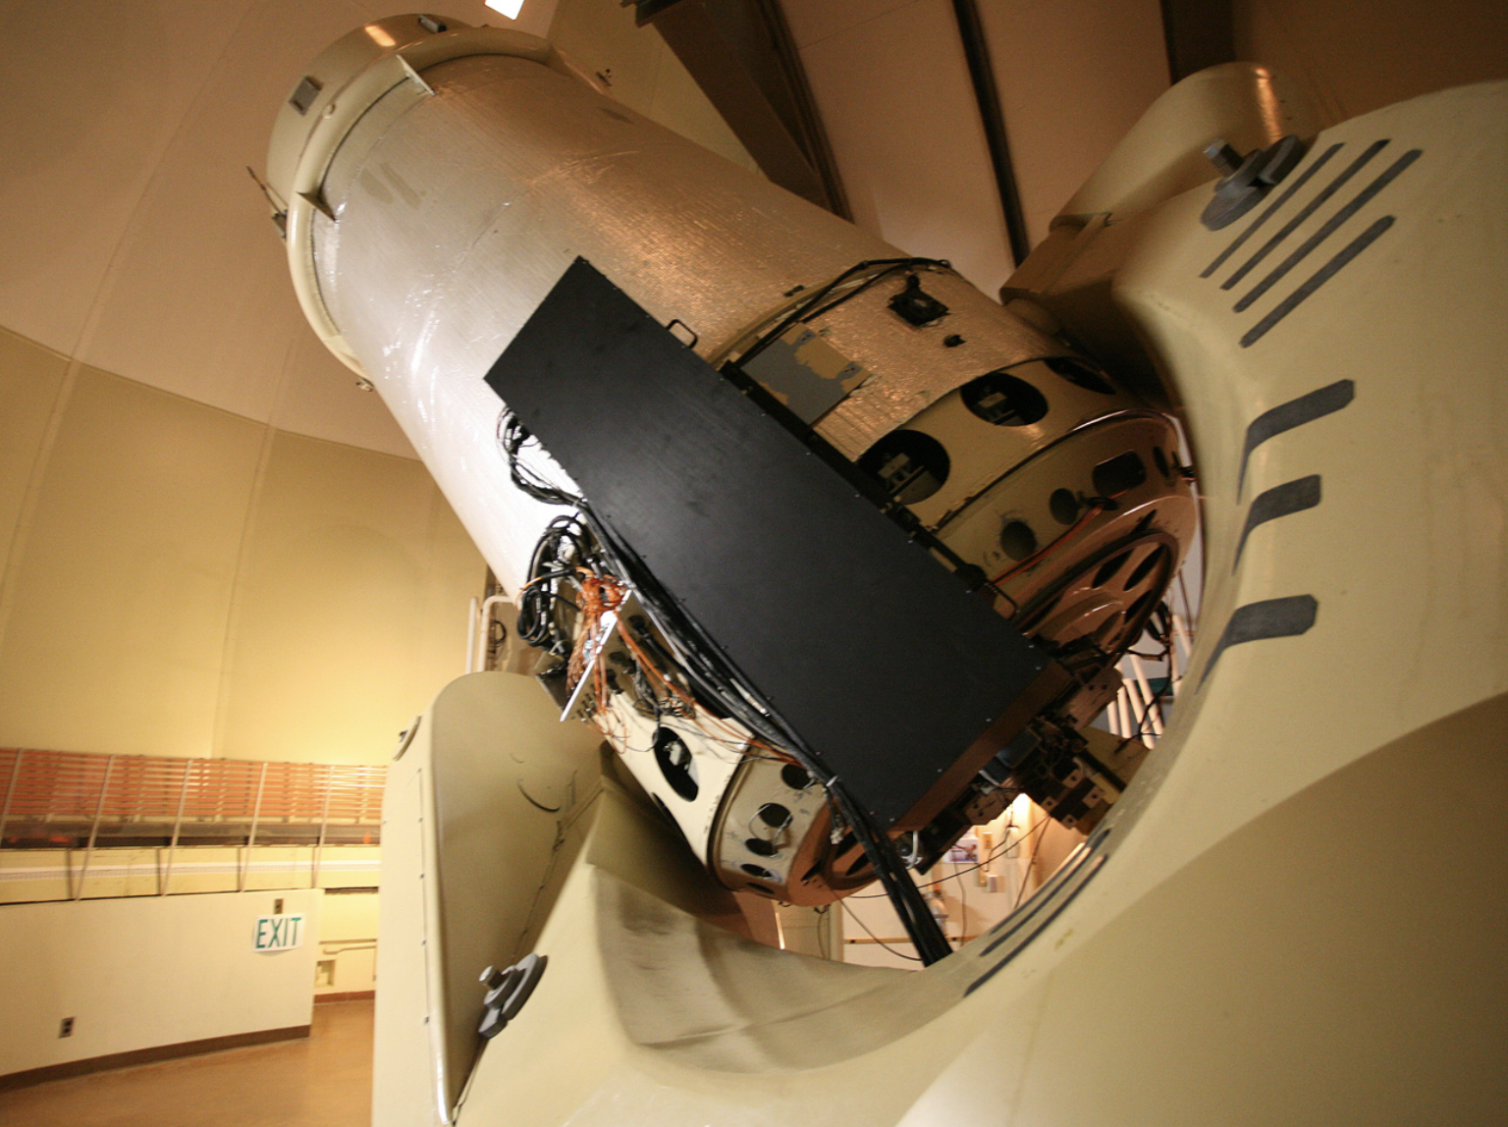
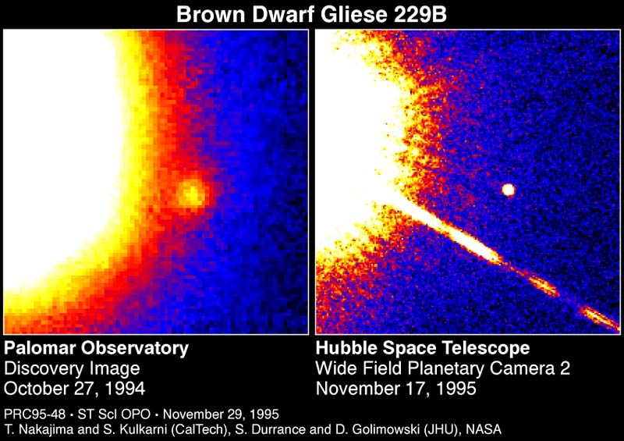
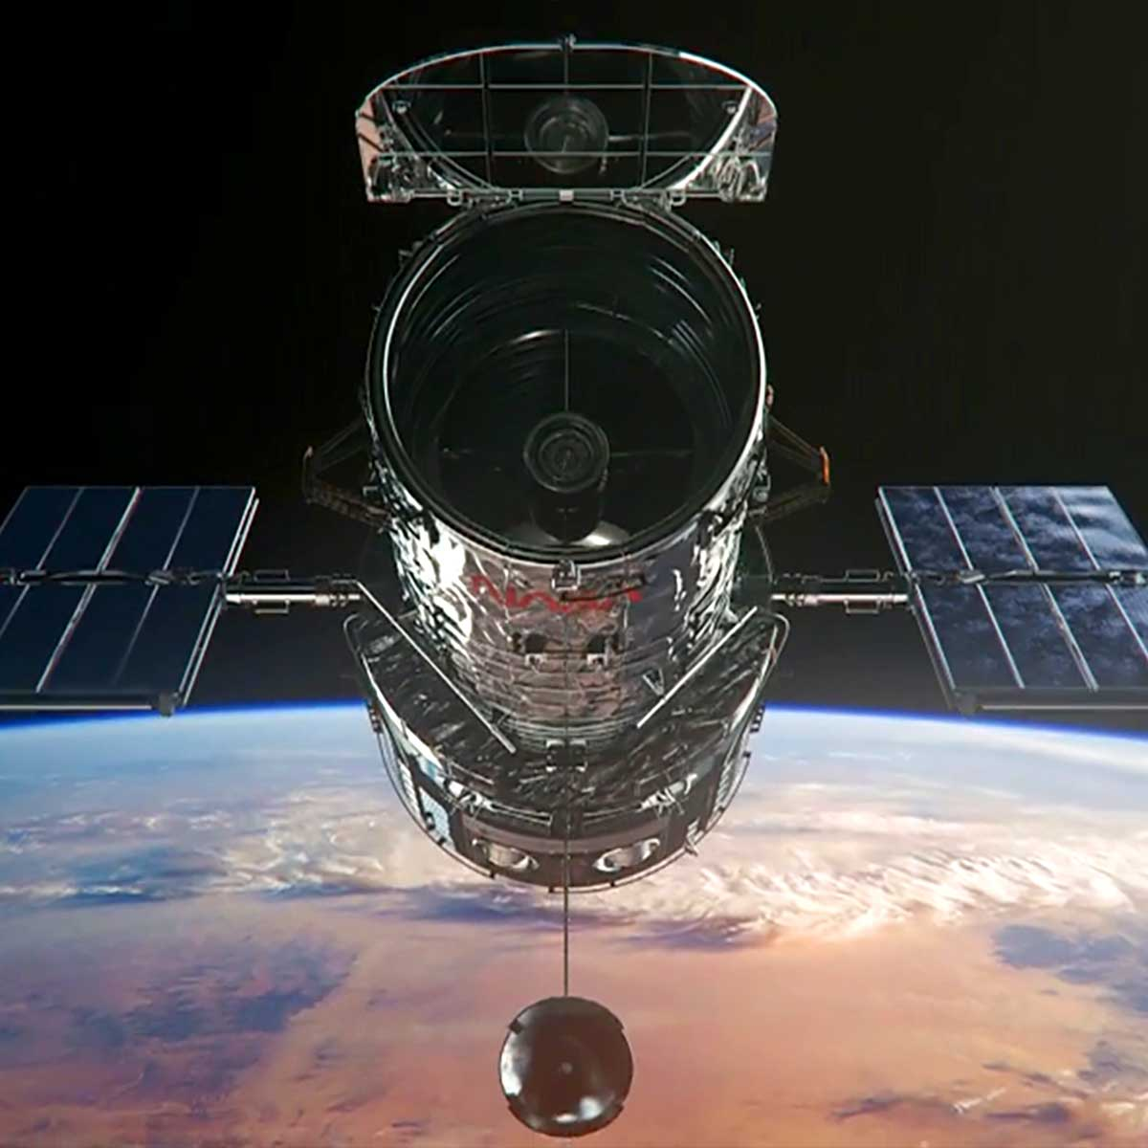
Do you need longer text?
~30 years of Directly Imaging Substellar Objects!
Palomar 1.5m
w/JHU AO
system + coronagraph
HST 2.4m
w/WFPC 2
(unocculted)

Slide 4
HCI from the ground vs. space: Similarities & Differences

Slide 5
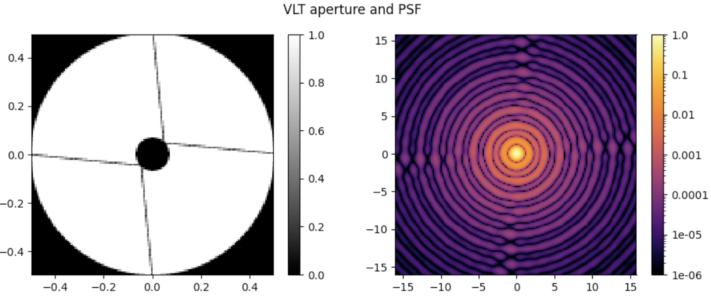
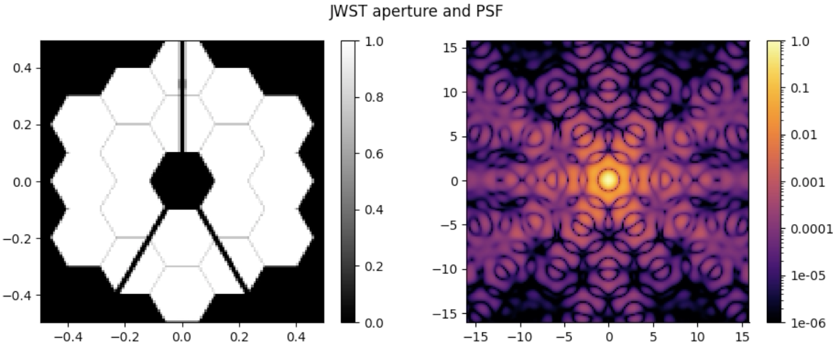
Ground vs. Space: Similarities
Both require careful understanding of the PSF for robust subtraction, forward modeling

Slide 6
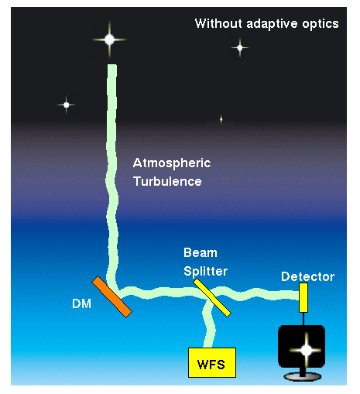
Ground vs. Space: Similarities
Wavefront error (WFE) is important (albeit on different scales/temporal regimes)
Optical Path Difference
(OPD) Maps
JWST:
(usually) ~60 nm RMS, stable for ~days (<10 Hz)
Keck AO:
180-250 nm RMS
>1 kHz changes
Van Dam et al. (2006)
Lajoie et al. (2023)

Slide 7
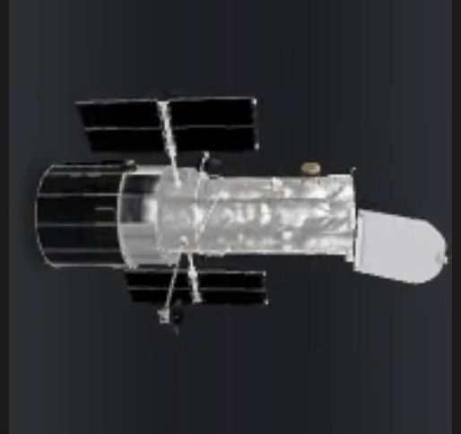
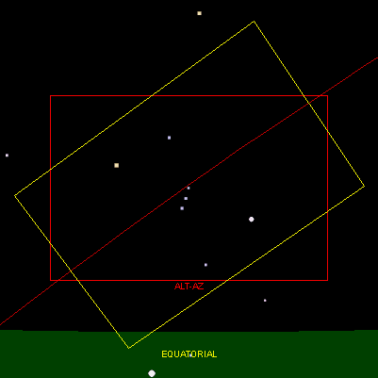
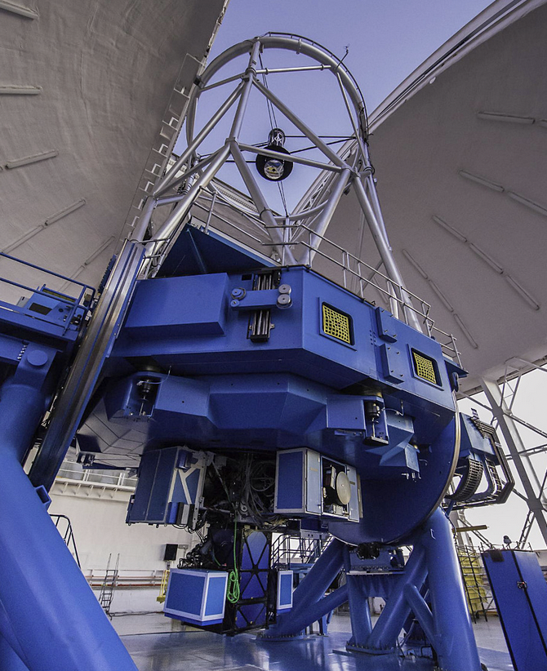
Ground vs. Space: Similarities
Space-based methods applied to ground-based imaging (angular differential imaging)
(see cADI; Marois et al. 2006, Schneider & Silverstone 2003)

Slide 8
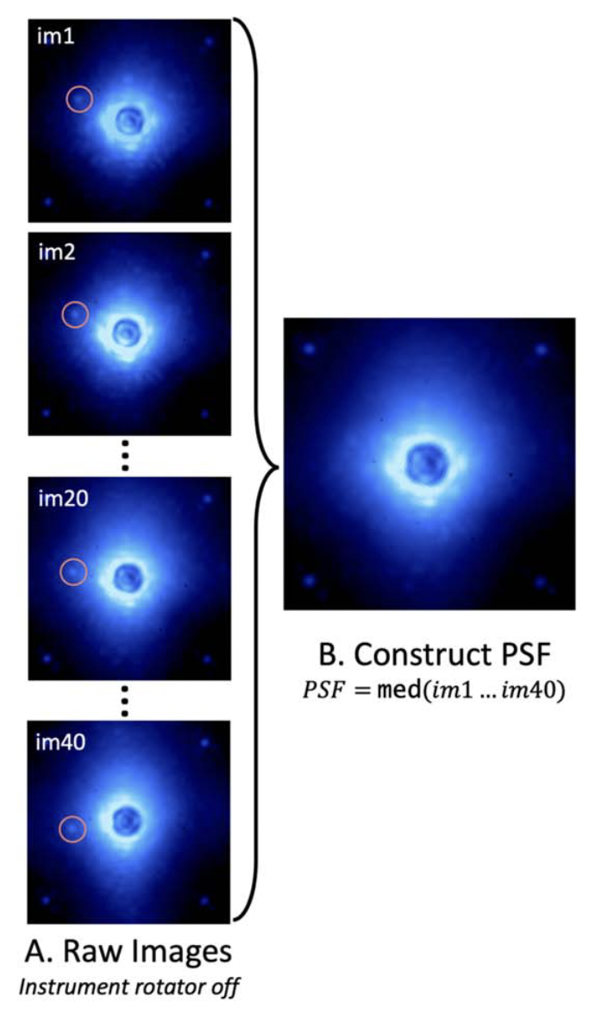
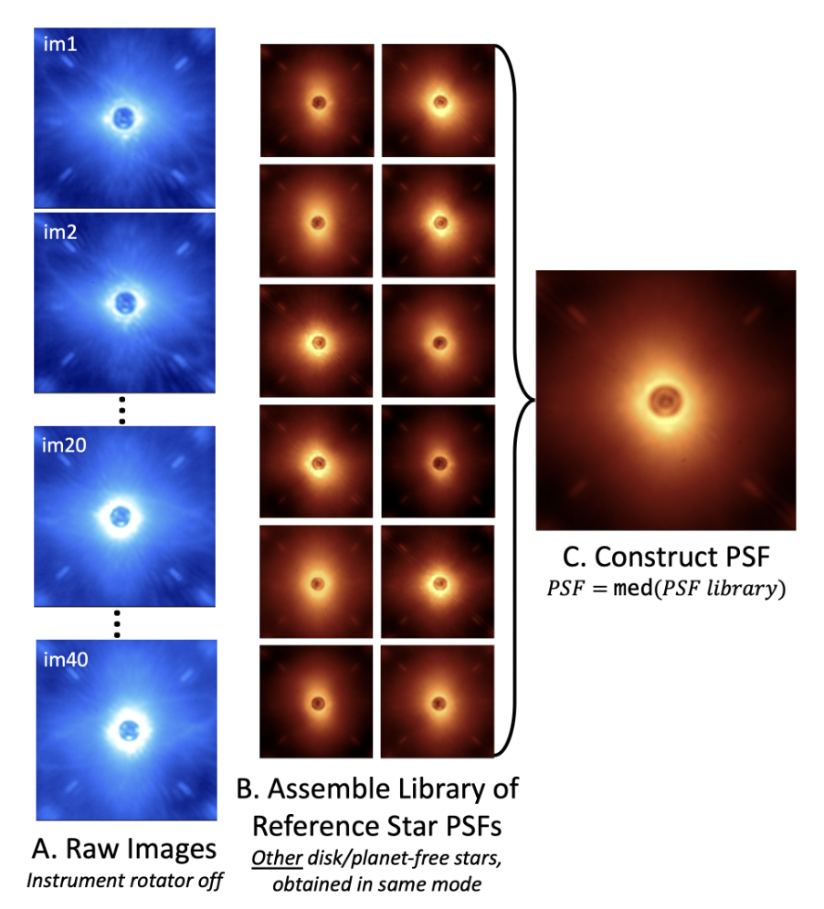
Ground vs. Space: Similarities
ADI
Can also use large image libraries to generate appropriate PSFs (reference differential imaging; RDI)
Considerations: one reference or many? matching stellar flux, spectral type and color, counts received on detector
RDI
See high contrast imaging review by Follette (2023)!
⭐️ 27 Julliard, 34 Mâlin

Slide 9
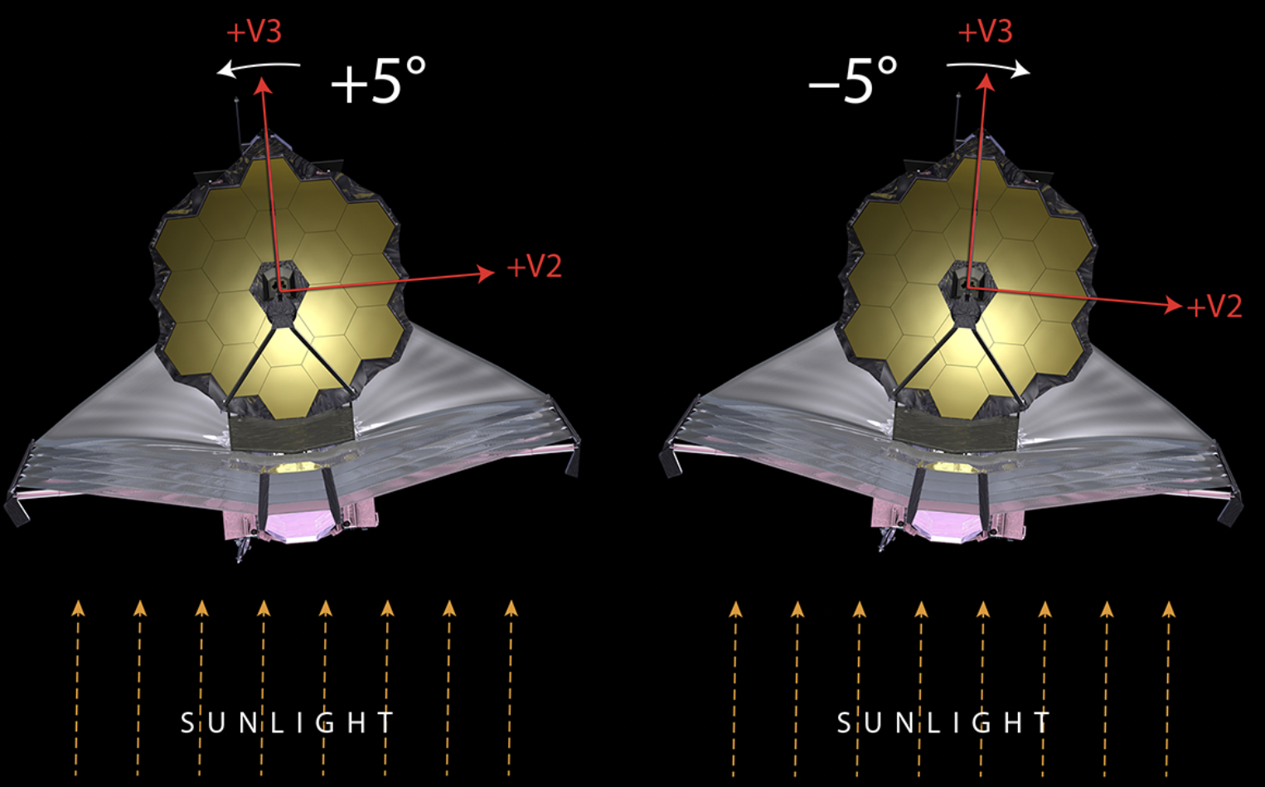
HCI from the Ground vs. Space: Differences
PSF structure/variation is much more well-behaved and characterizable in space
Space telescopes have exquisite pointing and stability, repeatability (e.g., 5-10 mas pointing and < 2 mas jitter for JWST)
Lambda/D is much larger for smaller diameter (HST: 2.4m, JWST: 6.5m) → larger inner working angles (~0.3” for NIRCam + MIRI, < 0.1” from ground)
For JWST, limited roll angles (only 5º-14º maximum) for ADI due to sunshield limitations (see also: glowsticks & dedicated backgrounds)
Space provides access to wavelengths inaccessible from the ground and much lower thermal background – new IR science! (see Rob de Rosa’s talk re: atmospheric transmission)

Slide 10
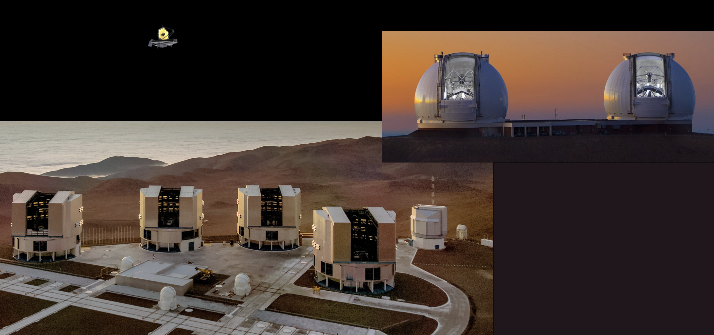
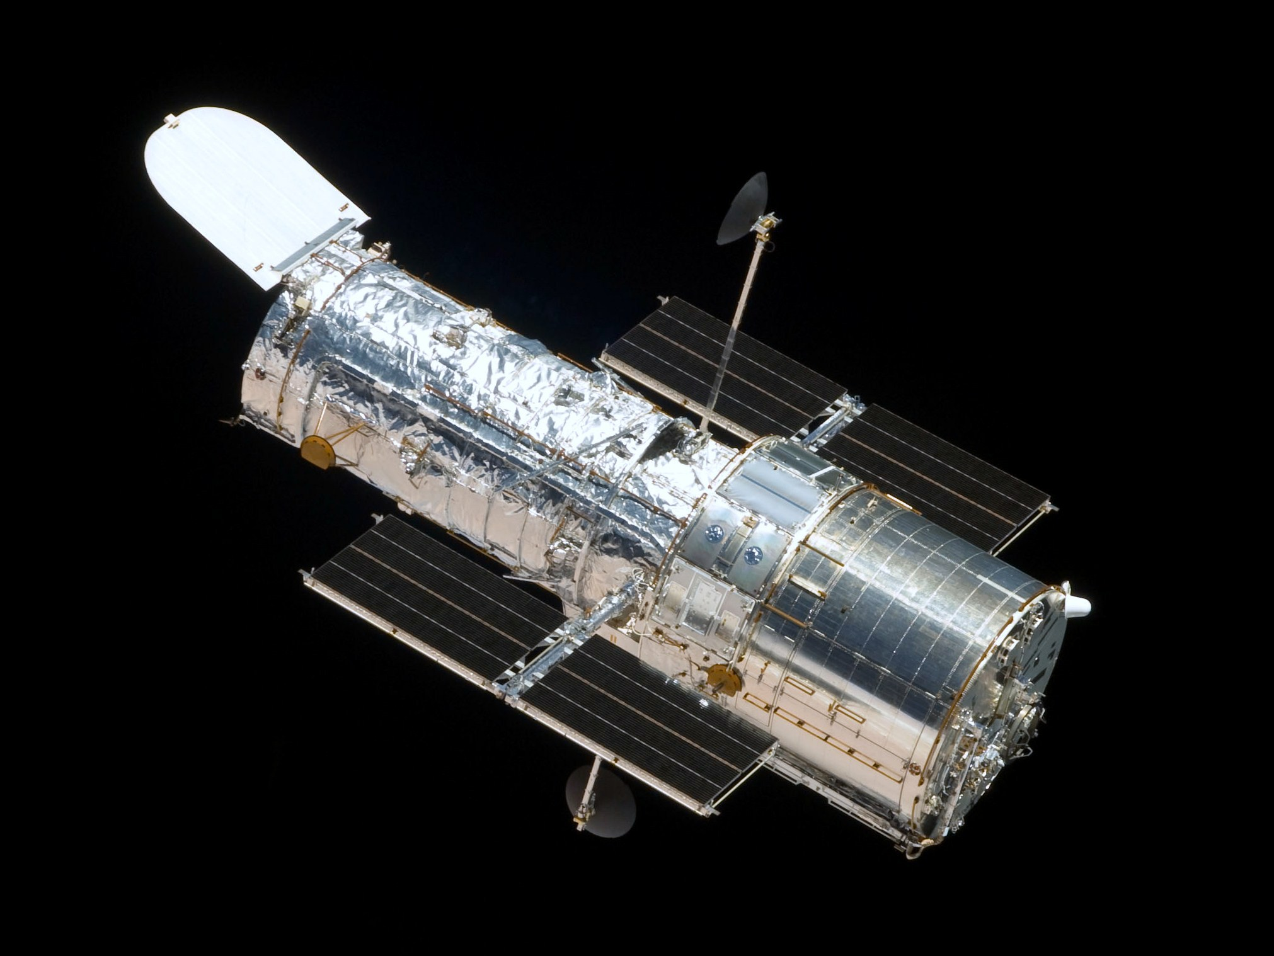
JWST is not that large of a telescope!
🚌
… but it IS exquisitely stable and not limited by atmosphere, telluric absorption
Adapted from slide courtesy of Marshall Perrin
Notes:
Significant implications in the thermal infrared

Slide 11
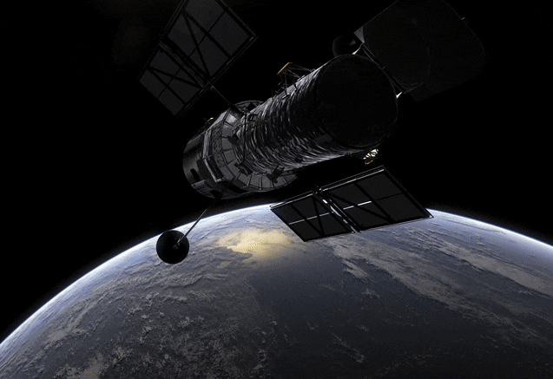
So what are the sources of aberrations? (See earlier talks from Becky Jensen-Clem, Sebastiaan Haffert, Julien Milli!)
In space, we are contending with…
Slower evolution of thermo-mechanical effects, e.g.,: HST “breathes" throughout orbit as pointing environment temperature changes, JWST “tilt events” occur due to relaxation of telescope supports/stick-slip motion (also micrometeoroids)
Pointing inaccuracies and jitter induced by vibrations from cooling systems, antenna motion, etc.
Note: JWST’s active wavefront sensing and control system corrects low frequency errors as part of routine maintenance!
(See earlier talks from Becky Jensen-Clem, Sebastiaan Haffert, Julien Milli!)

Slide 12
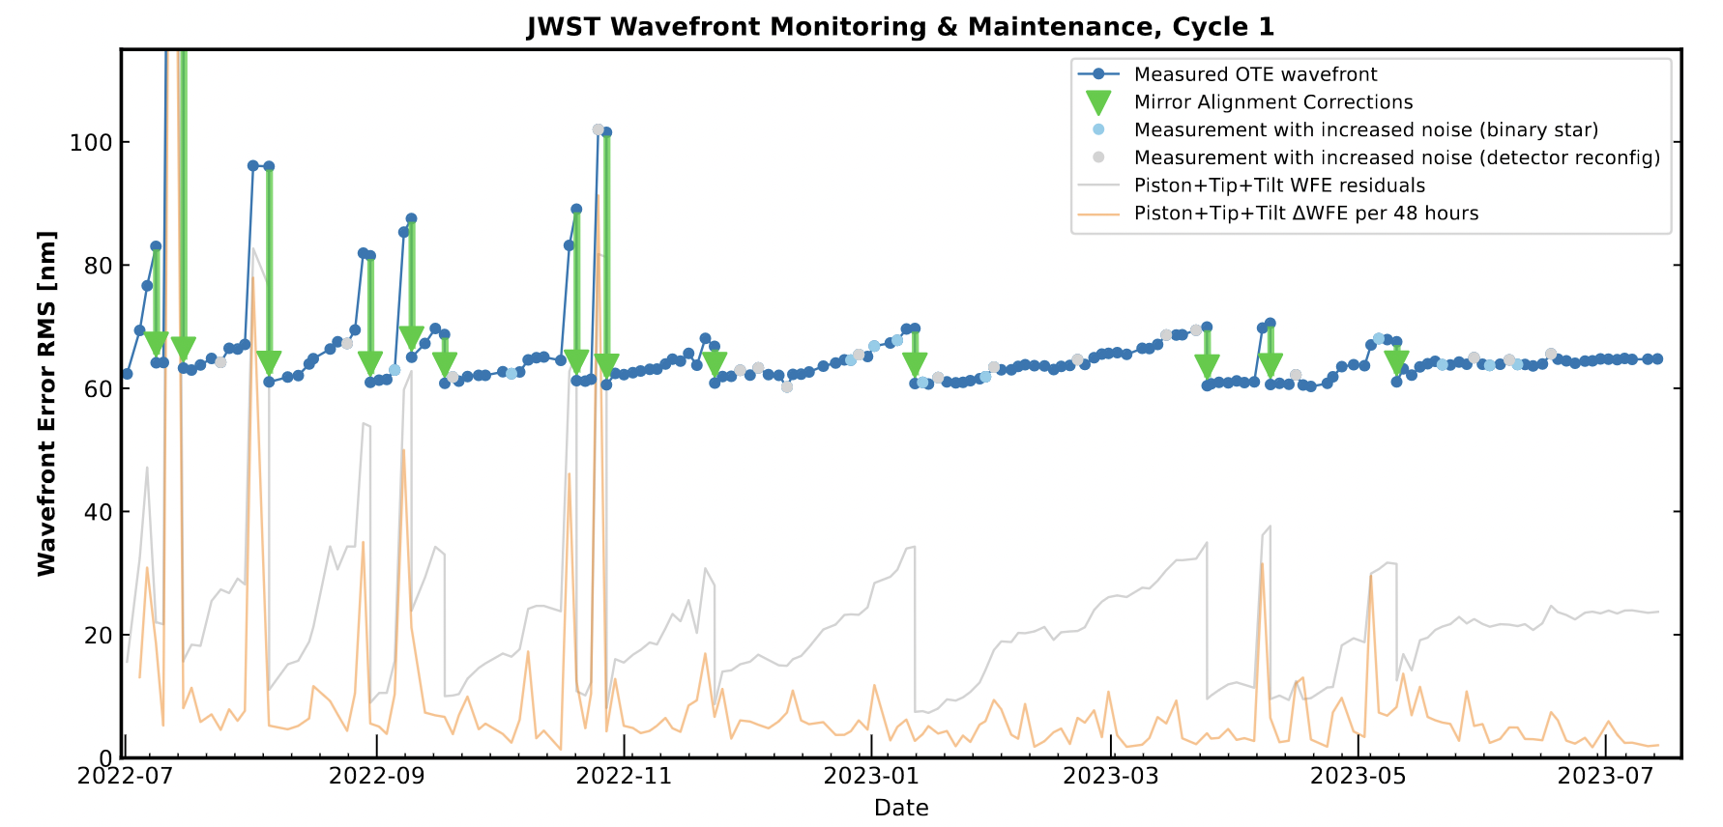
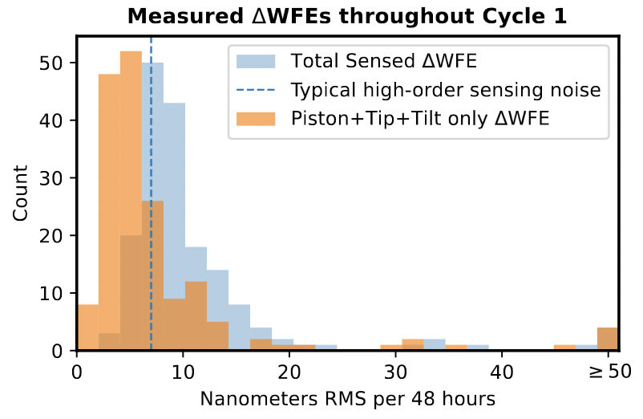
Do you need longer text?
Stability - JWST
Typical change in wavefront over ~2 days: < 10 nm (!)
→ Good news for PSF reference star observations
Lajoie et al. (2023)

Slide 13
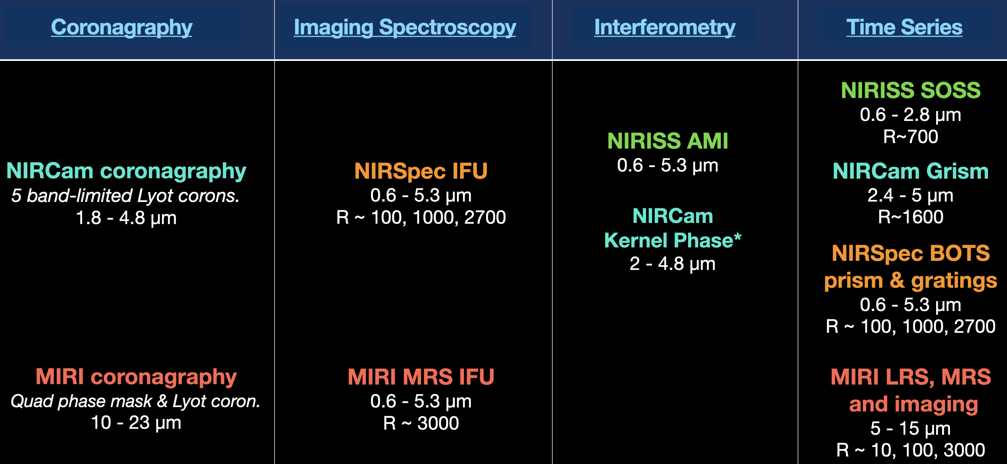
JWST Exoplanet and Circumstellar Disk Capabilities
Slide courtesy of Marshall Perrin

Slide 14
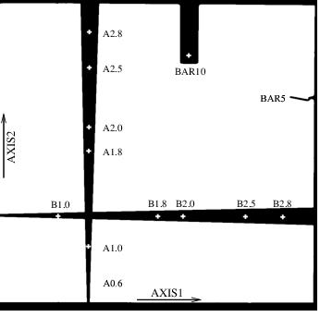
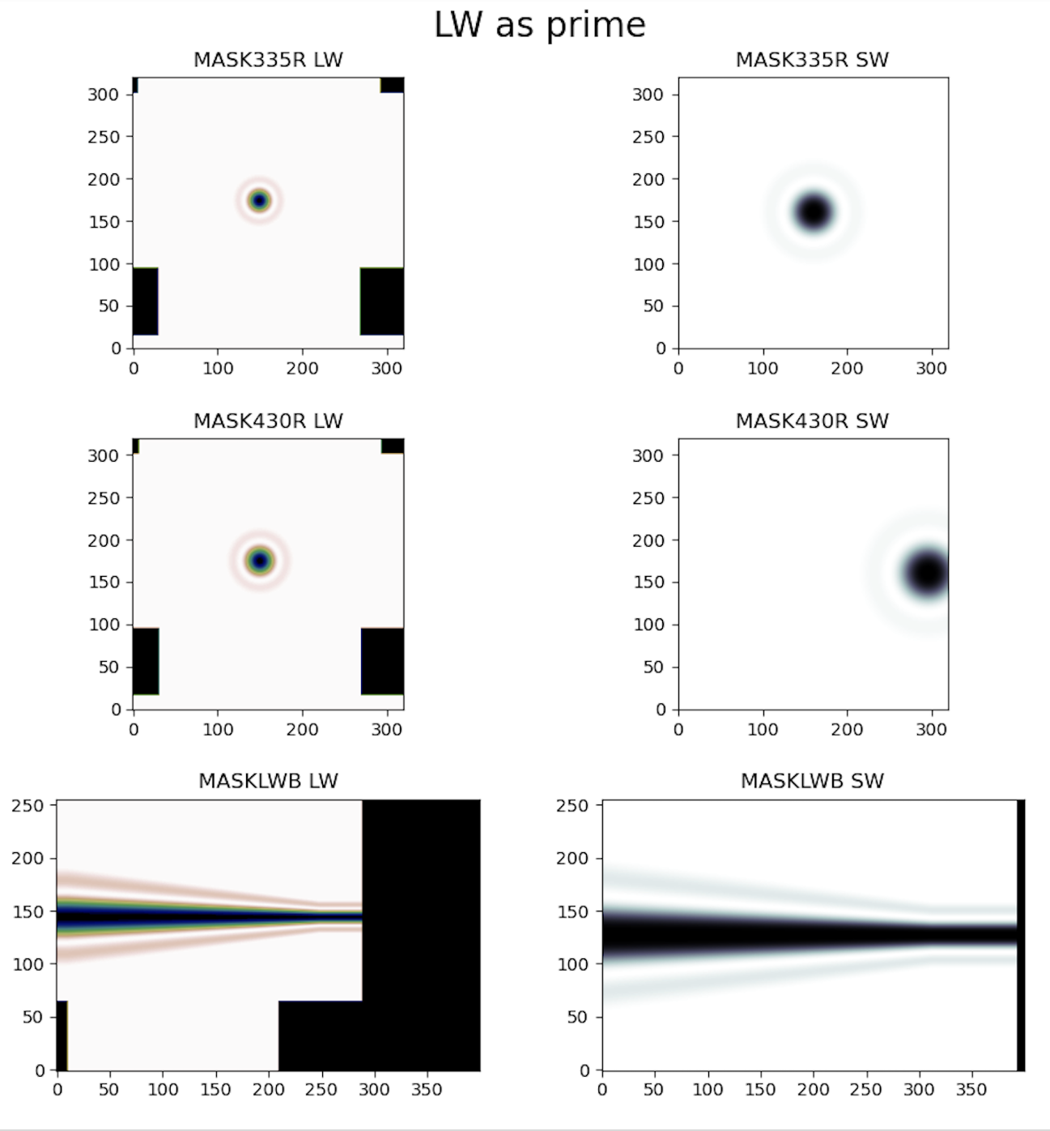
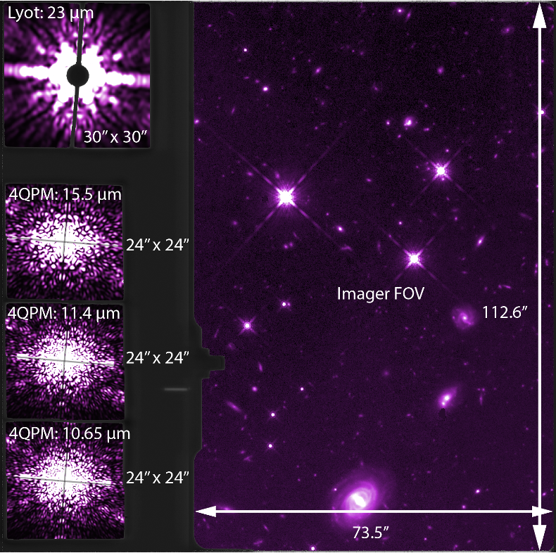
Do you need longer text?
The Zoo of Coronagraphs Currently in Space
HST
Space Telescope Imaging Spectrograph (STIS)
JWST
Near-Infrared Camera (NIRCam)
JWST Mid-Infrared Instrument (MIRI)
“The least optimized coronagraph in space!”
⭐️ NIRCam: 3 Balmer, 18 Ferrer-Chavez; MIRI: 34 Mâlin, 41 Sanghi
Images: JDox, STIS Instrument Handbook

Slide 15
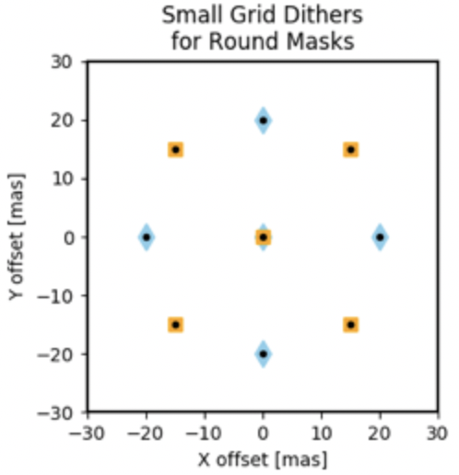
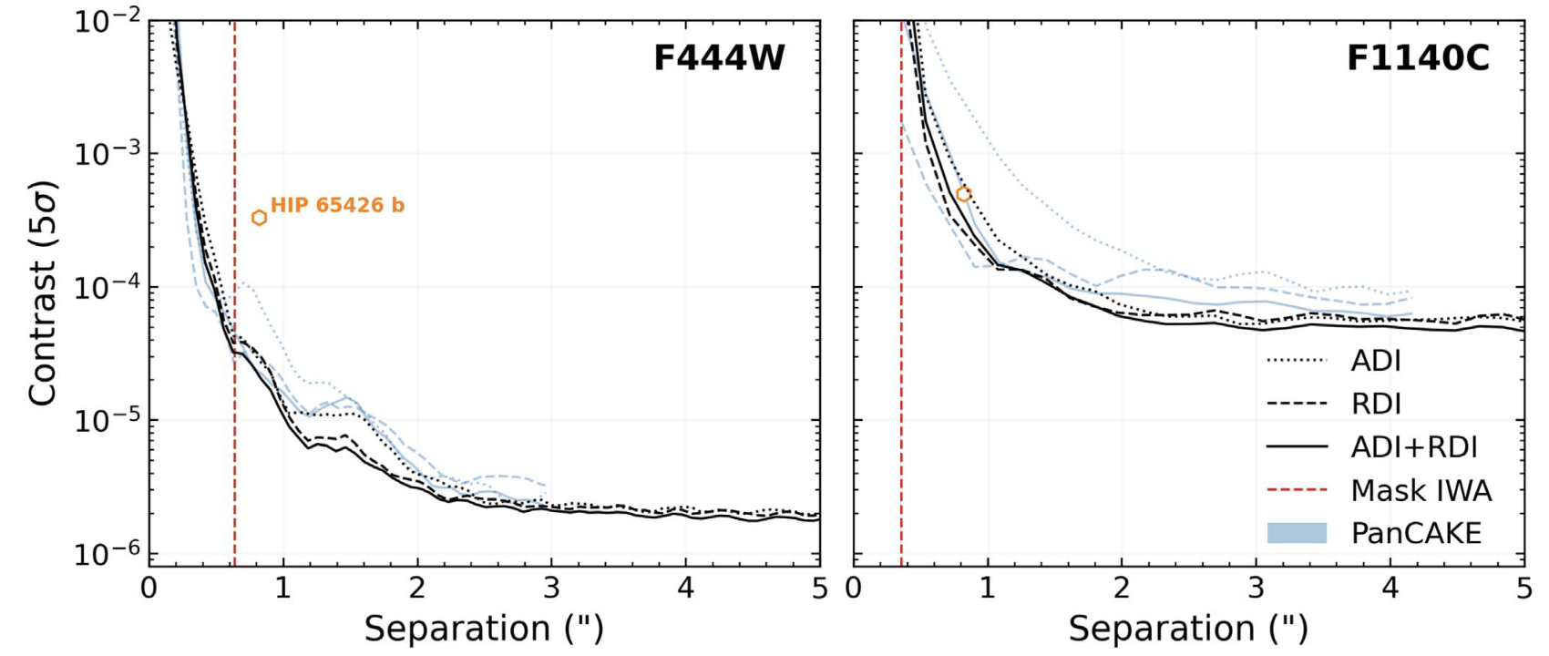
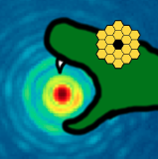
PSF Subtraction Approaches for JWST
Use small grid dithers (SGD) to ensure PSF reference is as similar as possible to science target observations
Apply RDI, ADI, and/or RDI + ADI combination
Also: Synthetic PSF subtraction! (heritage of high-fidelity simulated PSFs in space; Krist & Hook 2006, Perrin et al. 2021)
spaceKLIP (Kammerer et al. 2022, Carter et al. 2023)
Integration of pyKLIP post-processing and analysis with official JWST pipeline pre-processing
Carter et al. (incl. KWD), 2023; see commissioning results from Girard et al. (2022)
⭐️ 27 Julliard

Slide 16
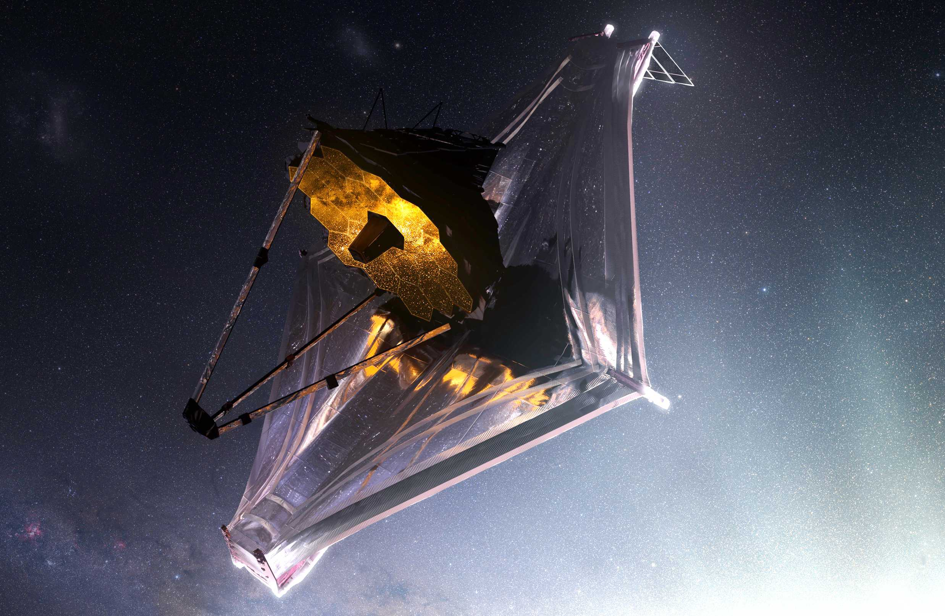
What high-contrast science is being done now with JWST?
And what’s coming next?

Slide 17
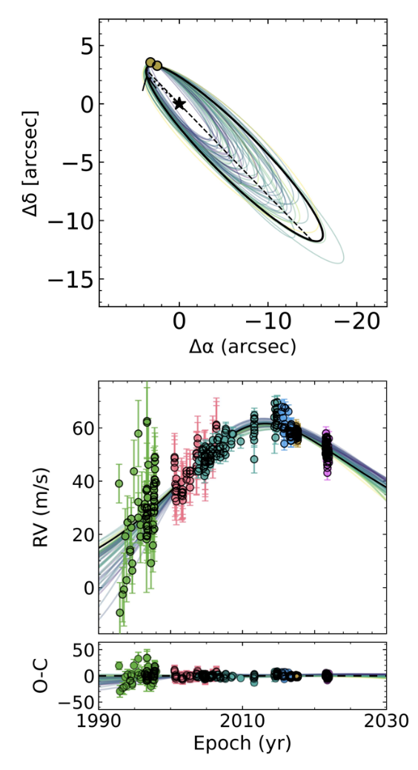
As of yesterday morning (!): Epsilon Indi Ab
The coldest, oldest imaged exoplanet; and a surprising one
Nearby (3 pc) K-type star of ~ solar age, with long-term RV trend and astrometric acceleration
MIRI coronagraphic imaging at F1065C and F1140C (Program 2243, PI Matthews)
Detection consistent with 275 K, 6-8 M_{Jup} planet, but not where expected!
Recovered at SNR~3 in VLT/VISIR-NEAR (10-12 µm), but non-detections from Spitzer → High metallicity, high C/O ratio planet?
Matthews et al. (2024), Nature

Slide 18
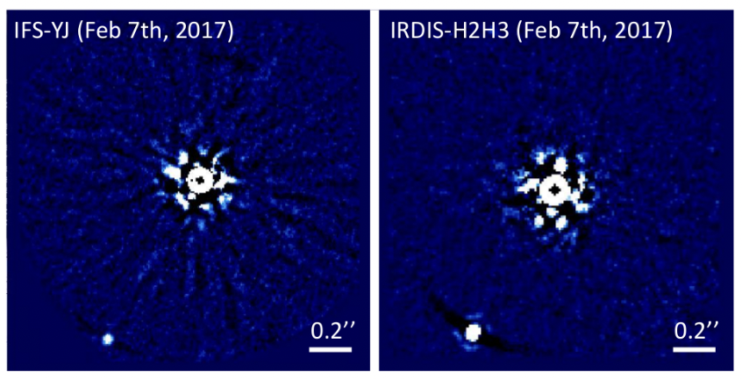
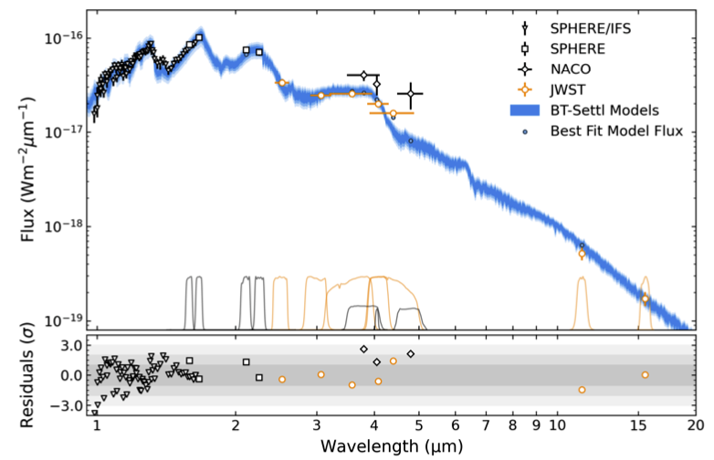
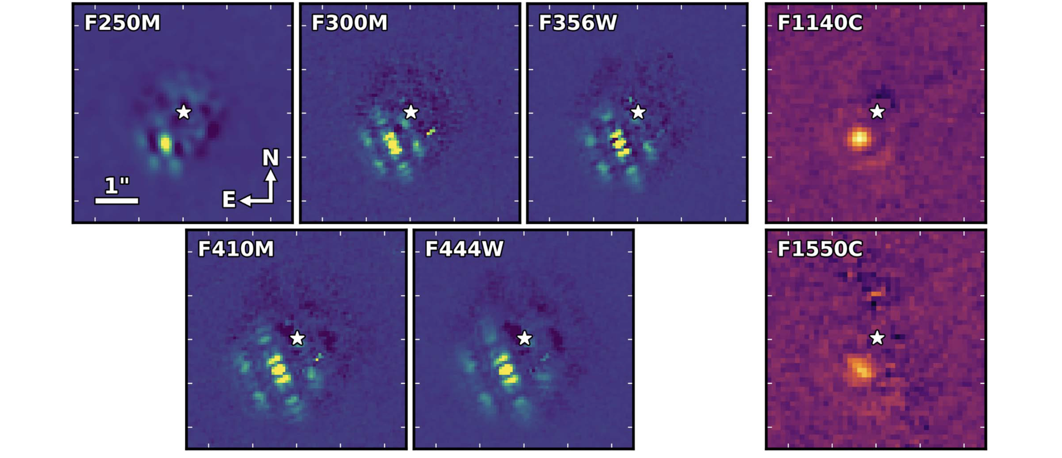
HIP 65426 b
NIRCam + MIRI Coronagraphy
The first 11-15µm images of an exoplanet!
SPHERE discovery; Chauvin et al. (2017)
See also Miles et al. (2023) for ERS spectroscopy!
Carter et al. (incl. KWD), 2023

Slide 19
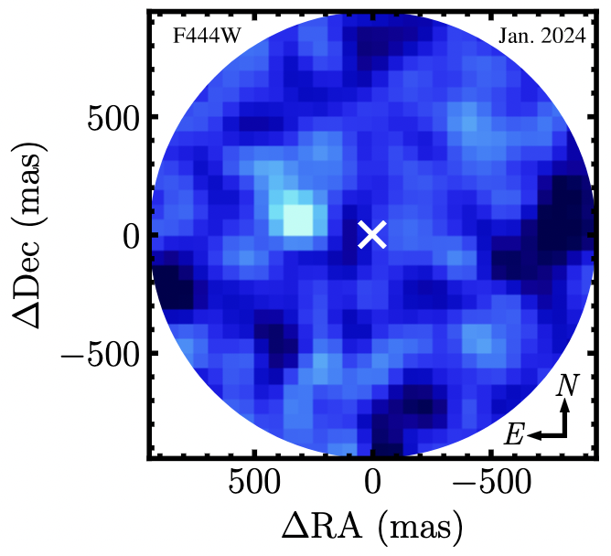
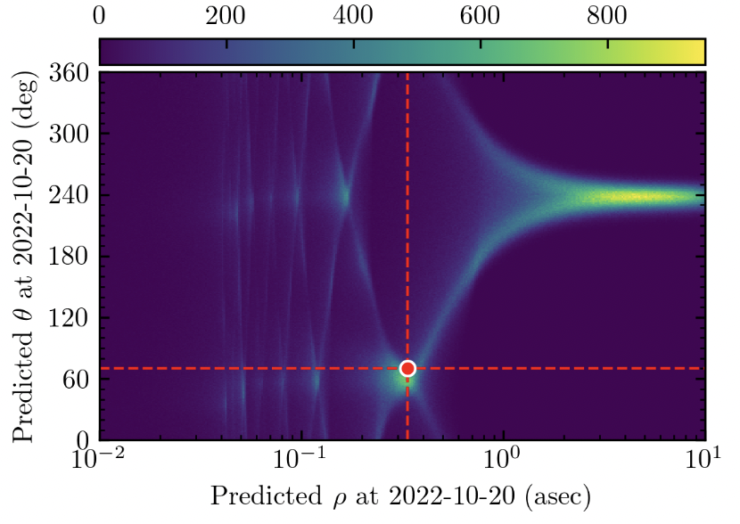
AF Lep b
NIRCam Coronagraphy
The closest-separation imaged exoplanet with JWST thus far!
Lowest-mass imaged planet with a dynamical mass (Franson et al. 2023, De Rosa et al. 2023, Mesa et al. 2023)
With NIRCam: Disquilibrium carbon chemistry? Enhanced metallicity?
Franson et al. (2024)
De Rosa et al. (2023)
⭐️ 19 Franson

Slide 20
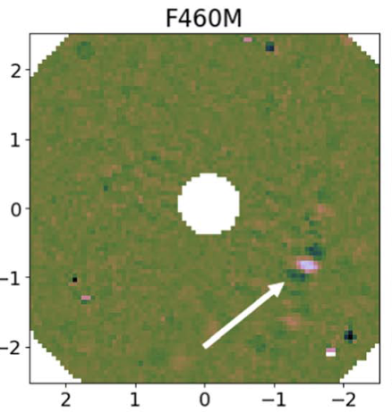
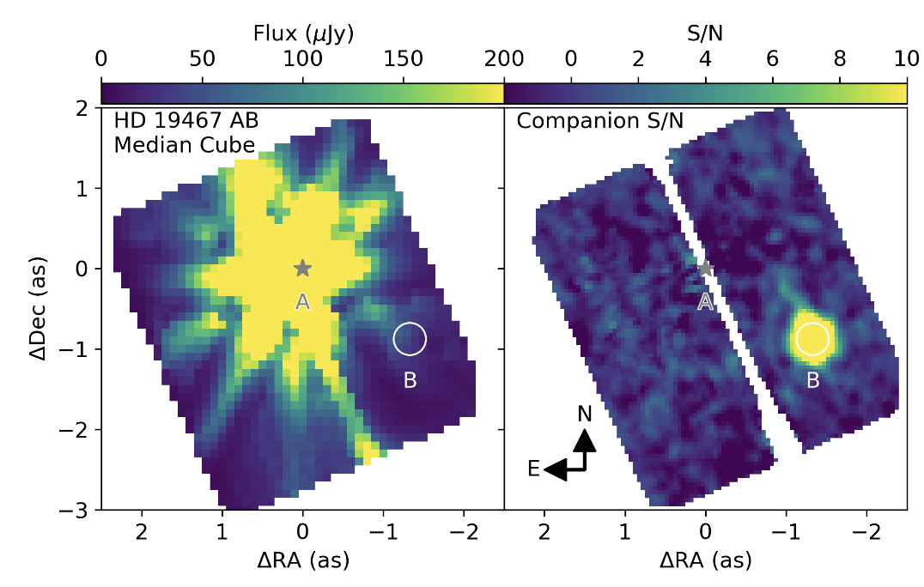
HD 19467 B – a benchmark brown dwarf
NIRCam Coronagraphy + NIRSpec IFU
Greenbaum et al. (2023)
Ruffio et al. (2023)
Notes:
Few e-6 at 4.6µm at 1 arcsec
2e-7 at > 3 arcsec at 3 µm

Slide 21
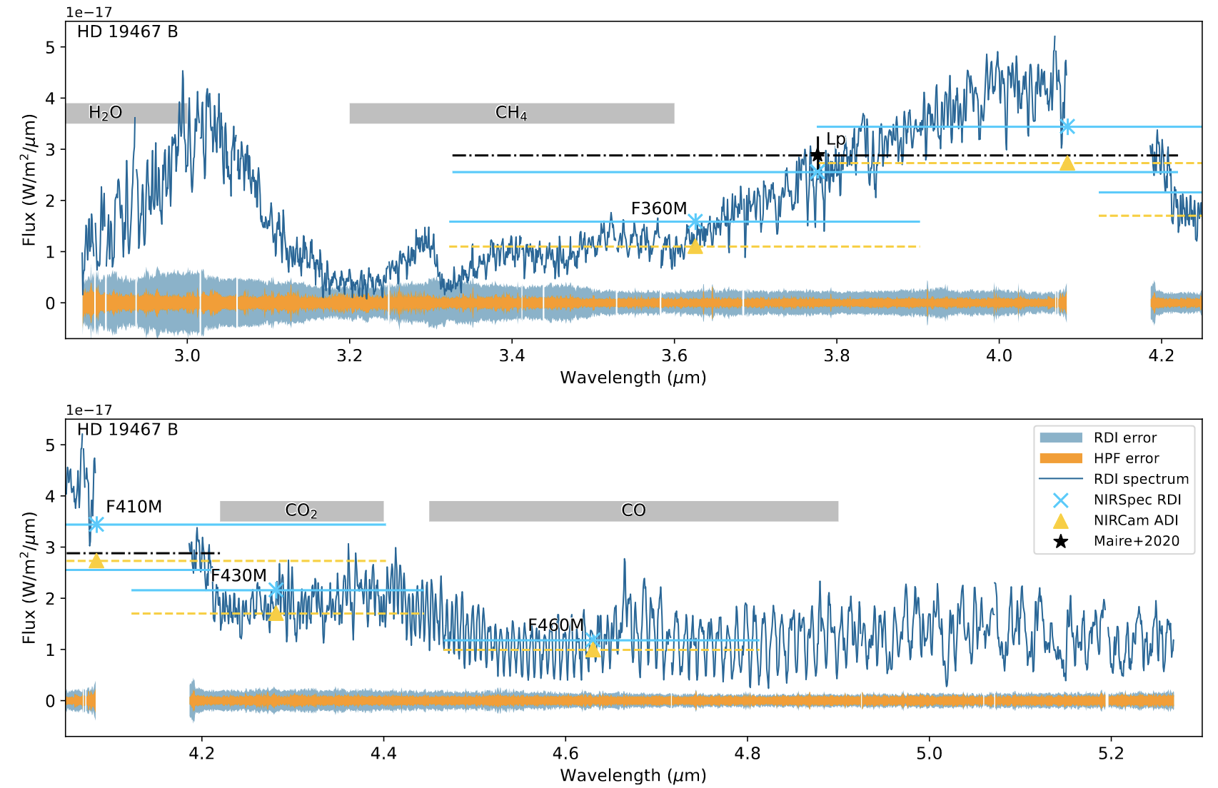
IFU High-Contrast Spectroscopy - NIR
3-5 µm, R~2700 spectra with forward modeling of companion + starlight
In best-case scenarios capable of reaching reaches few x 10⁻⁷ to 10⁻⁶ contrast at and beyond 1”
Ruffio et al. (2023)
Notes:
7-8e-7 contrast beyond 1” in best-case scenario

Slide 22
HR8799bcde with JWST in the MIR…
Boccaletti et al. (2023)
10.65 µm
11.40 µm
15.50 µm
21 µm (non-coron)
All four planets detected (plus fun bonus: z~1 background galaxy)
First resolved image of inner warm debris disk in system (15 au)
MIRI photometry favors larger radii and cooler temperatures than previous NIR observations (data discrepancy? model limitation?)
… and soon with NIRCam!
Balmer et al. (2024, in prep.)
⭐️ 3 Balmer

Slide 23
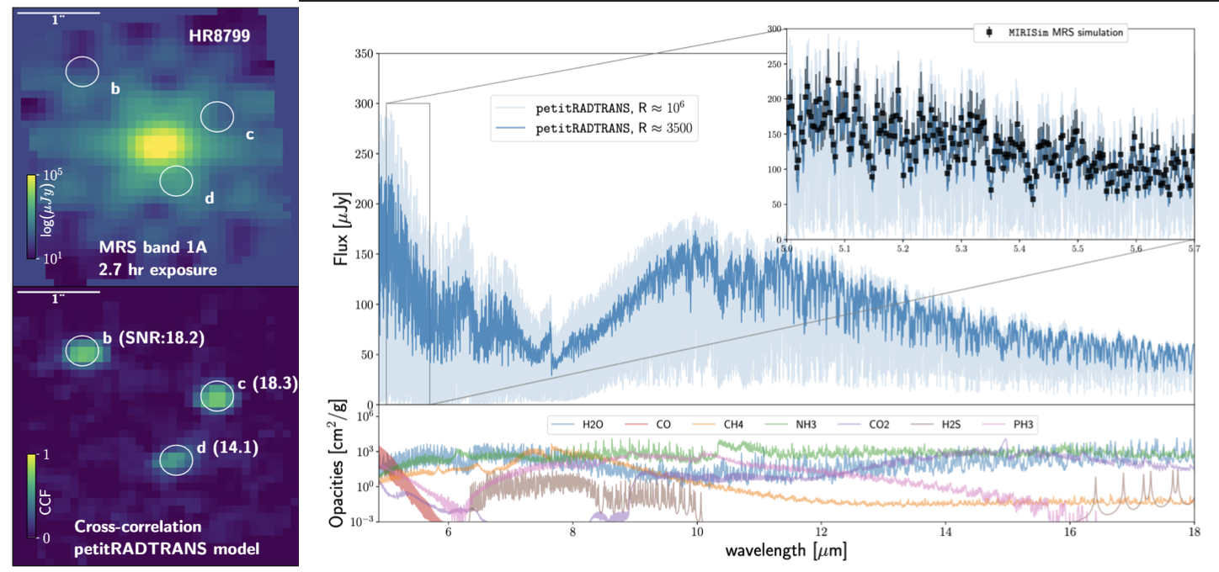
IFU High-Contrast Spectroscopy - MIR
Patapis et al. (2022)
Note: Various molecular species inaccessible from ground from 6-16 µm, compare w/4.6µm CO feature where Earth’s atmospheric transmission < 0.3

Slide 24
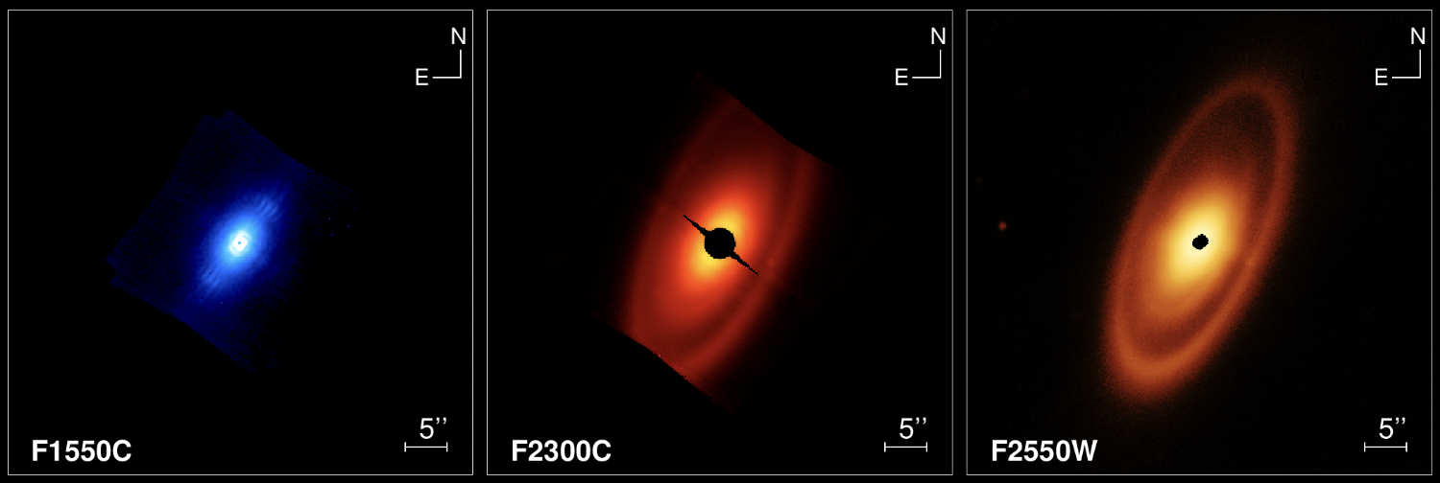
MIRI Coronagraphy
Disk Imaging in the MIR – Fomalhaut
JWST/MIRI coronagraphic + non-coronagraphic imaging
Gaspar et al. (incl. KWD) (2023)

Slide 25
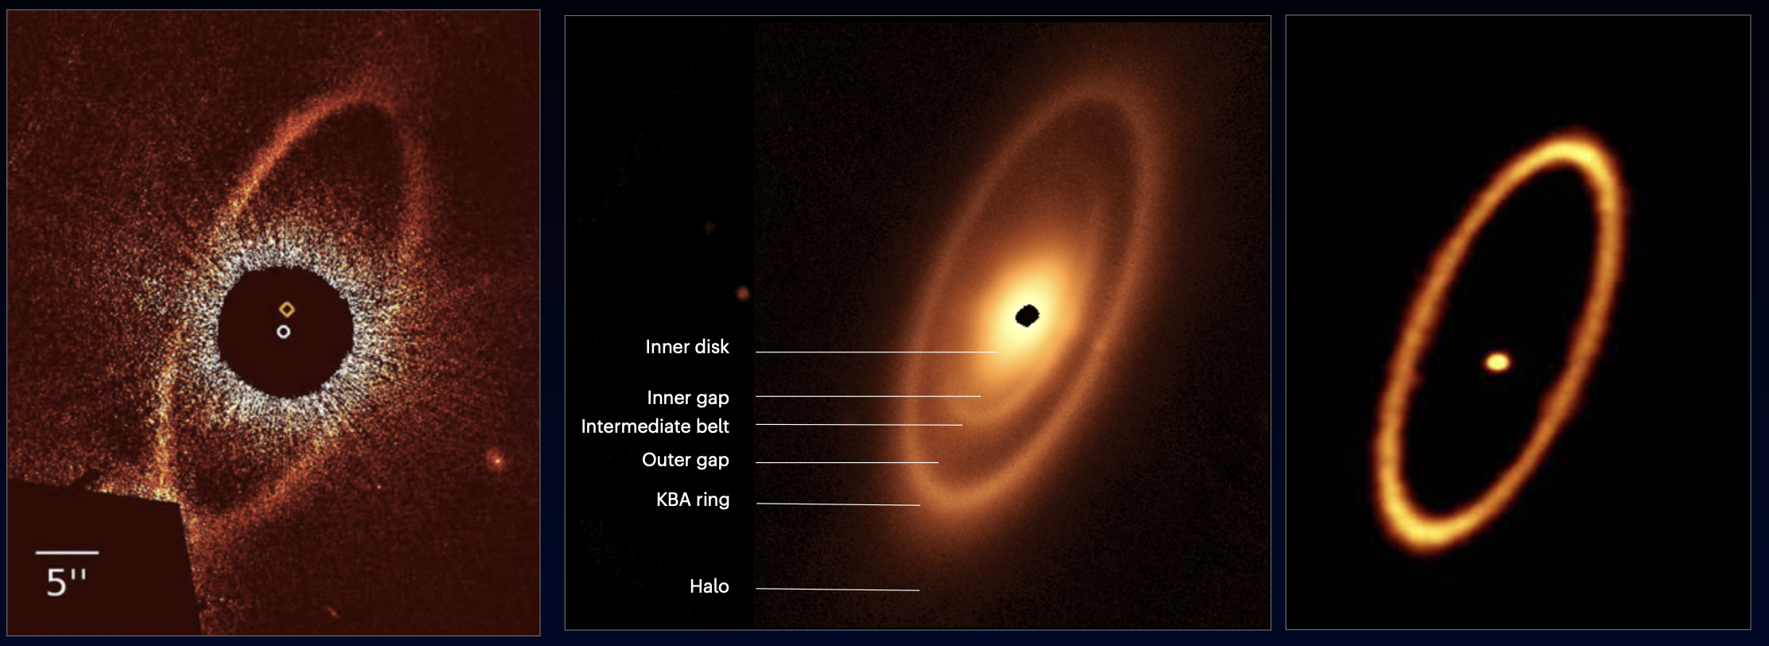
Disk Imaging in the MIR – Fomalhaut
HST/STIS. (0.5 µm)
Kalas et al. (2008)
JWST/MIRI (25 µm)
Gaspar et al. (incl. KWD) (2023)
ALMA (1.3 mm)
Macgregor et al. (2017)

Slide 26
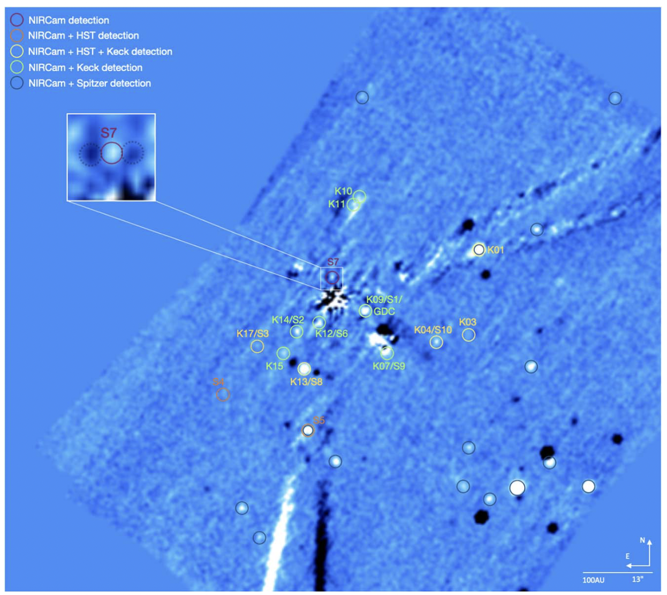
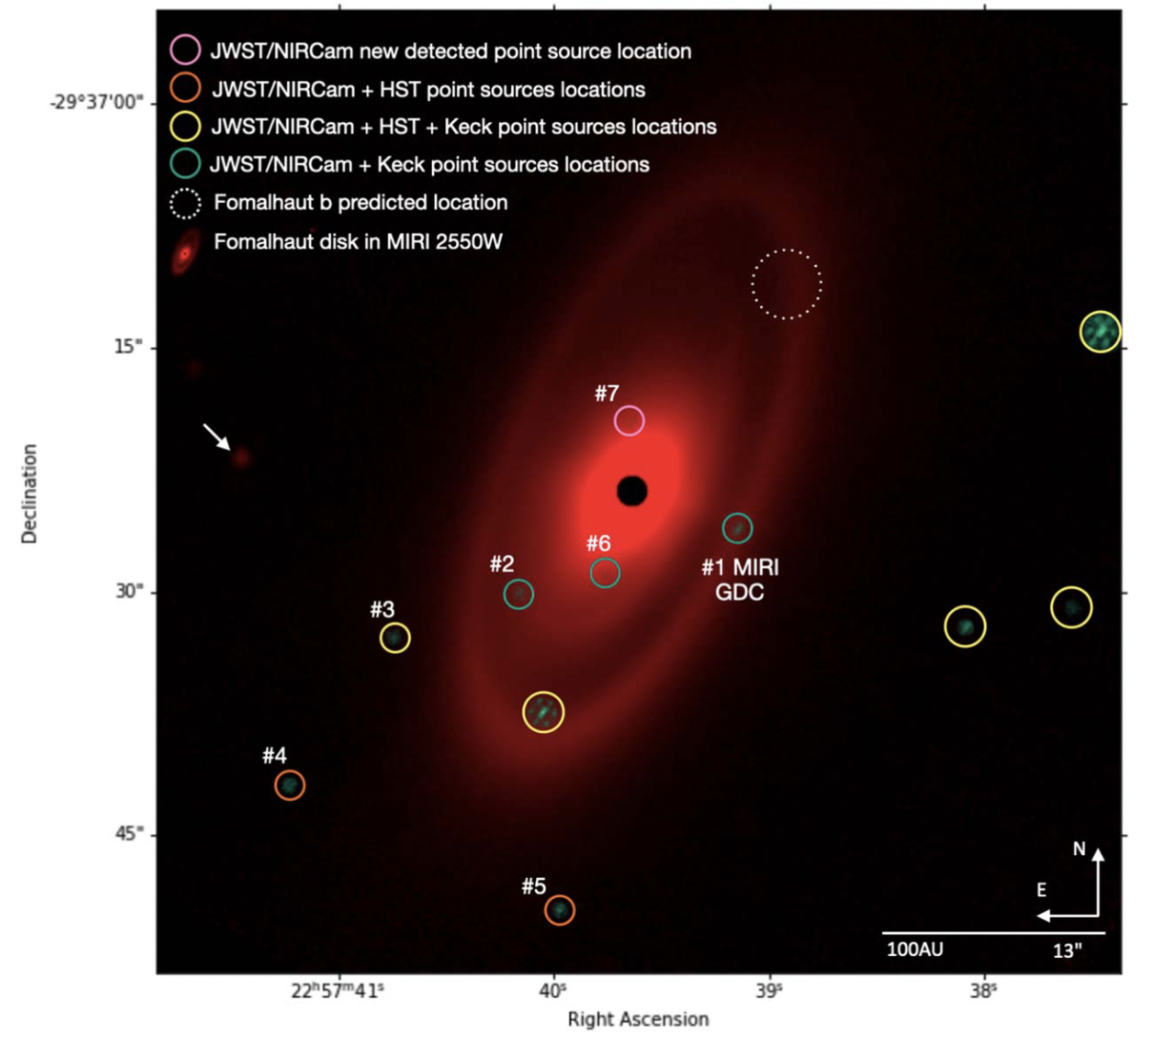
Fomalhaut planet search
NIRCam Coronagraphy
Ygouf et al. (2023)

Slide 27
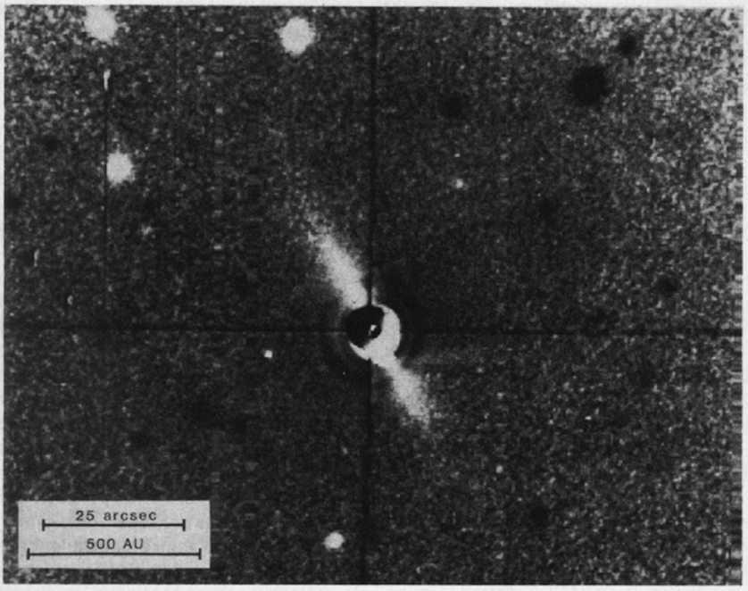
Beta Pictoris: Bright Disk, Bright Planet
NIRCam Coronagraphy
Companion(s) embedded within circumstellar backgrounds are requiring more complex modeling approaches
MCRDI – model-constrained differential imaging (Lawson et al. 2022)
Smith & Terrile (1984)
Kammerer et al. (incl. KWD), 2024

Slide 28
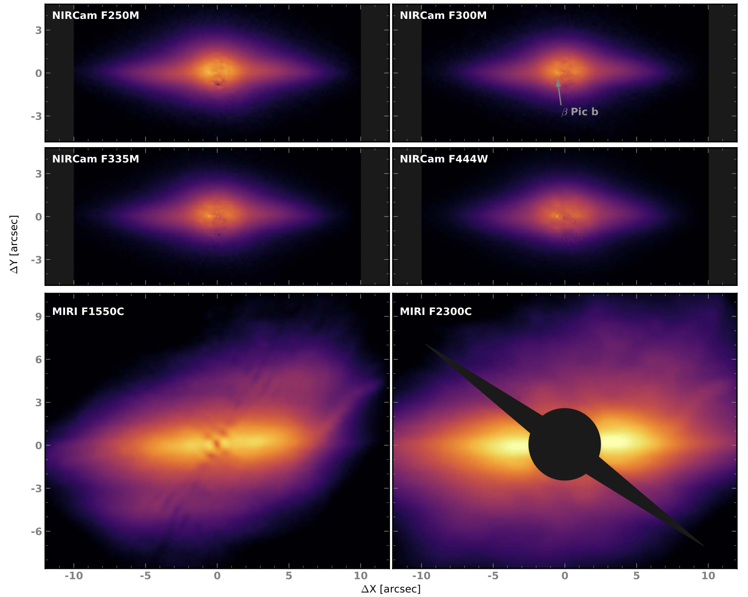
Beta Pictoris: Bright Disk, Bright Planet
NIRCam + MIRI Coronagraphy
(see also MIRI MRS, Chen et al. 2024)
Unanticipated structures at new wavelengths (and planet recovery!)
And more planet(s) + disk(s) systems (see HD 95086 b!)
10.65 µm
11.40 µm
23 µm Lyot
Mâlin et al. (2024, subm.)
Rebollido et al. (incl. KWD), 2024
⭐️ 36 Mullin

Slide 29
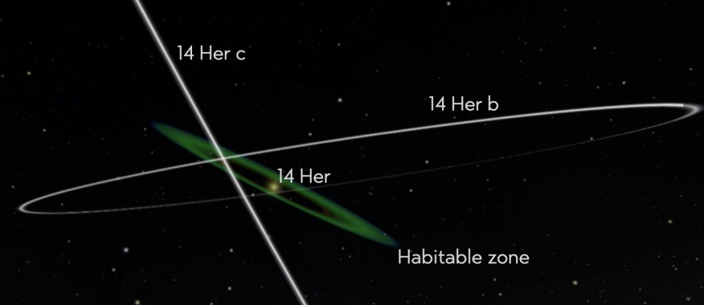
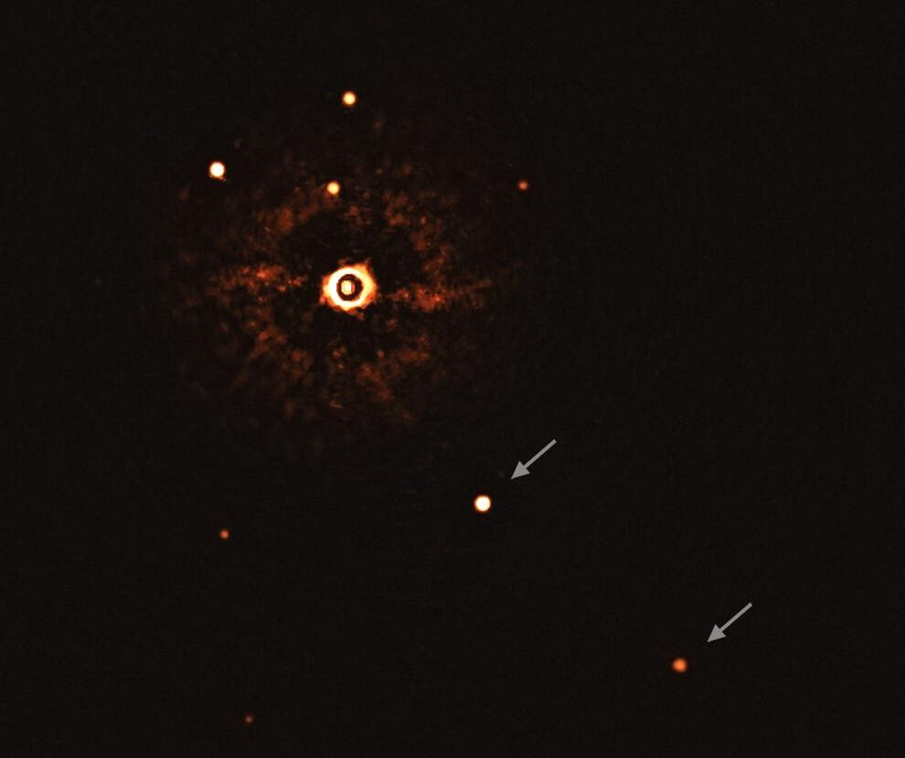
Ongoing/Upcoming JWST High Contrast Programs
Imaging planets with well-constrained dynamical masses e.g., long-term RV + astrometry (PI Bardalez-Gagliuffi)
Searches for kinematically-detected or substructure-causing protoplanets within disks (PI Benisty, PI Bowler)
MIRI coronagraphy/spectroscopy of one of the coldest imaged exoplanets orbiting a sunlike star (PI Patapis, PI Perrin)
Targeting nearby stellar neighbors for sub-Saturn mass planets (PI Bogat, PI Bowens-Rubin), planets around alpha Cen (PI Beichman)
Variability of companions with NIRSpec IFU (PI Zhou), multi-planet system characterization (PI Hoch)
Large planet search surveys! (see Clém Fontanive’s talk)
Notes:
AF Lep lowest mass imaged planet with dynamical mass

Slide 30
What might we expect in upcoming 10-15 years? 🔮
JWST | ELTs
Wide orbit sub-Jovian detections and population constraints | Reflected light planets and their characterization, frequency of true Jovian analogs
NIR to MIR atmospheric chemistry from coronagraphy & moderate-resolution IFUs | Opt/NIR atmospheric chemistry from high-dispersion coronagraphy
Faint large-scale circumstellar disk structures in thermal emission | Scattered light circumstellar disk features at exquisite angular resolution (also polarization)
Outer (JWST) and inner (ELTs) architectures of planetary systems: formation, migration, scattering
Circumplanetary disk chemistry through MIR; complementarity of ground/space molecular species (below 1 Jupiter mass, CPDs might require > 15 µm; Chen & Szulágyi 2022)
Broad wavelength coverage to constrain bolometric luminosities of planetary-mass companions, informing evolutionary and atmospheric models | Bolometric luminosity at short wavelengths

Slide 31
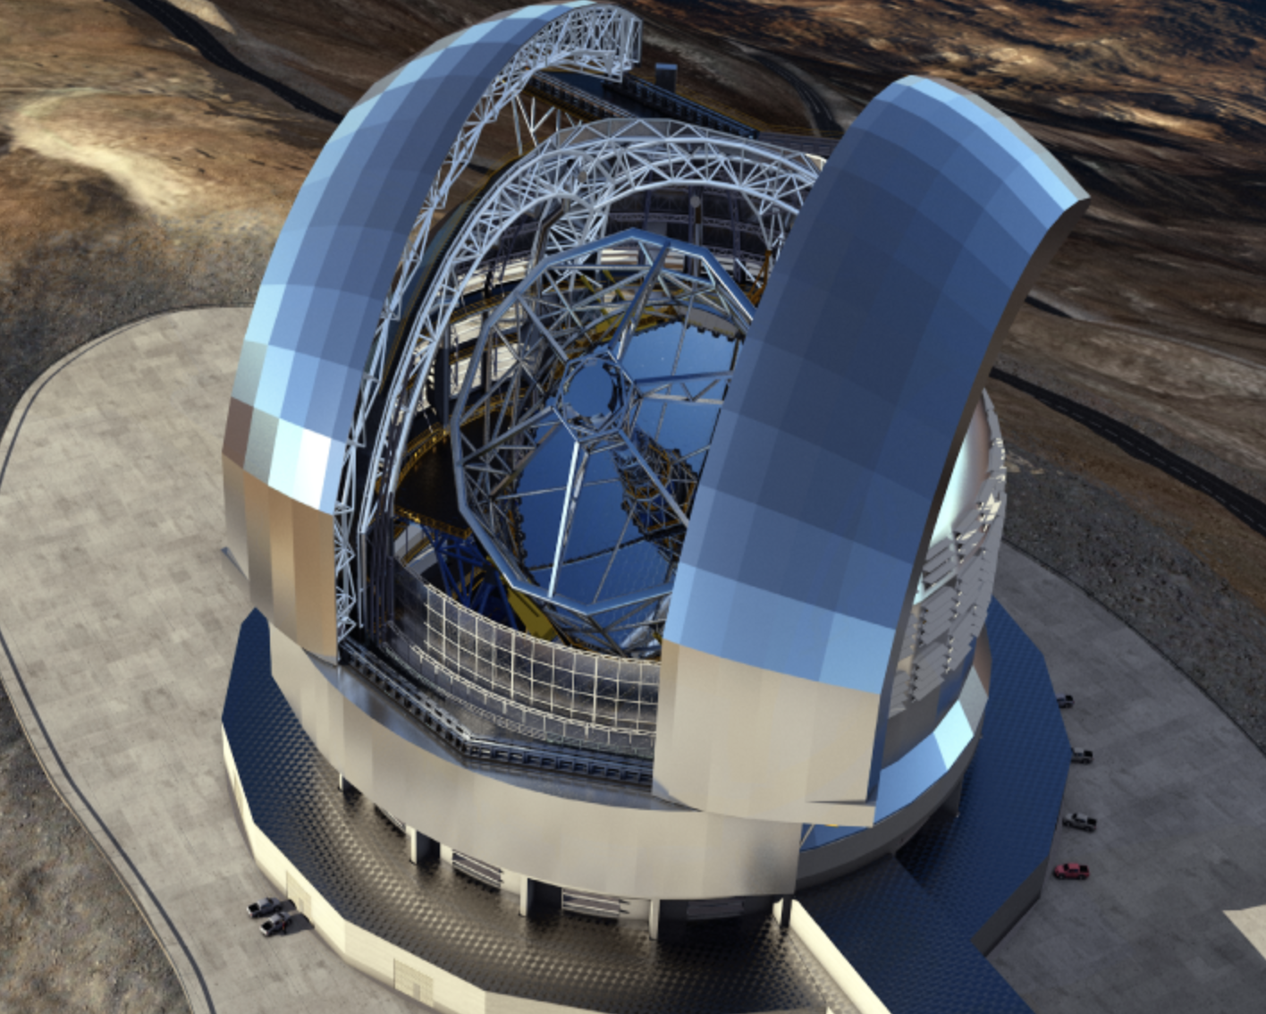
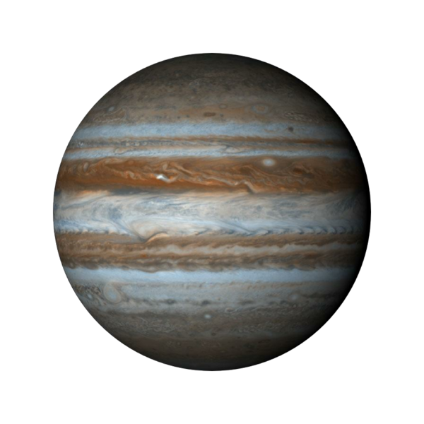
Take-away ideas:
Don’t forget!
Space-based and ground-based HCI currently share similarities… (PSF modeling/subtraction, WFE analysis)
… and some key differences (WFE sources, stability, IWA, atmospheric absorption)
JWST is not extremely large, but its sensitivity, wavelength, and stability are key
Disentangling imaged disk structures and planets within presents a challenge! Lots to learn & things to try
Lots of exciting discovery space awaits us in terms of: substellar atmospheres and chemistry disk architectures and composition 💫 and lower-mass, cooler planets than ever before! 🪐
Thank you!

Slide 32
Backup Slides

Slide 33
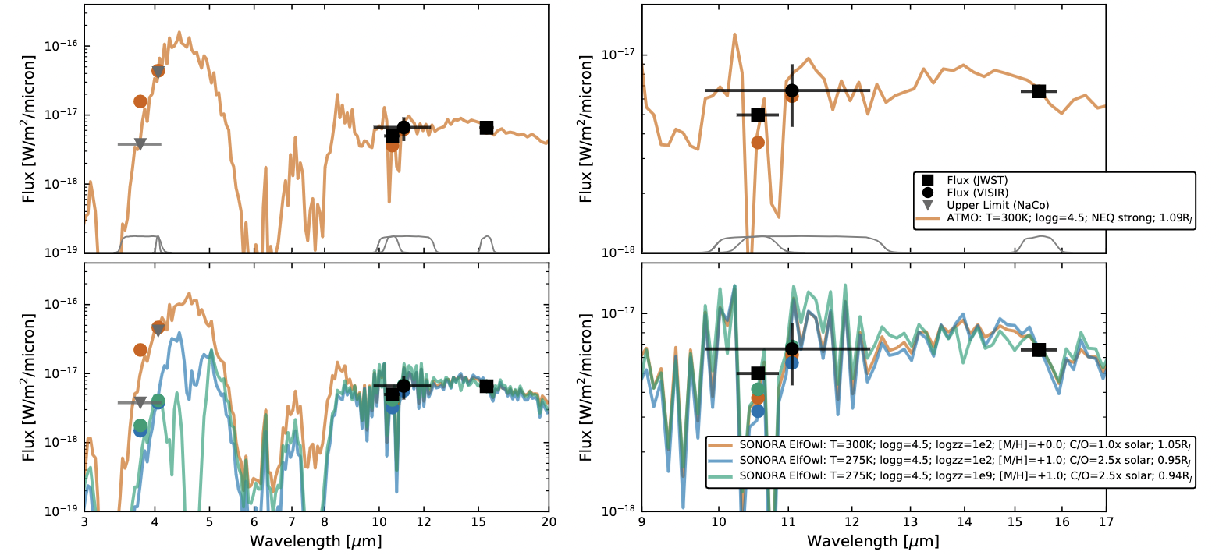
As of yesterday morning (!): Epsilon Indi Ab
The coldest, oldest imaged exoplanet; and a surprising one
Matthews et al. (2024), Nature

Slide 34
PSF Modeling for Space Telescopes
Approach:
Use Fraunhofer approximation for the far-field, propagate optical paths using transforms, filter/mask properties, etc., to simulate PSF at detector focal plane
Tiny Tim (1992!)
uses FFTs to translate from entrance pupil to focus plane
incorporates low-order aberrations using Zernike polynomials
still used in extragalactic science today...!
WebbPSF
Based on Physical Optics Propagation in PYthon (POPPY) -- assumes Fraunhofer diffraction but can include Fresnel
Uses optical path difference (OPD) maps
Uses FFTs and Matrix Fourier Transforms to finely sample image plane

Slide 35
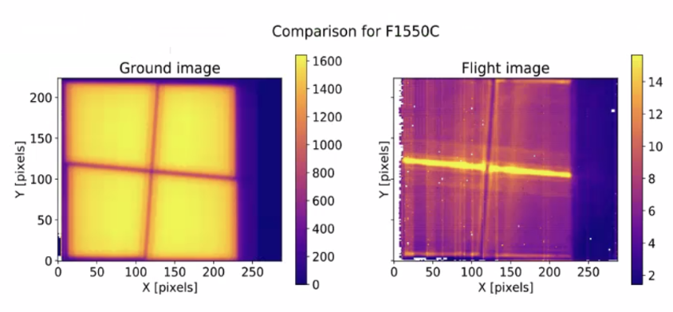
MIRI Glowsticks

Slide 36
ERS: VHS 1256 b
NIRSpec + MIRI IFU Spectroscopy
Miles et al. (incl. KWD), 2023

Slide 37
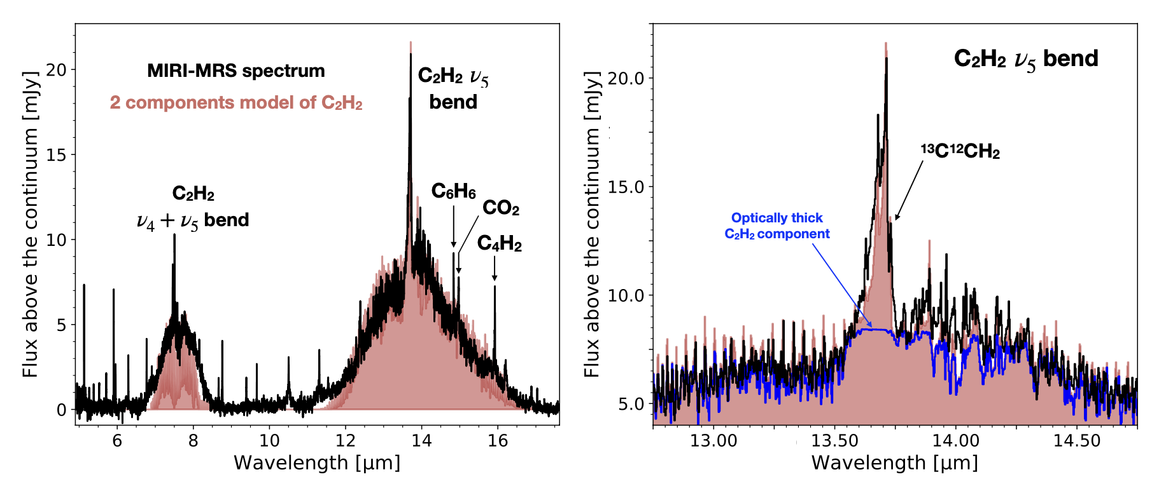
IFU High-Contrast Spectroscopy - MIR
Hydrocarbon species, accretion diagnostics, in protoplanetary disks around very low-mass stars
(Tabone et al. 2023)
Unique to JWST: Extend studies of disk chemistry (composition, winds, outflows) and accretion to circumplanetary disks
Note: Various molecular species inaccessible from ground from 6-16 µm, compare w/4.6µm CO feature where Earth’s atmospheric transmission < 0.3

Slide 38
Do you need longer text?
Simulating MIRI Coronagraphy with MIRISim
Real data taken
July 18, 2022
Simulated (!) Data Generated with MIRISim, July 14, 2022
Updating & documenting MIRISim for public release, simulating upcoming observations/proposal preparation
Becca Michelson
(Smith ‘25J)

Slide 39
Imaging in the MIR – GJ 758 B
10.65 µm
Ash Messier
(Smith ‘25)
Hannah Sun
(Smith ‘25)
Moiz Khalil
(UMass Amherst ‘24)
Becca Michelson
(Smith ’25J)
Benchmark substellar companion: well-constrained orbit, dynamical mass
Cool (600-800 K) T-dwarf, ammonia chemistry study
Potential offsets from evolutionary models vs. atmospheric fits
Ward-Duong et al. (in prep)

Slide 40
Impact of Technical Advances
Sensitivity
Unprecedented detector sensitivity (esp. at new wavelengths) – new populations of cool companions and novel circumstellar features
Chauvin et al. (2004)
Contrast at Close Separation
Pushing to smaller angular separations – moving ever inwards toward innermost architectures of planetary systems
Marois et al. (2008)
Spectral Resolution/Grasp
Broader wavelength coverage and/or higher spectral resolution – new chemistry, kinematics, evolutionary tracers
Miles et al. (2023)
Notes:
JWST has most recently improved all of these things, and the ELTs will continue that growth – so where are we now?

Slide 41
Current Landscape: Imaged Exoplanets
TYC 8998-760-1 bc
1”
95 au
Marois et al. (2010b)
Lagrange et al. (2019)
Macintosh et al. (2015)
Bohn et al. (2020)
Notes:
Down to the 1 mjup limit; multiple planet systems, systems with interior planets detected by RV and astrometry, and ensemble of other systems including candidates and uncertain masses

Slide 42
Current Landscape: Protoplanetary & Debris Disks
GPIES Debris Disks (Image: Tom Esposito)
Benisty et al. (2023)

Slide 43
Imaging Demographics & Survey Strategy
Large statistical surveys
Targeted, highly-biased surveys
Hundreds of stars
‘Uninformed’ approach to avoid bias/ensure completeness
Statistically significant sample selection
Tens of stars
Pre-selected to likely harbor image-able planets: RV trends, Hipparcos-Gaia accelerations, youth/disks/proximity
Design: maximize detection yield
Example: AF Lep b
Nielsen et al. (2019), Vigan et al. (2021)
Franson et al. (2023), De Rosa et al. (2023), Mesa et al. (2023)

Slide 44
How do ELT instruments and JWST complement each other?
Inner Working Angle
Deeper achievable contrasts at much closer angular separations afforded by ELTs!
Wavelength Coverage
ELT optimized sensitivity shortward of 5 µm; only ELT/METIS first-gen overlap with JWST/MIRI.
(pt source ~ IRAC; spectral ~ JWST)
Rigby et al. (2023)
Follette (2023), based on tools by Vanessa Bailey

Slide 45
ELT Capabilities
ELT/METIS:
Reflected light temperate terrestrial planets for the closest systems (Alpha Cen @ 11 µm, Prox. Cen @ 3.8 µm)
Young warm Saturn & Neptune-like planets
L-band:
2 x 10⁻⁴ contrast @ 40 mas
2 x 10⁻⁵ contrast @ 100 mas
Longslit spectra, L & M-band IFU spectroscopy; see also ELT/HARMONI (2 x 10⁻⁶ @ 2.2 µm, 100 mas)
Brandl et al. (2021)
Notes:
See Dimitri Mawet’s talk from Monday –(Skemer et al. 2022 for SCALES) – PSI coupling coronagraphy and IFU spectroscopy (Fitzgerald et al. 2019)

Slide 46
ELT Capabilities
TMT/PSI + MODHIS:
Imaging planets within habitable zone for closest M-dwarf systems, over 100 accessible planets that can be imaged of varying size, temperature
Anticipated contrasts of 1 x 10⁻⁷ spanning 2-10 µm at 1-2 λ/D (10-30 mas)
Imaging, polarimetry (0.6-5.3µm)
IFS from R~30 (8-13 µm) to R~200-5000 across opt/NIR
MODHIS: R~100,000 spectroscopy (1-2.5µm)
Fitzgerald et al. (2019)
(See also TMT/MICHI - MIR, AO-fed IFU; Packham+2018)
Notes:
See Dimitri Mawet’s talk from Monday –(Skemer et al. 2022 for SCALES) – PSI coupling coronagraphy and IFU spectroscopy (Fitzgerald et al. 2019)

Slide 47
ELT Capabilities
GMT/GMagAO-X:
Reflected light temperate planets across range of radii, masses (RV sample)
Mass, orbital constraints (precision RV fed to G-CLEF)
Lower-mass self-luminous young planets, accreting protoplanets
Visible light (g to y-bands) corongraphy and NIR coronagraphy
Raw contrast on order of 1 x 10⁻⁵ at 3 λ/D (20 mas)
Image: GMagAO-X team
Males et al. (2022), Kautz et al. (2023)
Notes:
See Dimitri Mawet’s talk from Monday –(Skemer et al. 2022 for SCALES) – PSI coupling coronagraphy and IFU spectroscopy (Fitzgerald et al. 2019)

Slide 48
JWST Sensitivity and Contrast (Rigby et al. 2023)

Slide 49
Do you need longer text?
Coronagraphic Imaging with HST/STIS
Evolving Shadows in the TW Hya Disk
Protoplanet Candidate in AB Aurigae
Debes et al. (2023)
Currie et al. (including KWD) 2022, Nature Astronomy
Artist’s Conception (NASA, AURA/STScI for ESA, Leah Hustak - STScI)

Slide 50
Do you need longer text?
Speaking of HST: Coronagraphic Spectroscopy!
HST/STIS is only one of two instruments in the world that combines long-slit spectroscopy with a coronagraphic occulter
Upcoming HST program to calibrate this unsupported mode and determine the achievable contrast (PI: Ward-Duong)
Preliminary results: 10⁻⁵ contrast at 1” from 600nm-950nm (!)
Upcoming thesis work: determine best starlight subtraction algorithms and validate fidelity of spectral extraction for white dwarf companion
Jingyi Zhang
(Smith ‘24)

Slide 51
Do you need longer text?
Coronagraphic Spectroscopy

