Slide 1
Exoplanets with Interferometry
Guillaume Bourdarot
Nobel Laureate Fellow (Max Planck Gesellschaft)
Max Planck for extraterrestrial Physcics (Garching, Germany)
Sagan Summer Workshop
Caltech, July 2024

Slide 2
Bibliography
“Advances in Optical / Infrared Interferometry”
Eisenhauer, Monnier & Pfuhl, ARAA, 2022
General Introductions to Interferometry:
“Practical Optical Interferometry”
David Buscher, Cambridge Press
“Principles of Long Baseline Stellar Interferometry”
P.Lawson, Proceedings of the Michelson School
“Interferometry and Synthesis in Radio Astronomy”
Thompson & Moran, Springer

Slide 3
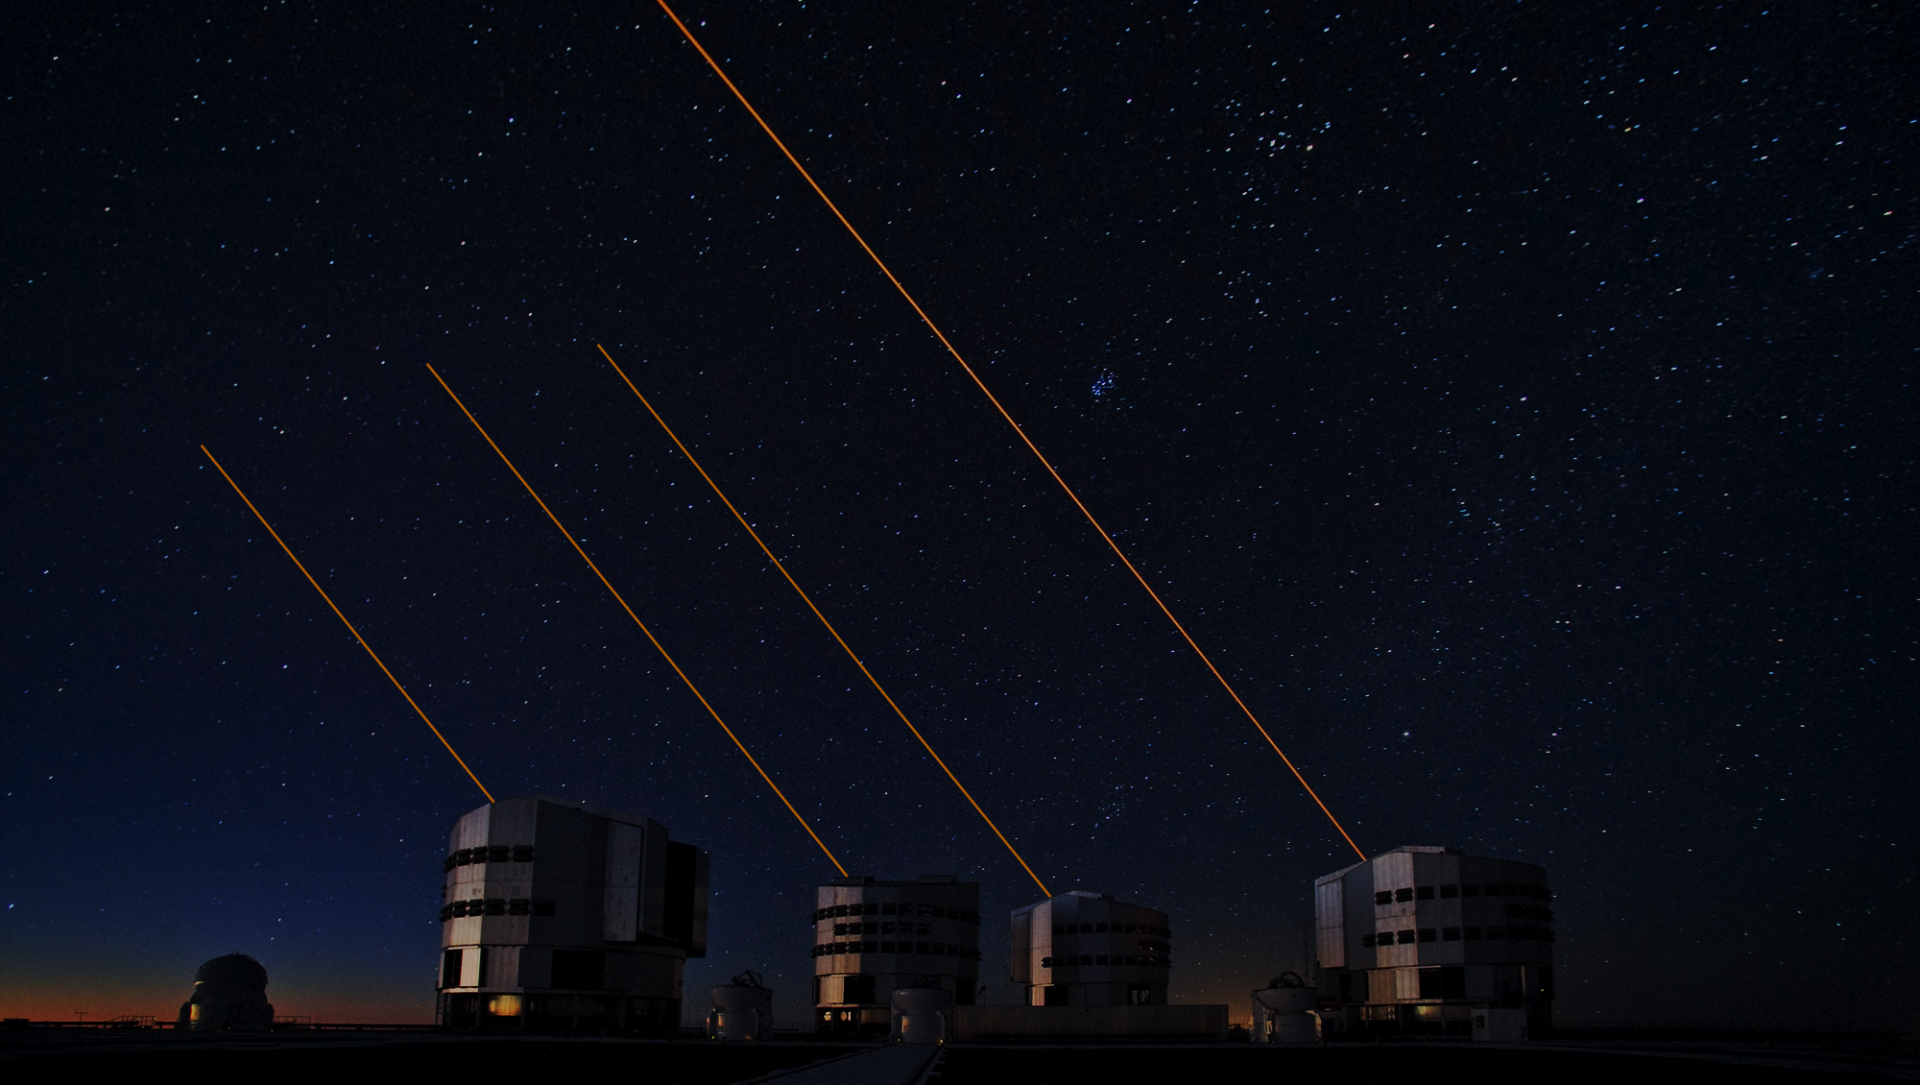
What is interferometry?

Slide 4
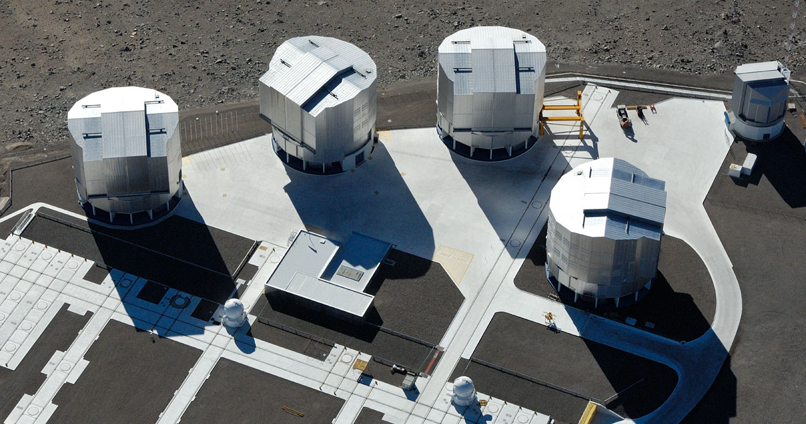
What is interferometry?
Very Large Telescope Interferometer (VLTI)

Slide 5
What is interferometry?
$$\frac{λ}{B}$$
Telescope
Diffraction
$$\sim \frac{λ}{D}$$
Very Large Telescope Interferometer (VLTI)

Slide 6
What is interferometry?
$$\frac{λ}{B}$$
Telescope
Diffraction
$$\sim \frac{λ}{D}$$
Very Large Telescope Interferometer (VLTI)

Slide 7
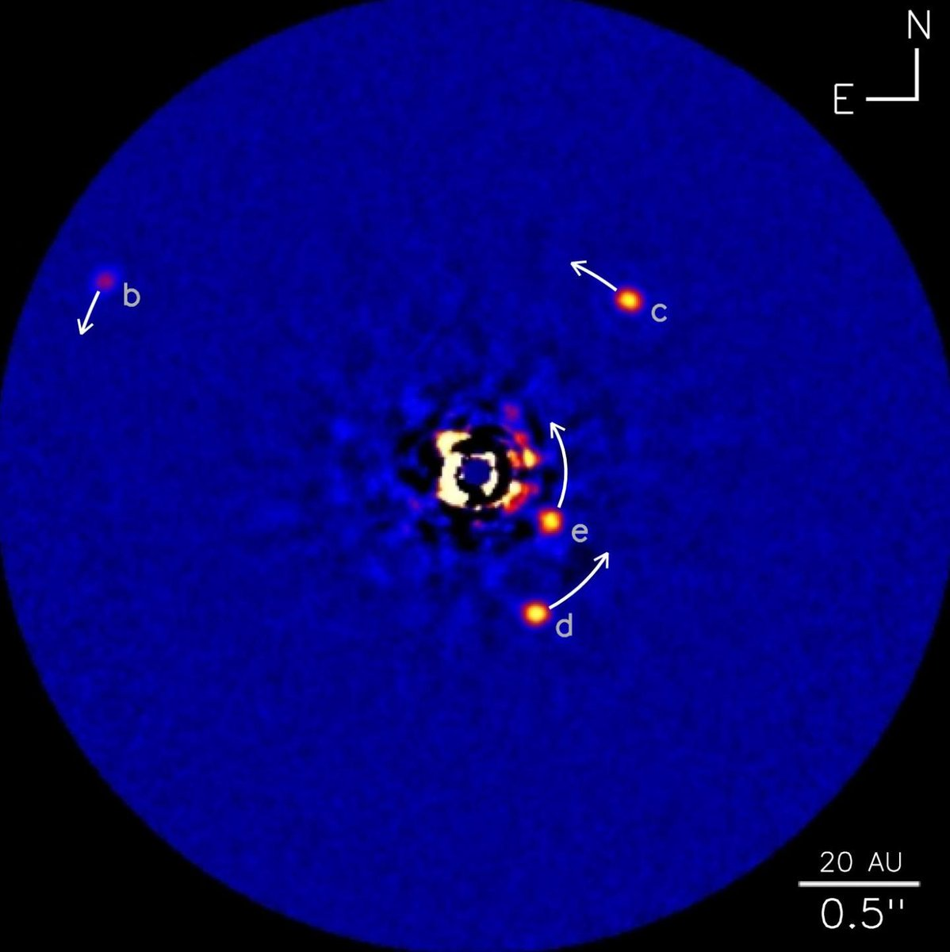
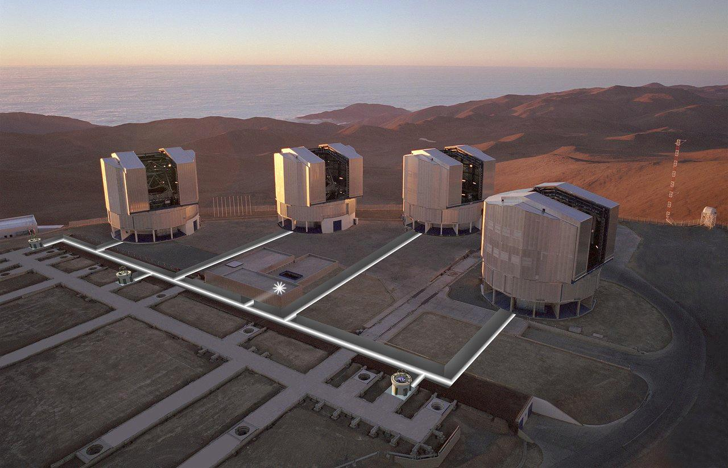
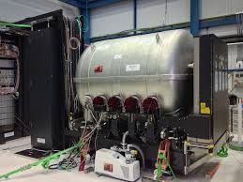
What is interferometry?
1
DUAL FIELD
Very Large Telescope Interferometer
- High Contrast 10⁻⁵ @90mas
- Spectrum up to R~4000
- Astrometry 10 - 100µas
B=130m
D=8m
B
2
ASTROMETRY
- 10 - 100 µas accuracy
- Detection & Characterization
GRAVITY
3
NULLING
20 AU
- High Angular Resolution
- Inner planets (0.1AU - 5AU)
0.5”
K-band (2.2µm)
R=4000

Slide 8
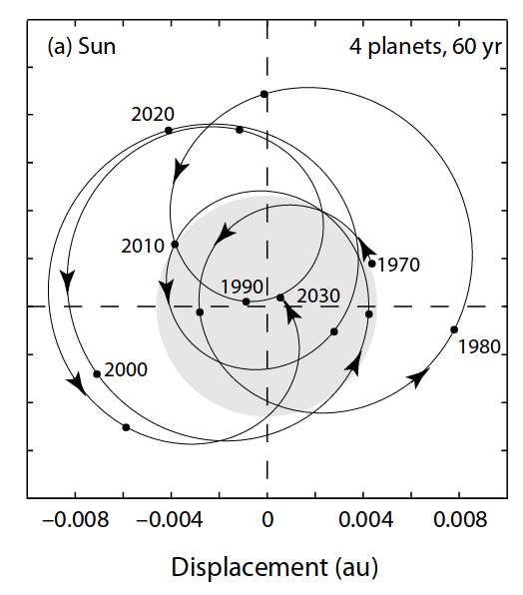
What is interferometry?
$$\frac{1}{300}×\frac{λ}{B}≈10μas$$
1
DUAL FIELD
- High Contrast 10⁻⁵ @90mas
- Spectrum up to R~4000
- Astrometry 10 - 100µas
2
ASTROMETRY
- 10 - 100 µas accuracy
- Detection & Characterization
3
NULLING
20 AU
- High Angular Resolution
- Inner planets (0.1AU - 5AU)
0.5”

Slide 9
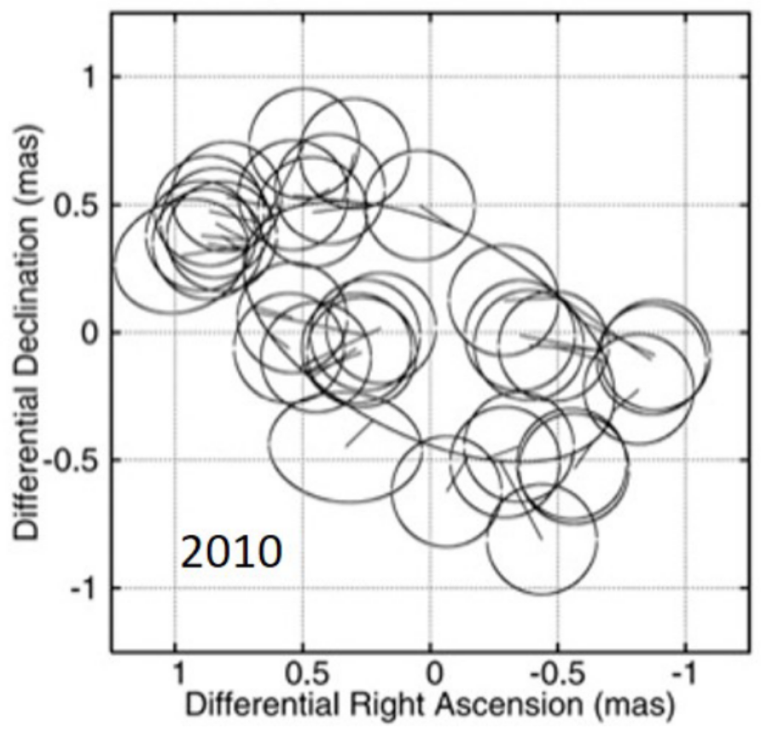
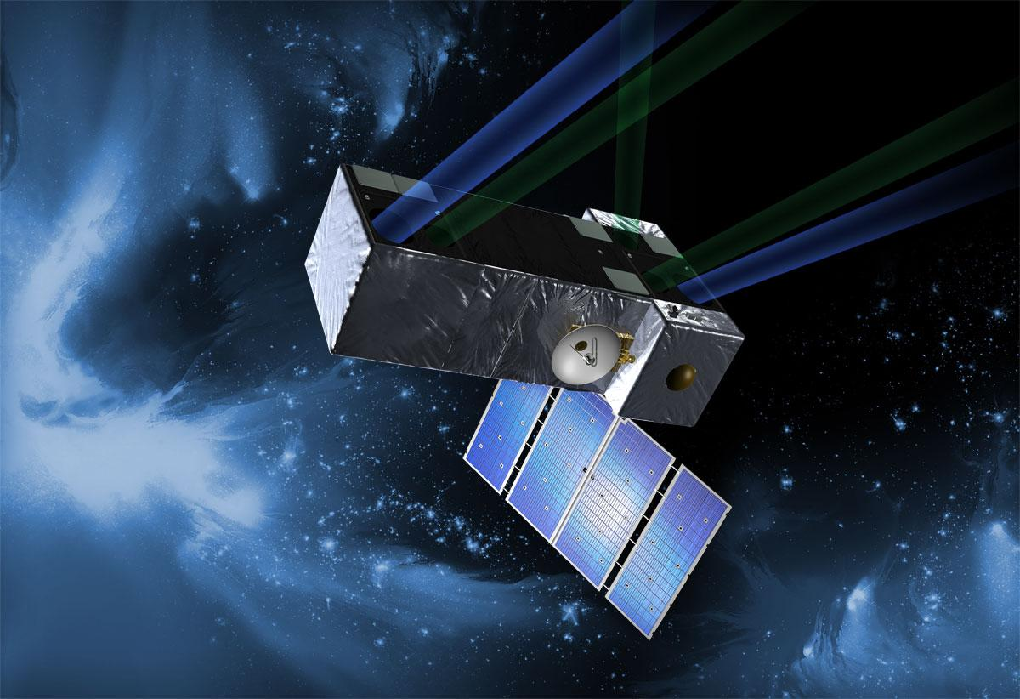
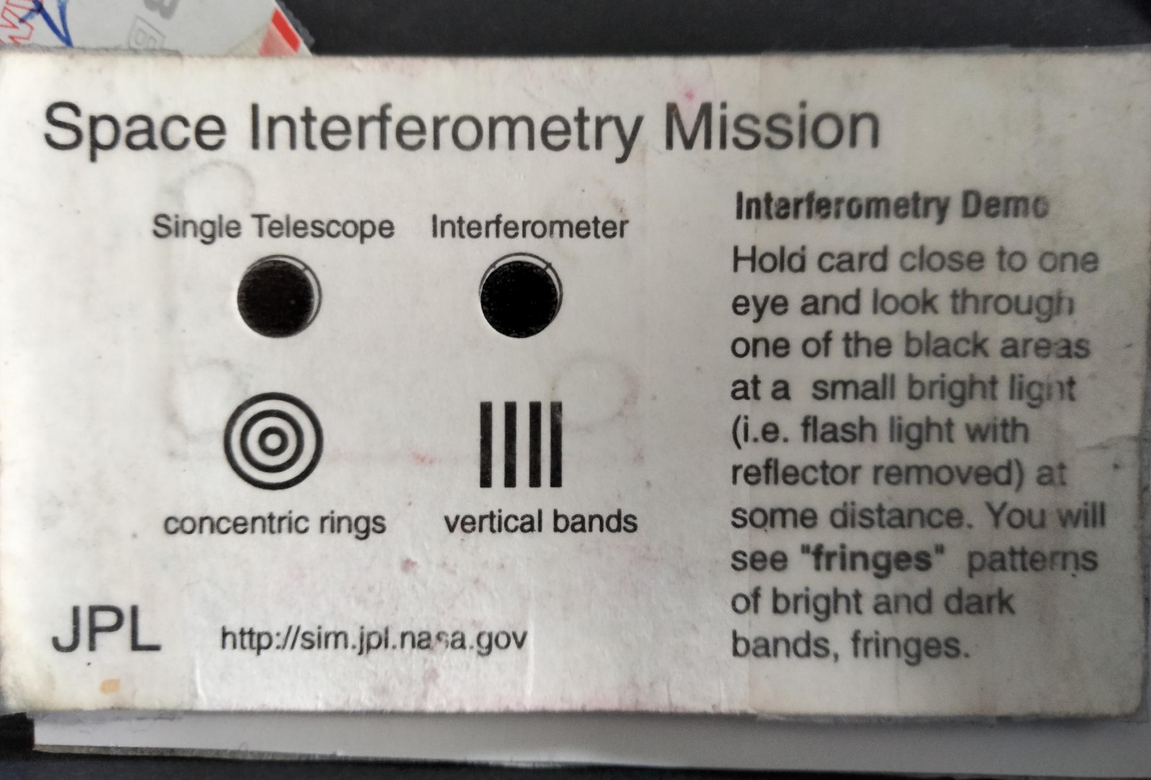
What is interferometry?
$$\frac{1}{300}×\frac{λ}{B}≈10μas$$
1
DUAL FIELD
- High Contrast 10⁻⁵ @90mas
- Spectrum up to R~4000
- Astrometry 10 - 100µas
2
ASTROMETRY
- 10 - 100 µas accuracy
- Detection & Characterization
Unwin+ 2008
Muterspaugh+ 2010
Gardner+ 2021
3
NULLING
20 AU
- High Angular Resolution
- Inner planets (0.1AU - 5AU)
0.5”

Slide 10
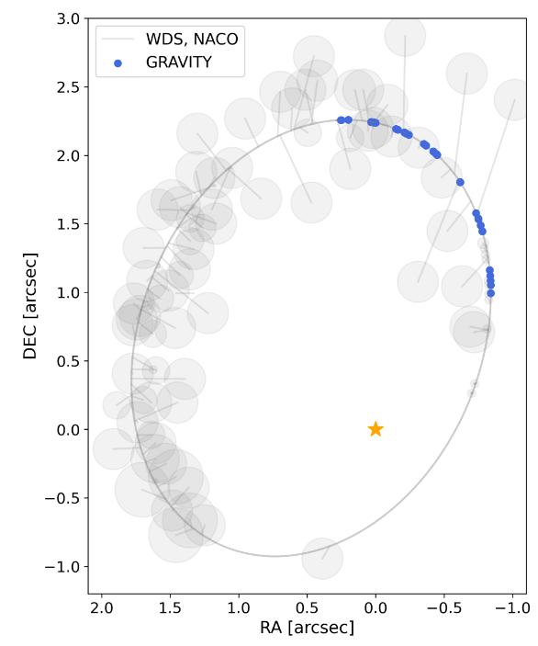
What is interferometry?
$$\frac{1}{300}×\frac{λ}{B}≈10μas$$
1
DUAL FIELD
- High Contrast 10⁻⁵ @90mas
- Spectrum up to R~4000
- Astrometry 10 - 100µas
2
ASTROMETRY
- 10 - 100 µas accuracy
- Detection & Characterization
Unwin+ 2008
Muterspaugh+ 2010
Gardner+ 2021
GRAVITY Collab. 2024
3
NULLING
20 AU
- High Angular Resolution
- Inner planets (0.1AU - 5AU)
0.5”
GJ65 (M-dwarf)
d=2.7pc

Slide 11
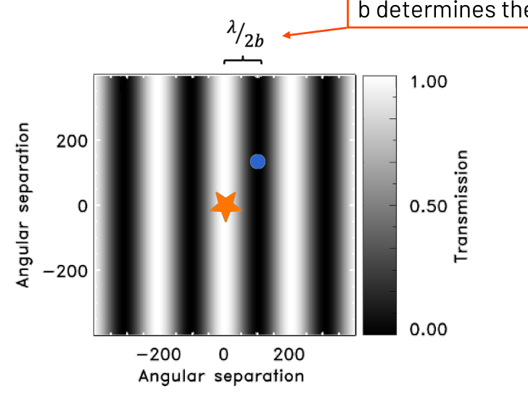
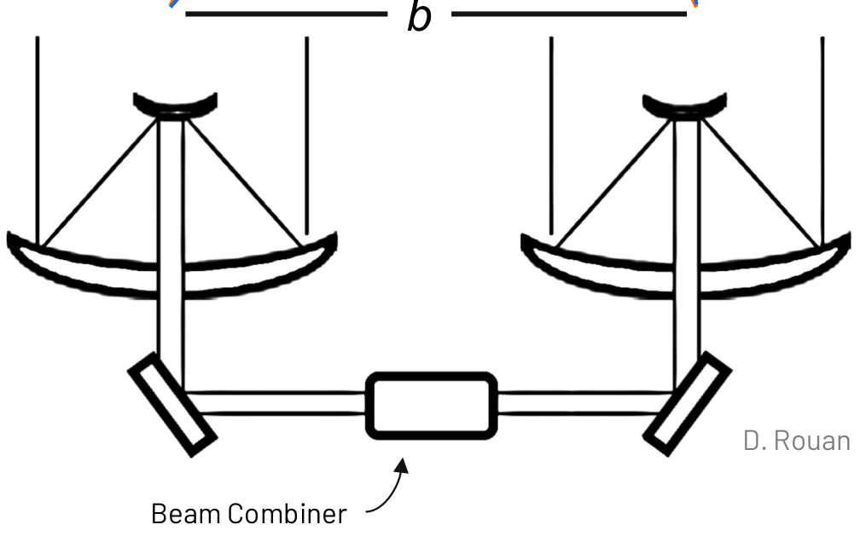
What is interferometry?
1
DUAL FIELD
- High Contrast 10⁻⁵ @90mas
- Spectrum up to R~4000
- Astrometry 10 - 100µas
2
ASTROMETRY
- 10 - 100 µas accuracy
- Detection & Characterization
3
NULLING
20 AU
- High Angular Resolution
- Inner planets (0.1AU - 5AU)
0.5”

Slide 12
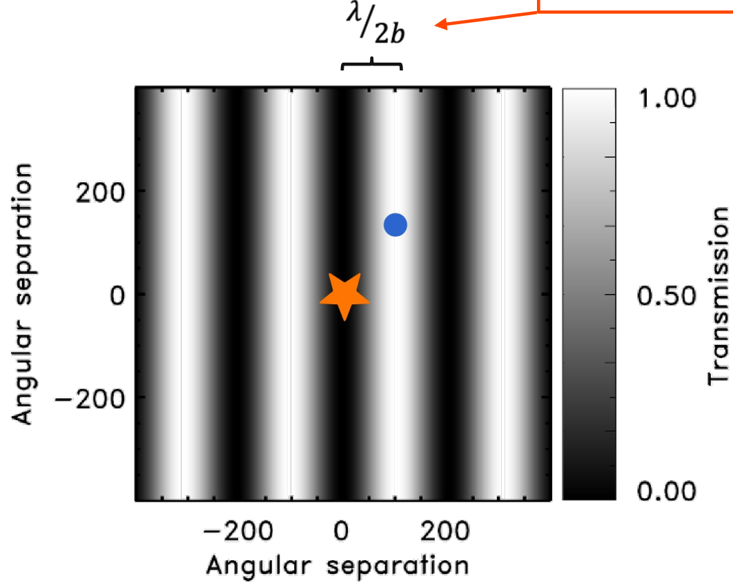
What is interferometry?
1
DUAL FIELD
- High Contrast 10⁻⁵ @90mas
- Spectrum up to R~4000
- Astrometry 10 - 100µas
2
ASTROMETRY
- 10 - 100 µas accuracy
- Detection & Characterization
3
NULLING
20 AU
- High Angular Resolution
- Inner planets (0.1AU - 5AU)
0.5”
+$π$ achromatic
shift

Slide 13
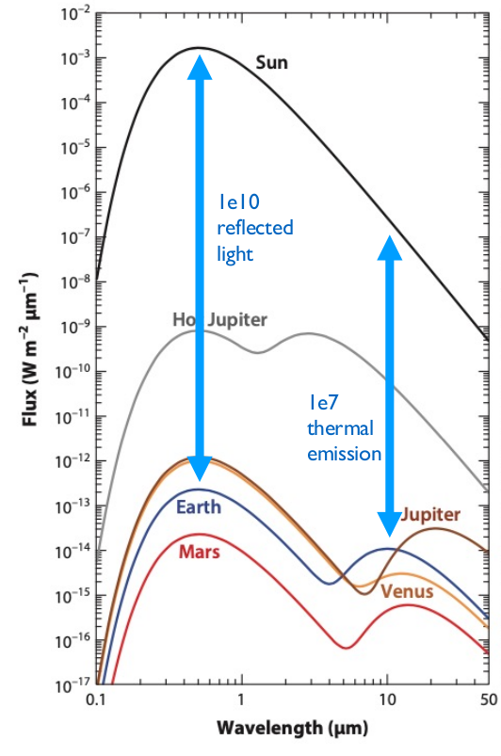
What is interferometry?
1
DUAL FIELD
Mid-IR Thermal emission
Jupiter & Earth-like in HZ
- High Contrast 10⁻⁵ @90mas
- Spectrum up to R~4000
- Astrometry 10 - 100µas
Kaltenegger 2017
2
ASTROMETRY
- 10 - 100 µas accuracy
- Detection & Characterization
3
NULLING
20 AU
- High Angular Resolution
- Inner planets (0.1AU - 5AU)
0.5”

Slide 14
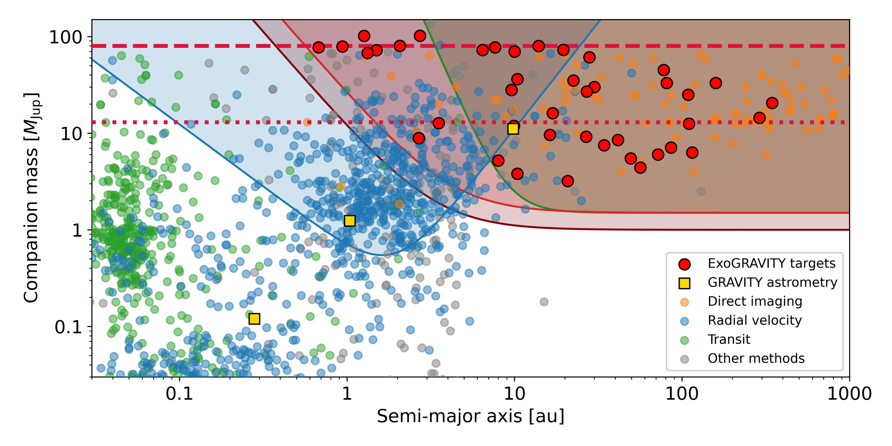
What is interferometry?
Nulling
High-Contrast
Astrometry
GJ65

Slide 15
Exoplanets with High-Contrast

Slide 16
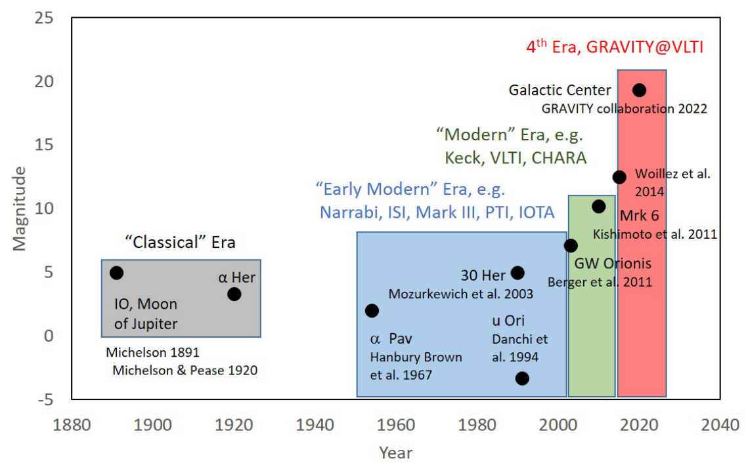
A revolution in sensitivity
Nobel Prize 2020
R.Genzel. A. Ghez
Eisenhauer, Monnier, Pfuhl, 2023
Dual-Field

Slide 17
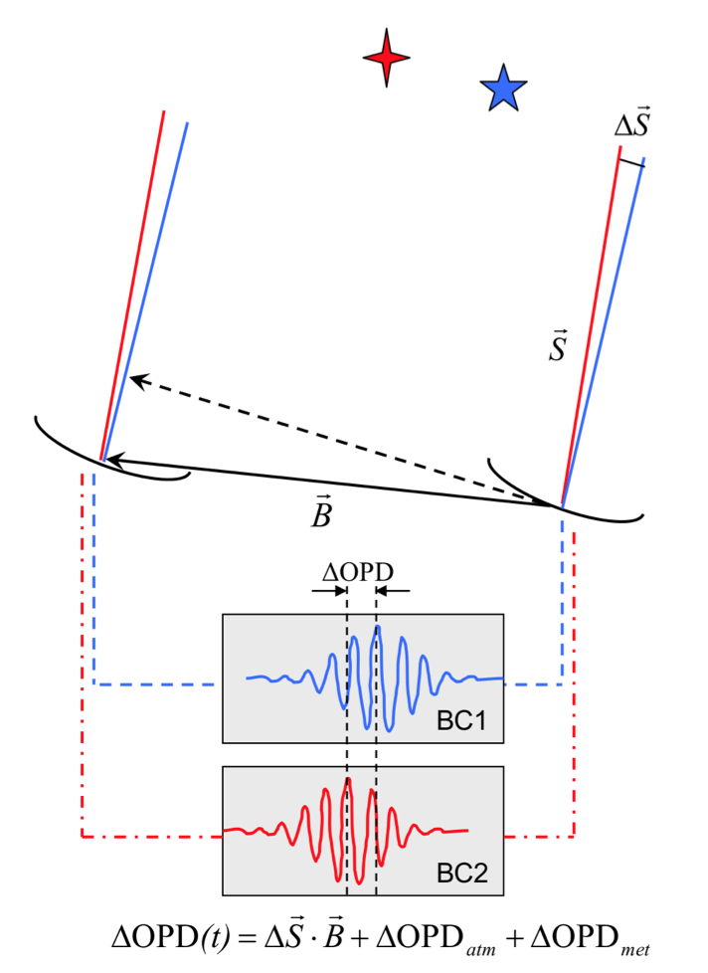
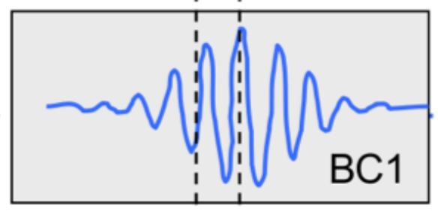
Single-Field Interferometry

Slide 18
Single-Field Interferometry
$$\frac{λ}{B}≈3.2 mas$$
B = 130 m
$$λ=2.2 μm$$

Slide 19
Single-Field Interferometry
$$\frac{λ}{B}≈3.2 mas$$
B = 130 m
$$λ=2.2 μm$$
Interferometry
1. Phase = Position

Slide 20
Single-Field Interferometry
$$\frac{λ}{B}≈3.2 mas$$
B = 130 m
$$λ=2.2 μm$$
Interferometry
1. Phase = Position
2. Normalized amplitude = Size
(“Visibility”)
3. Flux = Photometry / Flux

Slide 21
Single-Field Interferometry
$$\frac{λ}{B}≈3.2 mas$$
Fringe-Tracker
B = 130 m
This is the AO of interferometry!
$$λ=2.2 μm$$
Interferometry
Direct Imaging
1. Phase = Position
Phase
2. Normalized amplitude = Size
(“Visibility”)
Amplitude
3. Flux = Photometry / Flux

Slide 22
Dual-Field Interferometry
Fringe-Tracker
This is the AO of interferometry!
Science Channel
Sensitive, long integration

Slide 23
High-Contrast with dual field
SC
FT
20 AU
0.5”

Slide 24
Dual-Field Interferometry
Fringe-Tracker
This is the AO of interferometry!
Science Channel
Sensitive, long integration
Phase-referenced

Slide 25
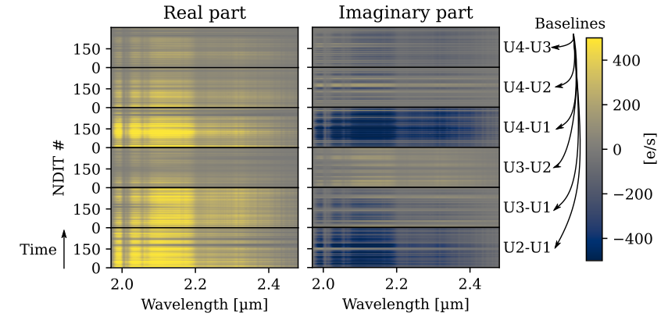
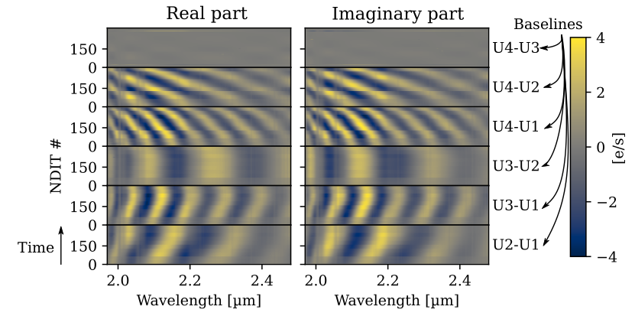
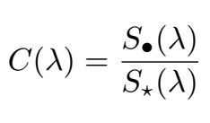
Exoplanets with dual-fiel interferometry (Lacour & Nowak)
credits: M.Nowak, 2020
Pourré+ 2024
Speckle
Nowak+ 2020
Planet
On-star:
(Phase-reference)
Planet:

Slide 26
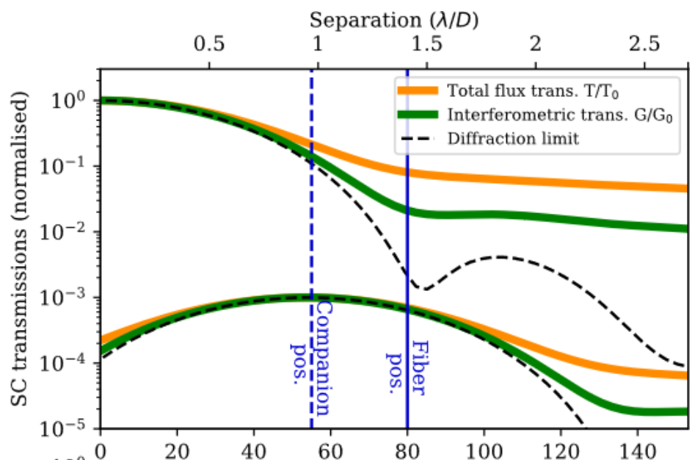
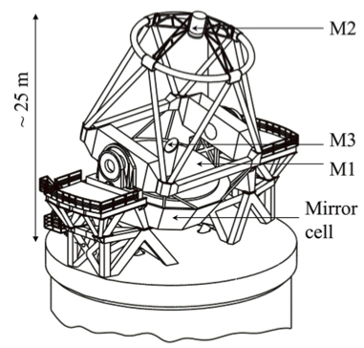
High Contrast with interferometry (Lacour & Nowak)
courtesy: M.Nowak
Nowak et al. 2020, 2021
Adaptive Optics
Single-mode filtering
Metrology and Phase Referencing
wavelength
separation [mas]
AO
Improve the Strehl ratio to decrease off-axis light
Star rejection
using the single-mode fibre, off-pointing
strategy, and dark-hole in the future
Speckle filtering
using low-order polynomials
$$\frac{λ}{D}$$
$$\frac{λ}{B}$$
Limited by telescope size:
Limited by baseline length:

Slide 27
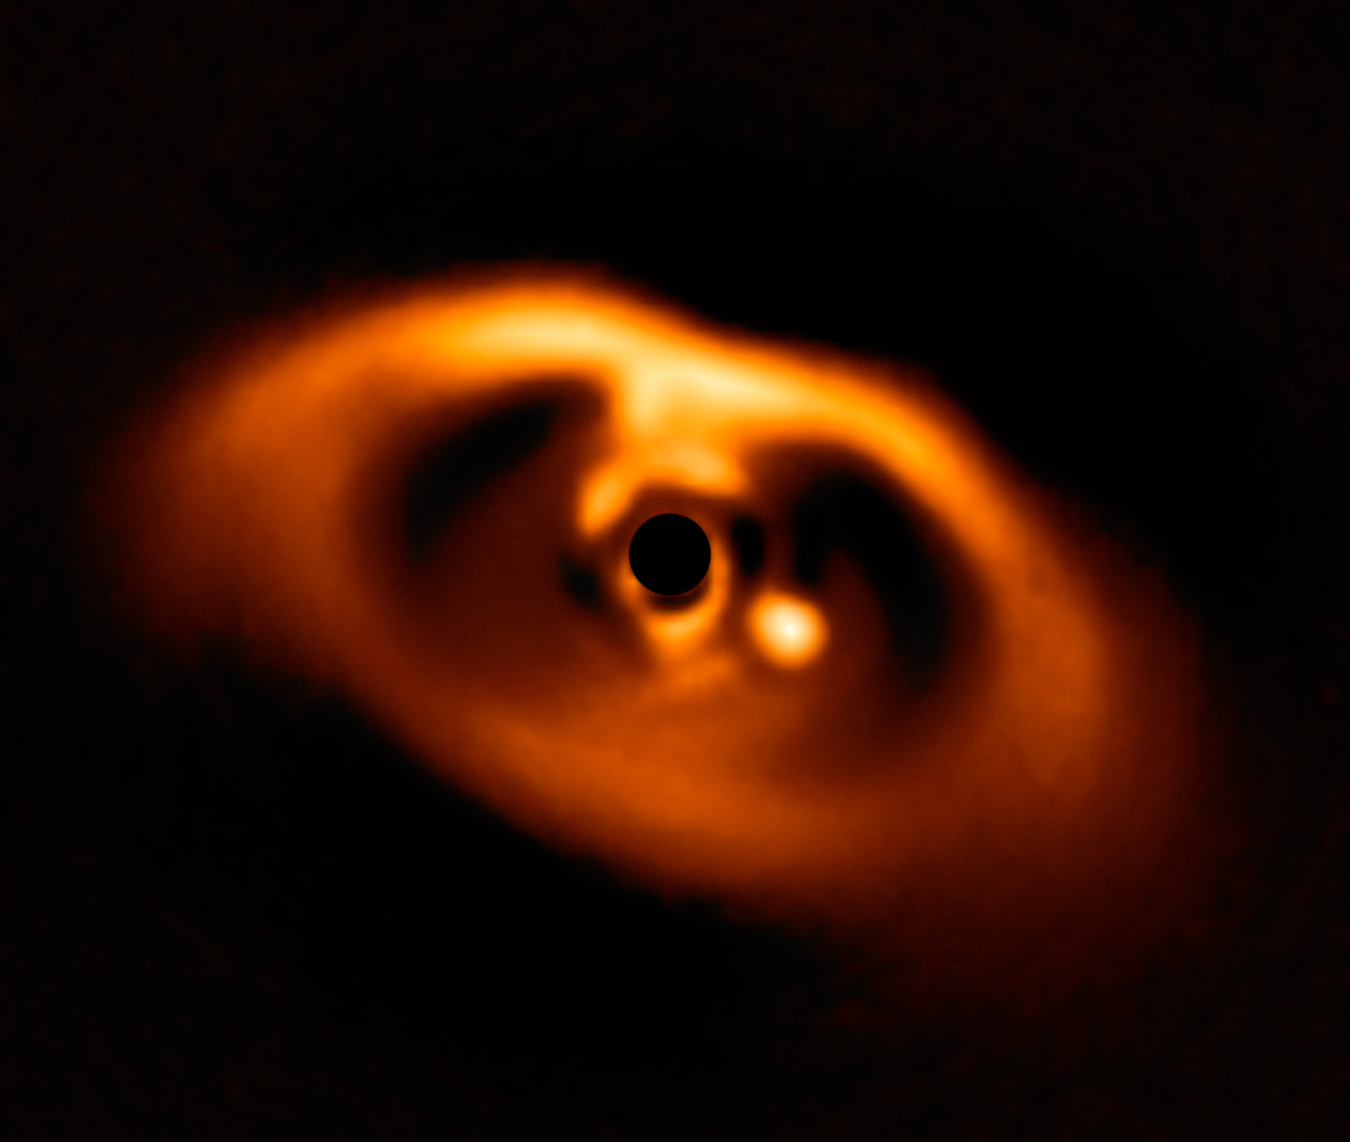
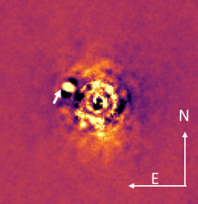
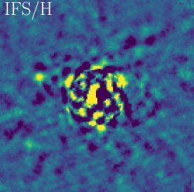
The ExoGravity Revolution
Fringe tracking fibre
credits: S.Lacour
Science fibre
HR8799 (GPI)
PDS 70 (SPHERE)
HD 95086 (GPI)
51 Eri (GPI)
beta Pic (SPHERE)
HD 206893 (SPHERE)
AF Lep b (SPHERE)

Slide 28
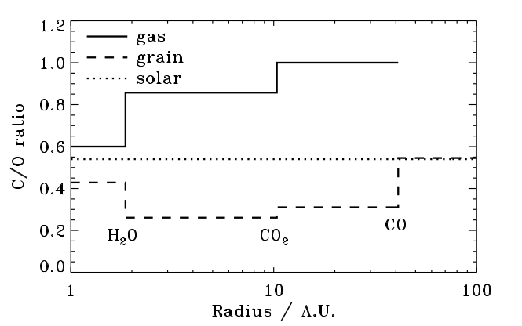
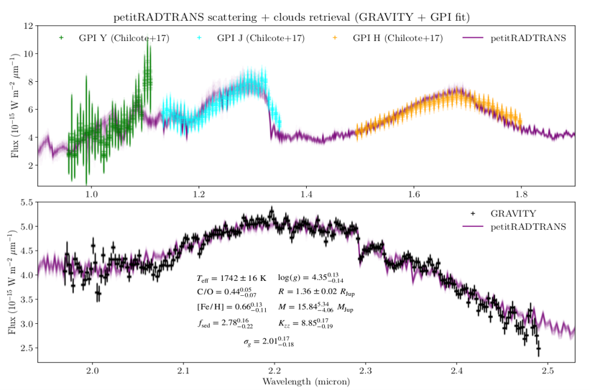
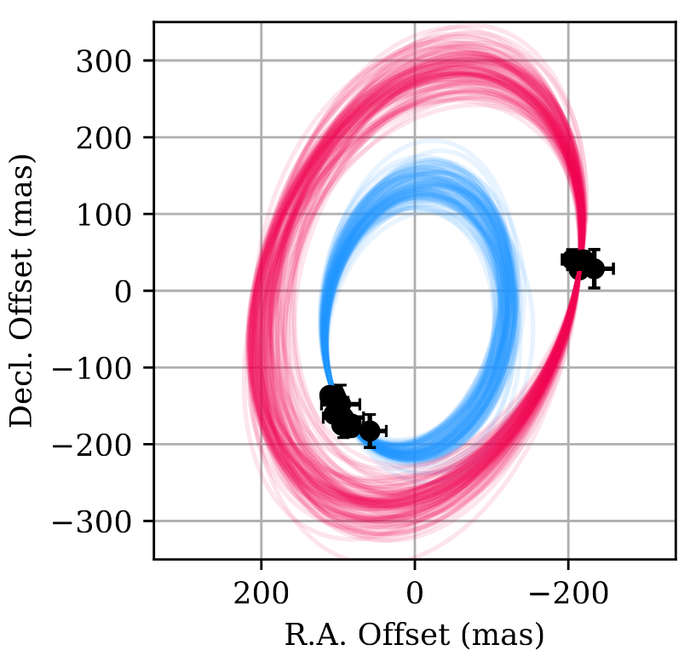
Beta Pictoris b and Planet Formation
Beta Pic b
Spectrum (R=500) and Astrometry (40µas)
Atmosphere
C/O Measurement
Öberg+ 2011
PDS 70 b & c
Architecture
Wang+2021
GRAVITY Collab, Nowak+2020

Slide 29
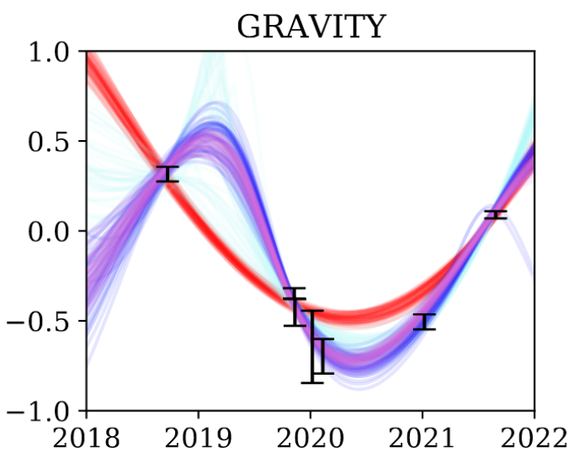
Beta Pictors c: First direct detection of an RV planet (Nowak+20)
Beta Pictoris
Lacour+ 2020
Direct Observation
of RV planets!
[mas]
year
Lagrange+2020
Nowak+ 2020
Nowak+ 2020

Slide 30
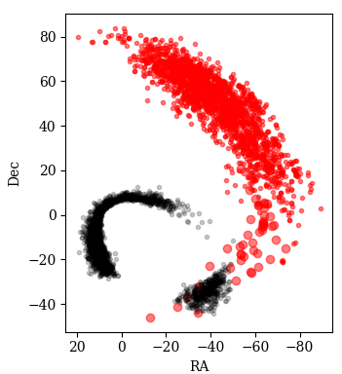
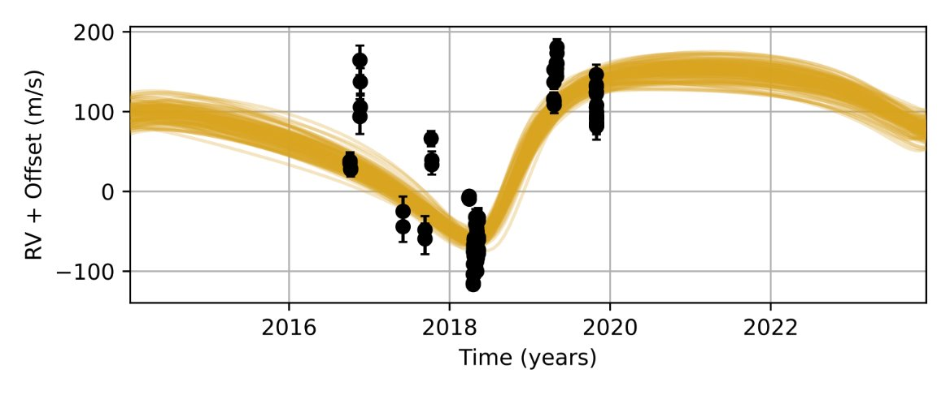
HD206893c: direct detection of an RV planet!
Direct Observation
of RV planets!
HD 206893c
Mass & Luminosity
Kammerer+2021
Grandjean+2019

Slide 31
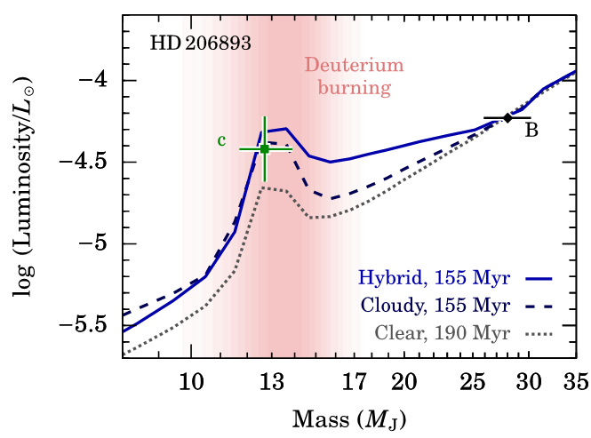
HD206893c: direct detection of an RV planet!
Direct Observation
of RV planets!
HD 206893c
Mass & Luminosity
Kammerer+2021
Hinkley+2023

Slide 32
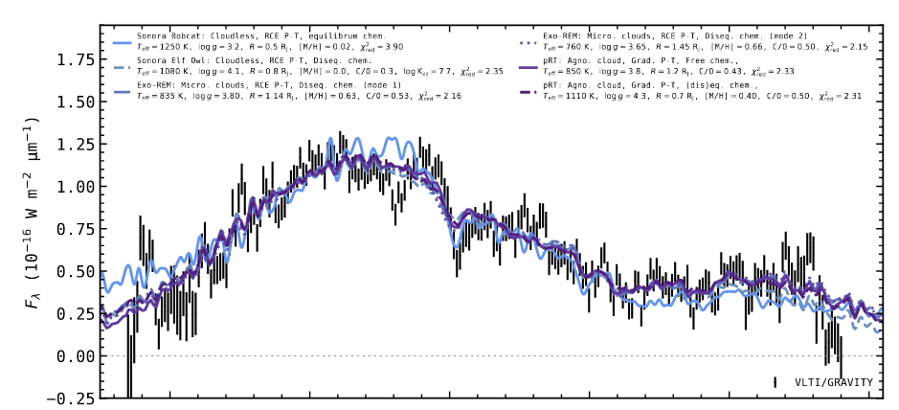
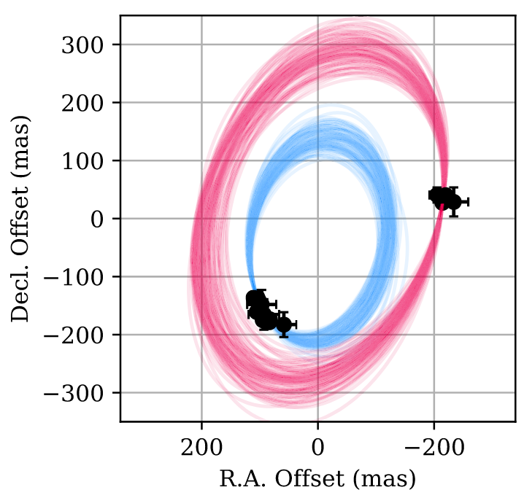
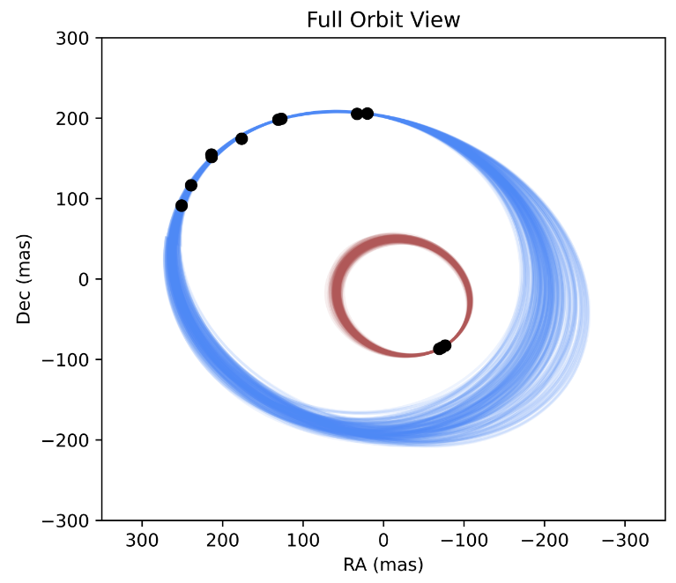
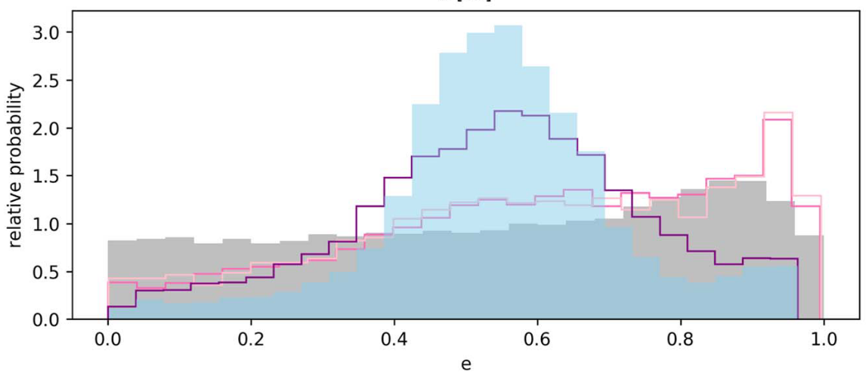
... and a lot more!
HR8799
beta Pic
AF Lep b
Gravity Collab., Lacour+ 2019
Molliere+ 2020
Nasedkin+ 2024
Nowak+ 2020
Lacour+ 2021
Lagrange+2020
Balmer+2024b
Brown Dwarfs: Balmer+2023, Balmer+2024a
PDS 70
HD 206893
HIP 65426
Wang+2021
Kammerer+2021
Hinkley+2023
Blunt+2024

Slide 33
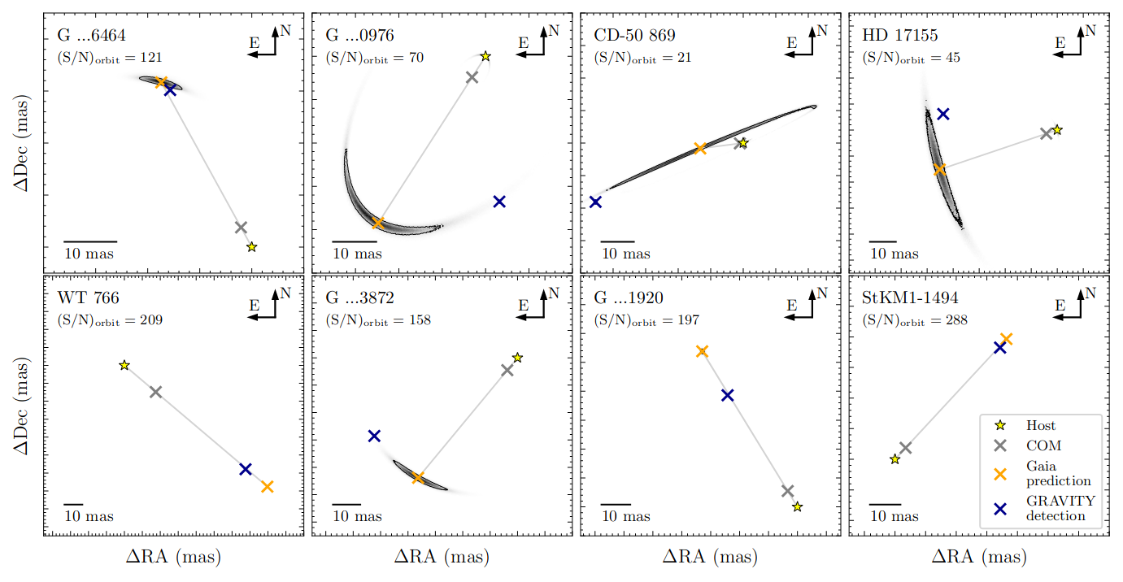
Combining GAIA and GRAVITY
Direct Observation
of GAIA companion!
Winterhalder+ 2024

Slide 34
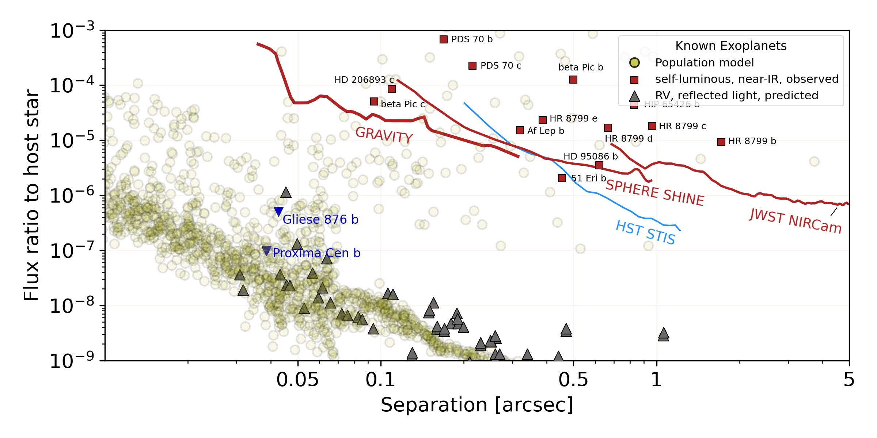
Contrast curves
Pourré+2024

Slide 35
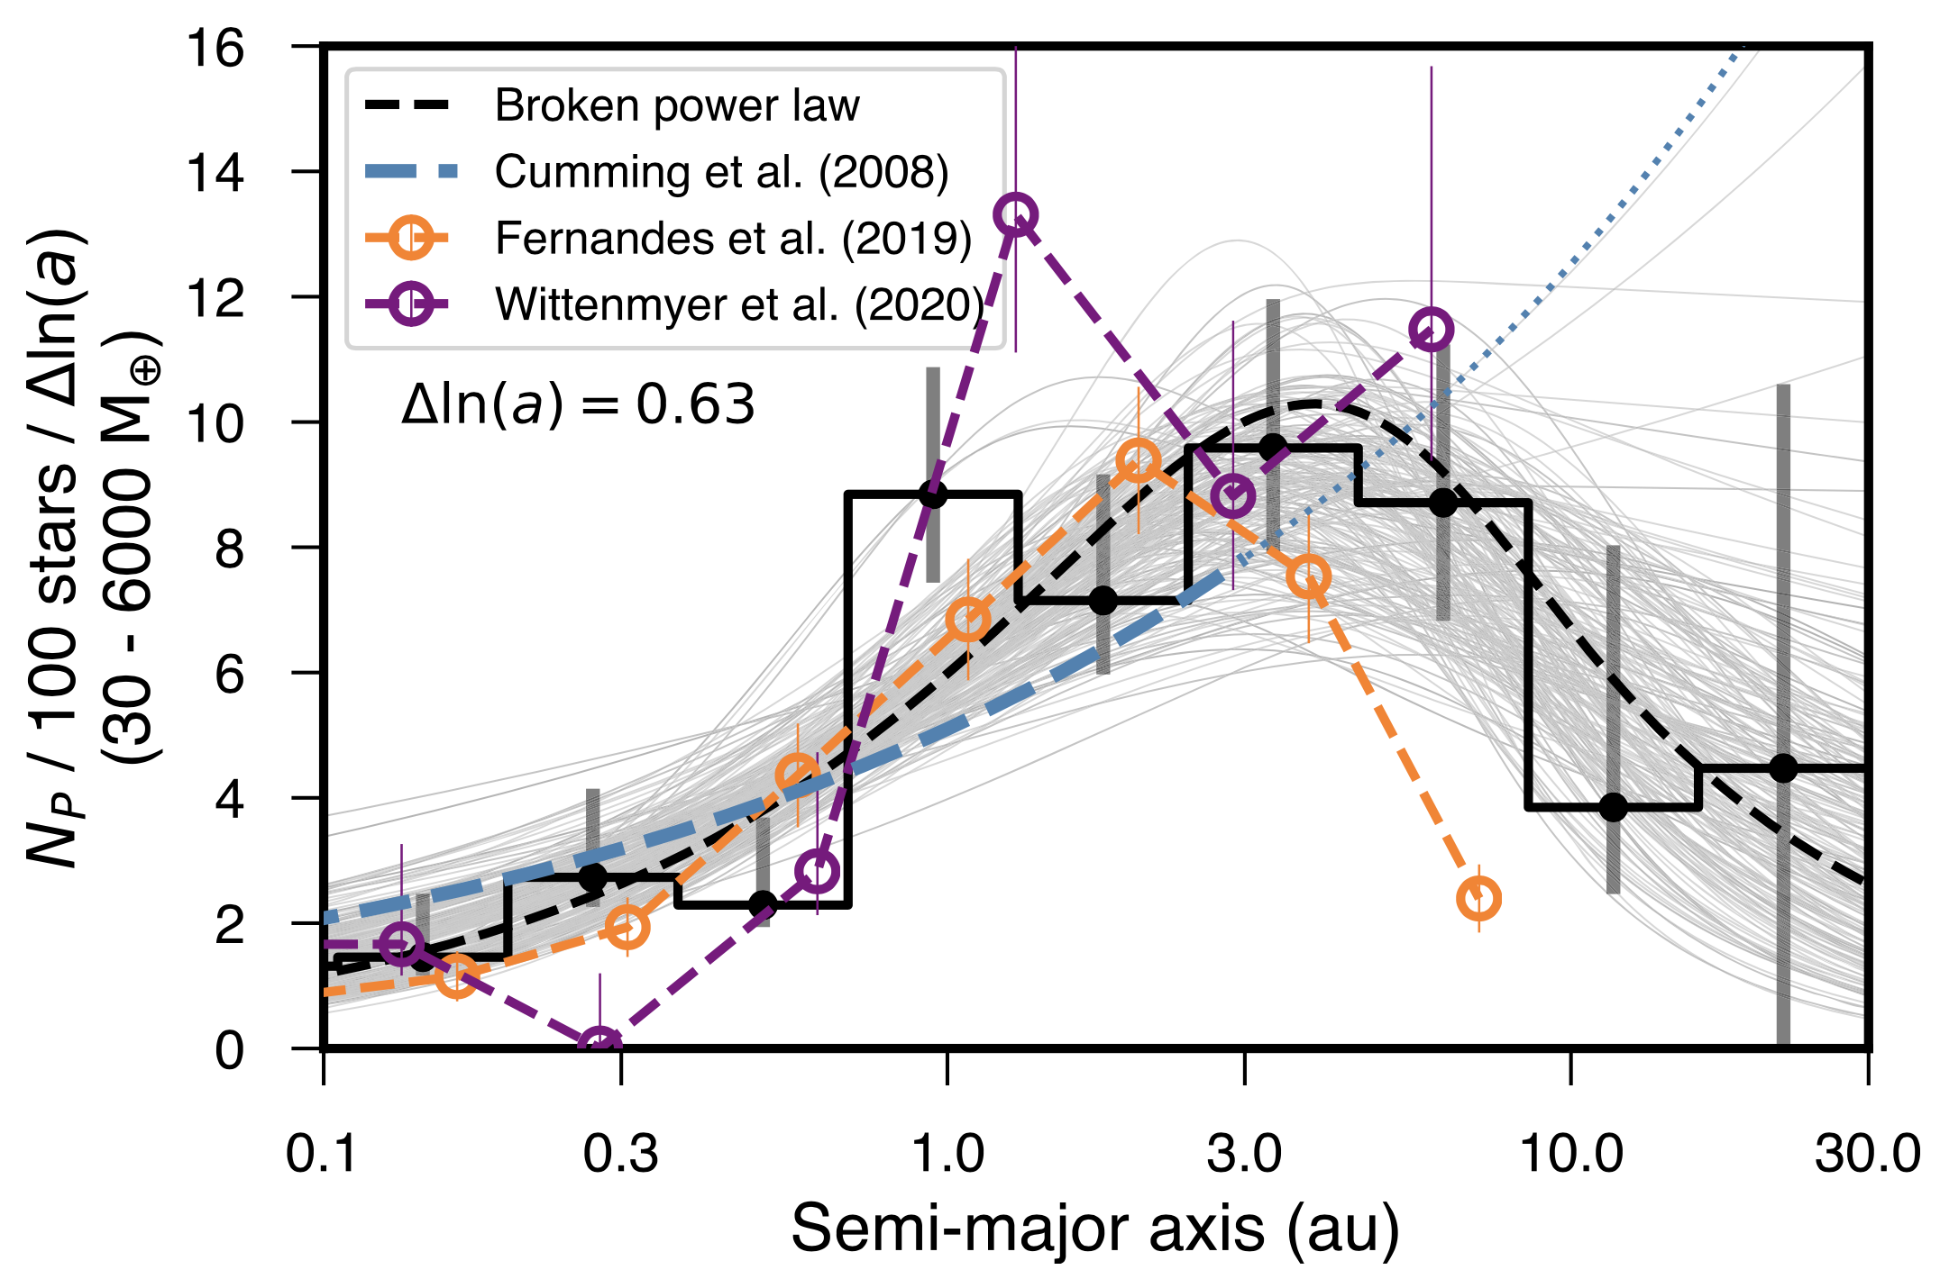
Combining GAIA and GRAVITY
Fulton+2021
High-Contrast

Slide 36
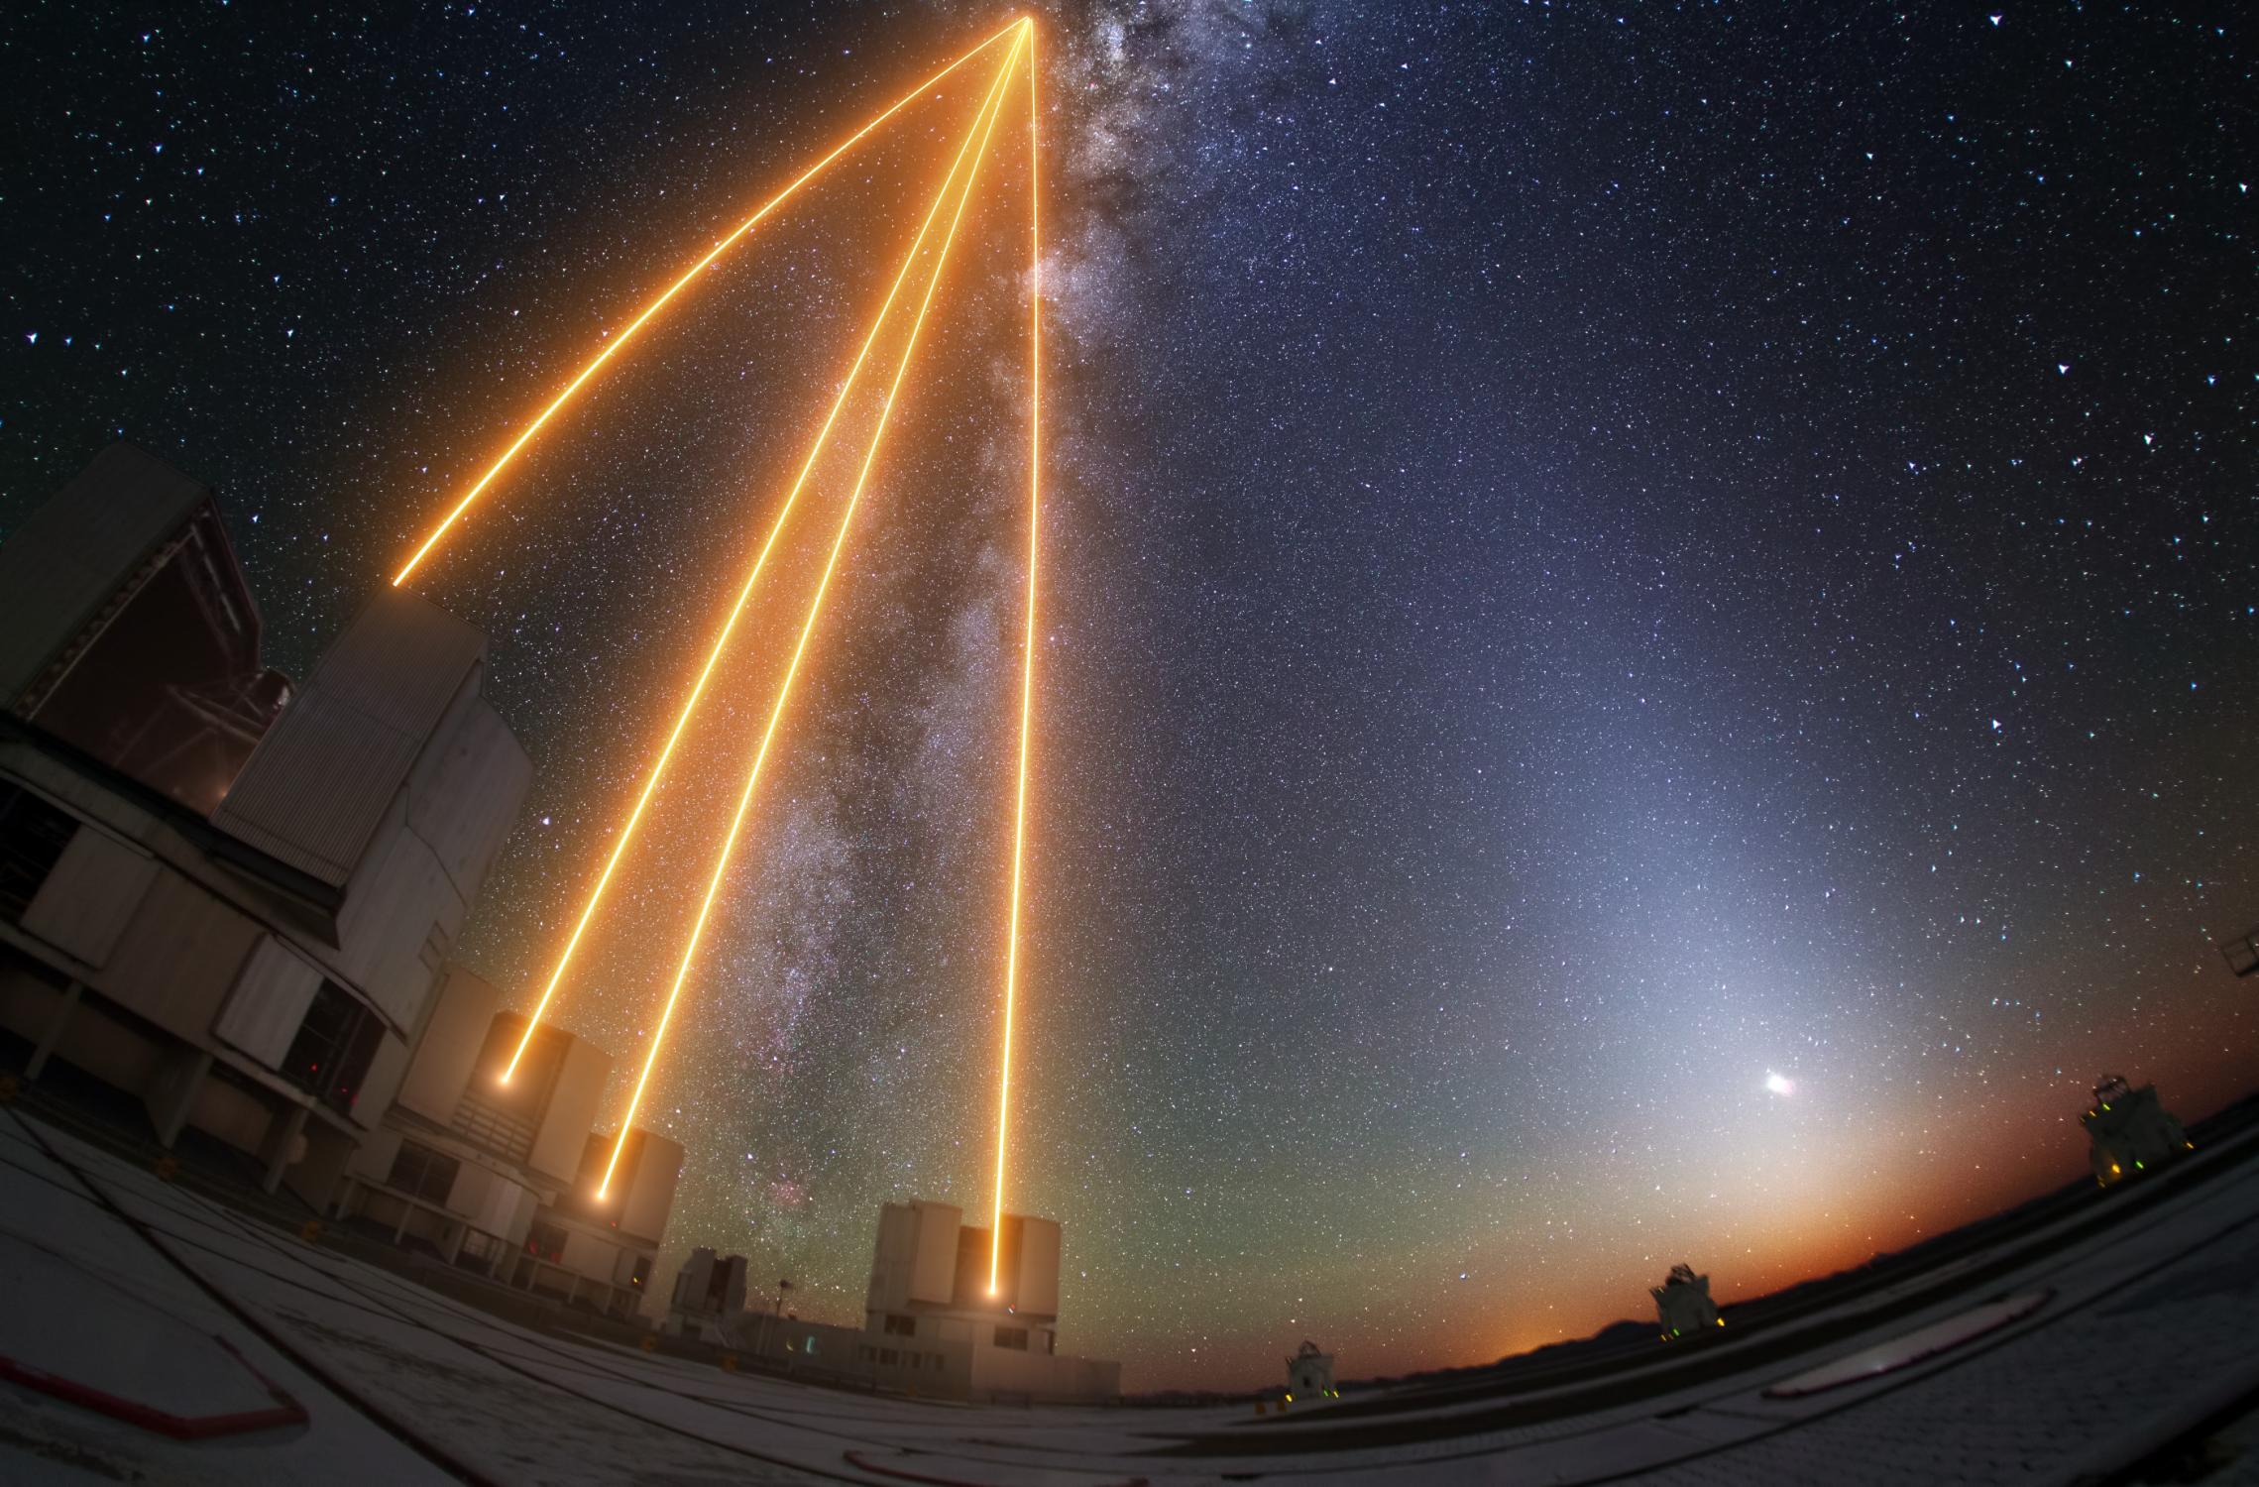
The Future: High-Contrast,
faint science, all-sky with GRAVITY+

Slide 37
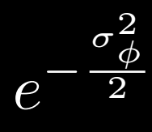
GRAVITY+ motivation
Eisenauher et al. 2023
Vibration:
AO injection
x2.5
x1.5
Factor ~20
AO rejection
1/(x3 ... x50) x 75%
Metrology + sky
0 x 10%
Long-Integration
0.1 x 15%
Factor x5

Slide 38
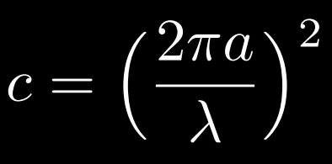
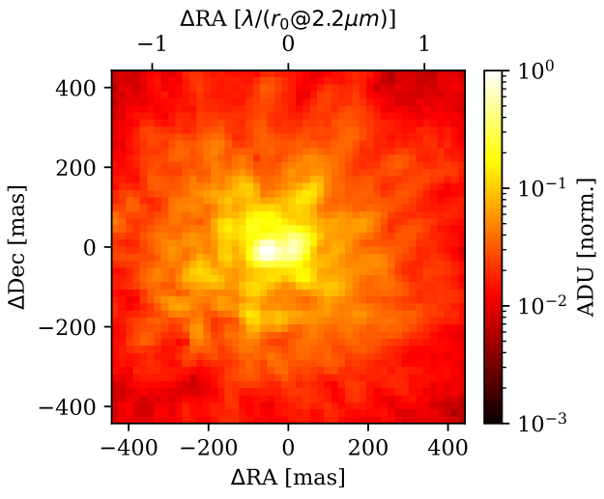
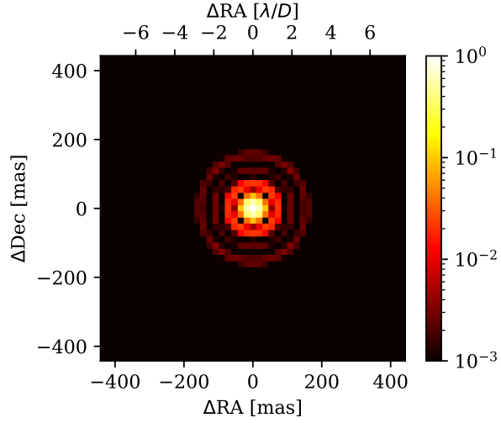
GRAVITY+ Adaptive Optics
MACAO
GPAO
credit: J-B Le Bouquin
$$\frac{λ}{r0}$$
$$\frac{λ}{D}$$
Atmosphere
Diffraction
Notes:
Inner Working Angle
Contrast

Slide 39
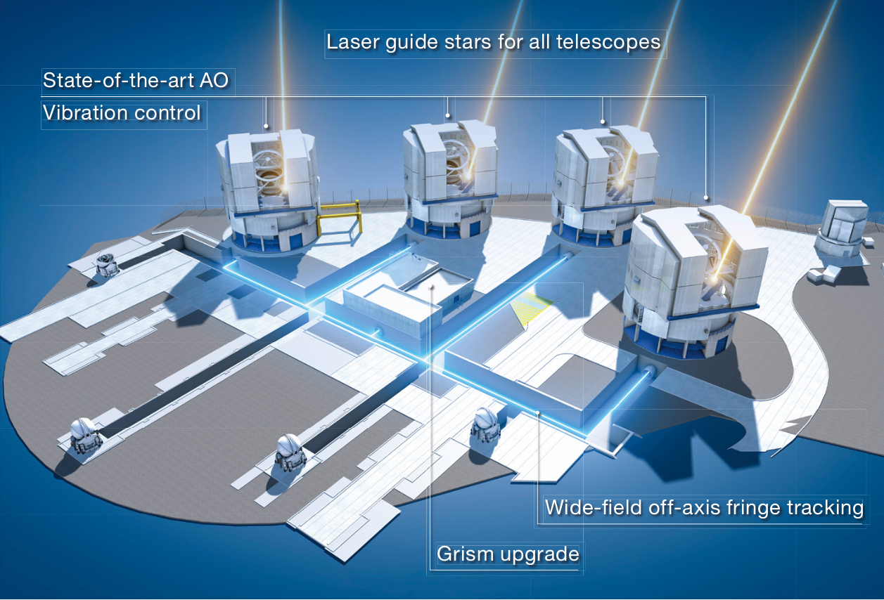
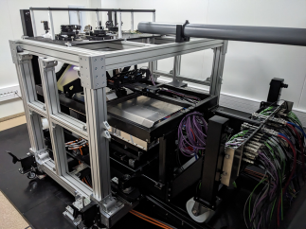
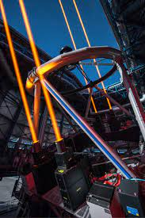
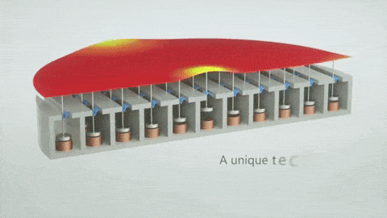
x4 ERIS-like
x4 LGS
LGS mode Rmag<18
Extreme AO
Contrast 10⁻⁶
High-Contrast
ALPAO DM, 43x43
1.3k actuators
Sensitivity
x10 -100
All-Sky Coverage
30”field of view
all-sky coverage
Vibration improvement
MANHATTAN upgrade
Notes:
thanks for your introduction
i am very glad to talk to you about the work we have been doing with GRAVITY and now within GRAVITY+ to keep puhing the astrometric capability of long baseline interferometry with GRAVITY.
it’s really a team effort, I’ll present results on behalf of many persons, in particular F.Widmann, S von Fellenberg, Julia Stadler, on behalf of GRAVITY+ community

Slide 40
x4 ERIS-like
x4 LGS
LGS mode Rmag<18
Extreme AO
Contrast 10⁻⁶
High-Contrast
ALPAO DM, 43x43
1.3k actuators
Sensitivity
x10 -100
Timeline
2019 : White Paper
2022 : FDR
2024 : GPAO Commissioning
2025 : Laser Guide Star
All-Sky Coverage
30”field of view
all-sky coverage
Vibration improvement
MANHATTAN upgrade
Notes:
thanks for your introduction
i am very glad to talk to you about the work we have been doing with GRAVITY and now within GRAVITY+ to keep puhing the astrometric capability of long baseline interferometry with GRAVITY.
it’s really a team effort, I’ll present results on behalf of many persons, in particular F.Widmann, S von Fellenberg, Julia Stadler, on behalf of GRAVITY+ community

Slide 41
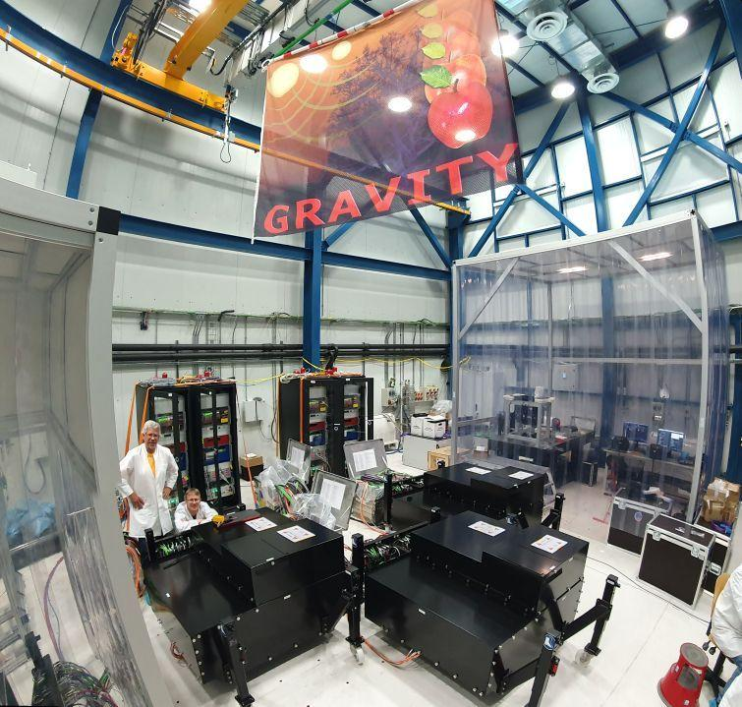
GRAVITY+ Adaptive Optics (Summer 2024)
Bourdarot+ 2024, in prep
40x40 Shack Hartmann
credits: S.Oberti
July 2024

Slide 42
GRAVITY+ High-Contrast: NCPA and dark hole
Hands-On Session I (S.Haffert) & II (J.Wang)
Por & Haffert 2020

Slide 43
GRAVITY+ High-Contrast: NCPA and dark hole
Dark Hole
NCPA
Wavefront Control
Pourré+2024
Bourdarot+2021
Por & Haffert 2020
Pourré+ 2024
Fiber Coupler

Slide 44
GRAVITY+ vibration control and VLTI/NOTT Nuller
Vibration Control
Nulling
VLTI / NOTT
Defrere+ 2024
Laugier, Defrere+ 2023
Martinache+ 2021

Slide 45
GRAVITY+ High-Contrast
Cumulated
sum
Number of
target
HL Tau
GRAVITY+
T Tauri
Laser Guide
Stars
GRAVITY
Herbig
Ae/Be
G mag
Up Sco [Luhman+2020]

Slide 46
GRAVITY+ High-Contrast
High-Contrast

Slide 47
Beyond the Pale Blue Dot (2040+)
E-VLTI
Kilometric Baseline
Space Interferometry
Quanz+2019
Eisenhauer & Bourdarot, 2024
Thank You!

Slide 48
Back-up

Slide 49
An analogy between DI and Interferometry
Direct Imaging
Interferometry
- Angular Differential Imaging (ADI)
- Baseline Rotation
~130m (factor x16 of 8m diameter)
- Pupil Grid / Calibration spots
- Metrology laser (10⁻⁴ accuracy)
- Spectral mid- to high resolution
- Speckle filtering (low order polynomial) R=500 (up to R=4000)

