Slide 1
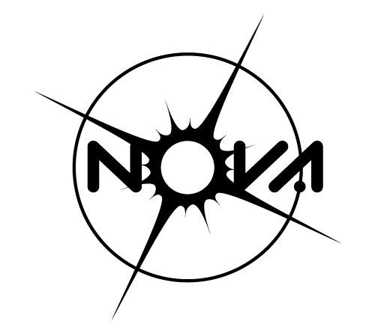
Introduction: Coronagraph Optical Theory and Practice
Sagan Summer Workshop lecture
In collaboration with:
David Doelman - 22-07-2024

Slide 2
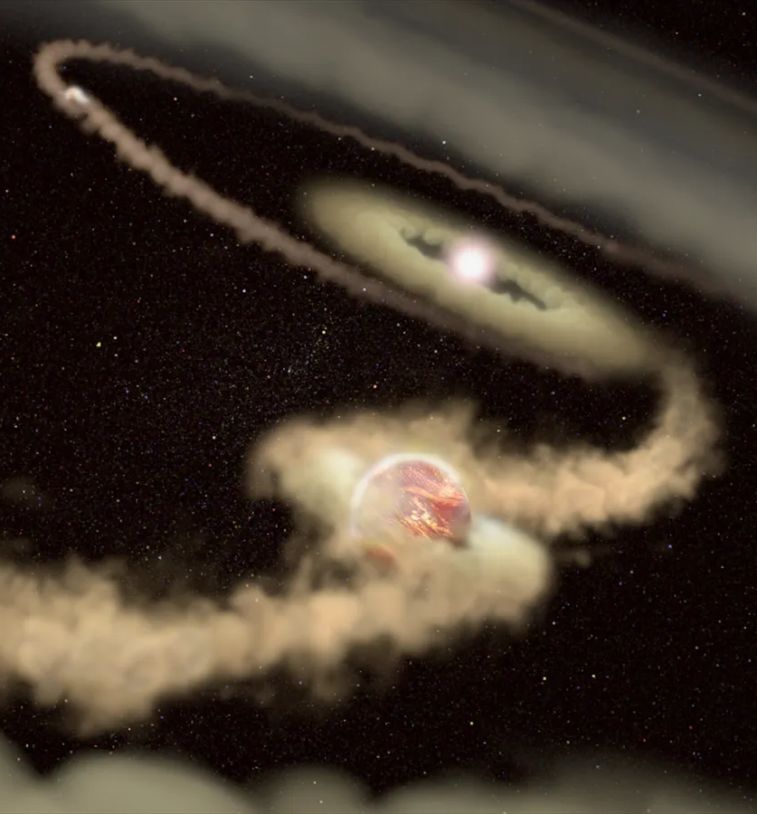
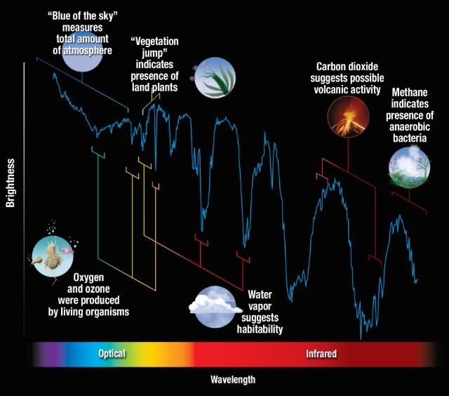
Motivation: coronagraph science
How do planets form?
Is the Earth Unique?
Are we alone?
David Doelman
SSW 2024 - Coronagraphy

Slide 3
How to image exoplanets
According to Google
Image credit: Google
David Doelman
SSW 2024 - Coronagraphy

Slide 4
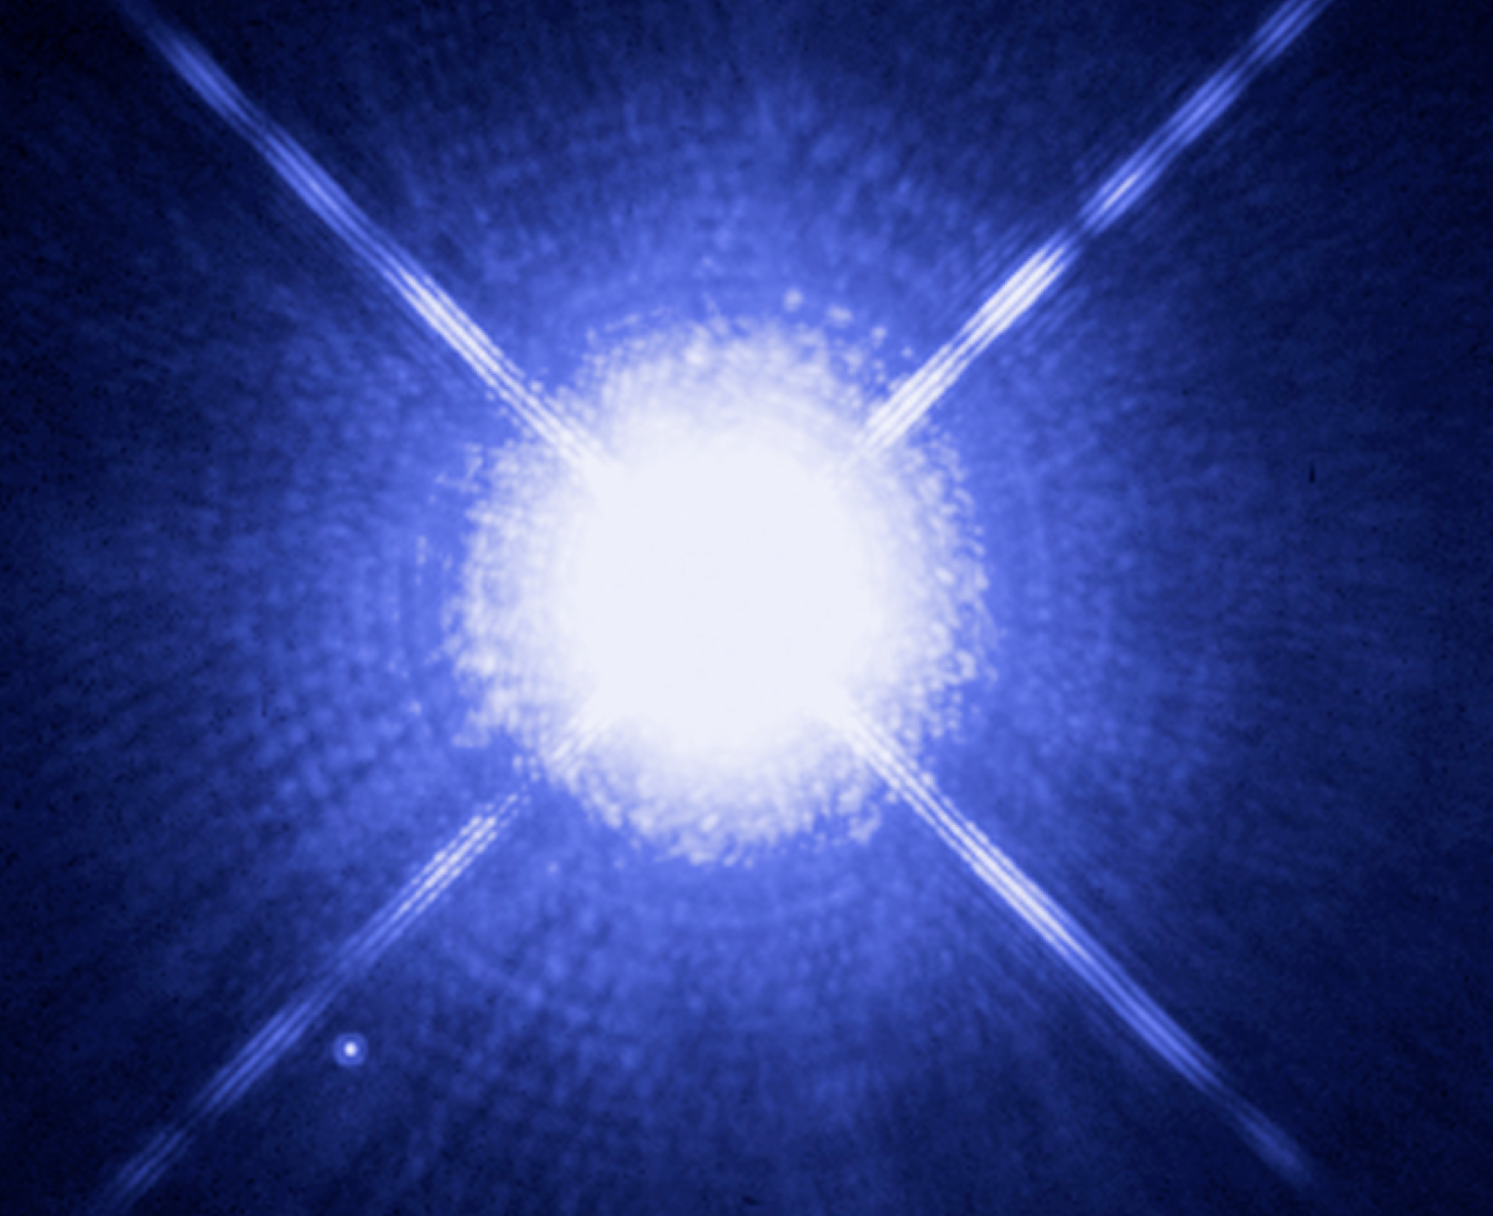
Habitable planets are hiding in plain sight!
Directly imaging planets is not trivial
Diffracted light from the star dominates
Flux ratio = contrast: 10⁻⁷ -10⁻¹⁰
Need to remove starlight!
Planet orbit
NASA, ESA, H. Bond (STScI), and M. Barstow (University of Leicester)
David Doelman
SSW 2024 - Coronagraphy

Slide 5
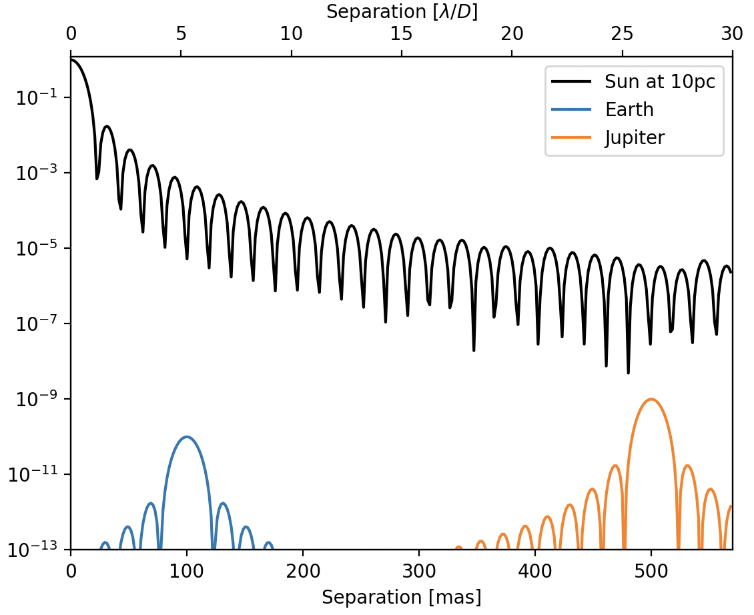
Habitable planets are hiding in plain sight!
Sun at 10 pc, D = 6.5m, λ = 630 nm
Directly imaging planets is not trivial
Diffracted light from the star dominates
Flux ratio = contrast: 10⁻⁷ -10⁻¹⁰
Need to remove starlight!
David Doelman
SSW 2024 - Coronagraphy

Slide 6
Removing starlight, keeping planet light
Fundamental and obvious ideas
To image a planet we point the telescope on the host star
Apriori location of planets unknown, extended objects (disks), use symmetry optical system
David Doelman
SSW 2024 - Coronagraphy

Slide 7
Removing starlight, keeping planet light
Fundamental and obvious ideas
To image a planet we point the telescope on the host star
Apriori location of planets unknown, extended objects (disks), use symmetry optical system
Fundamental differences between off-axis (planet) light and on-axis (star) light
Angle -> different location in the focal plane
Spectrum -> not practical for optical implementation but good for post-processing
Polarization -> not practical for optical implementation but good for post-processing
David Doelman
SSW 2024 - Coronagraphy

Slide 8
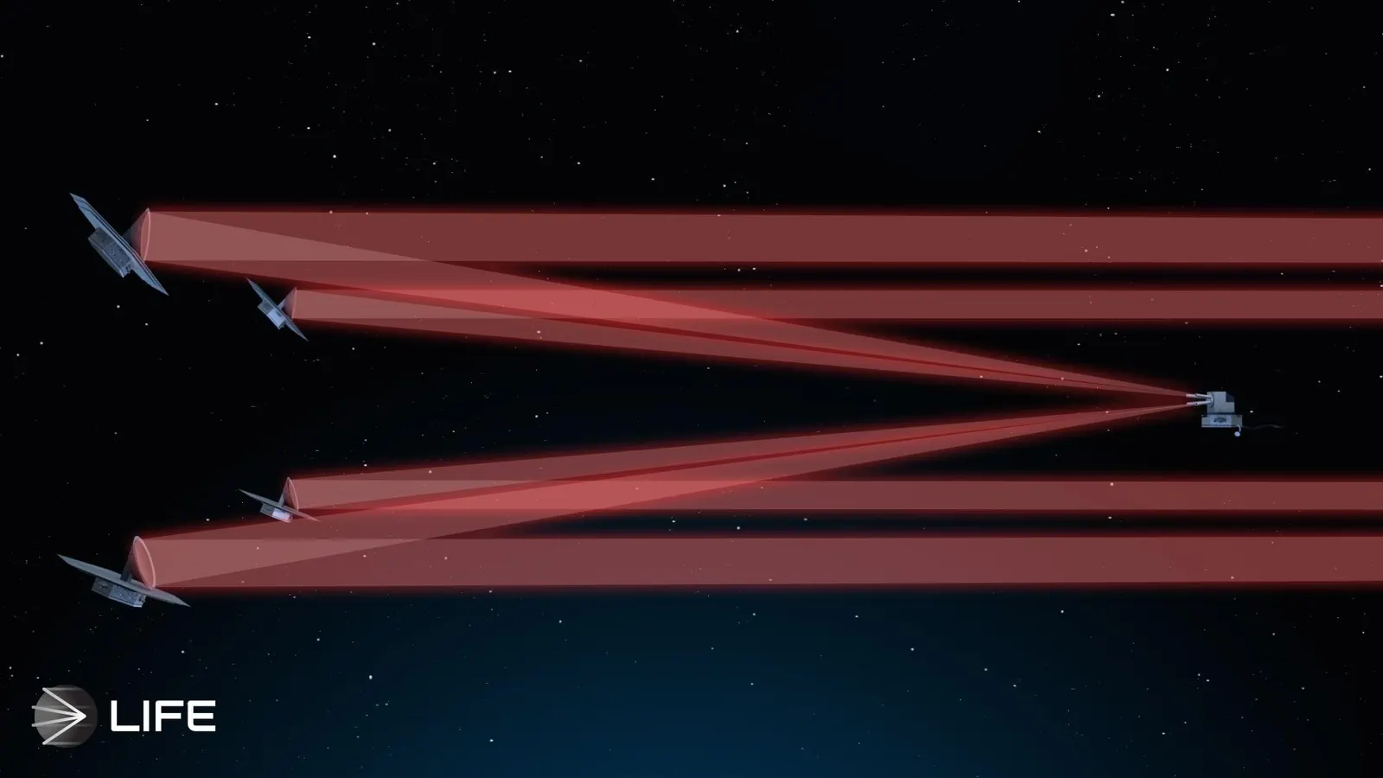
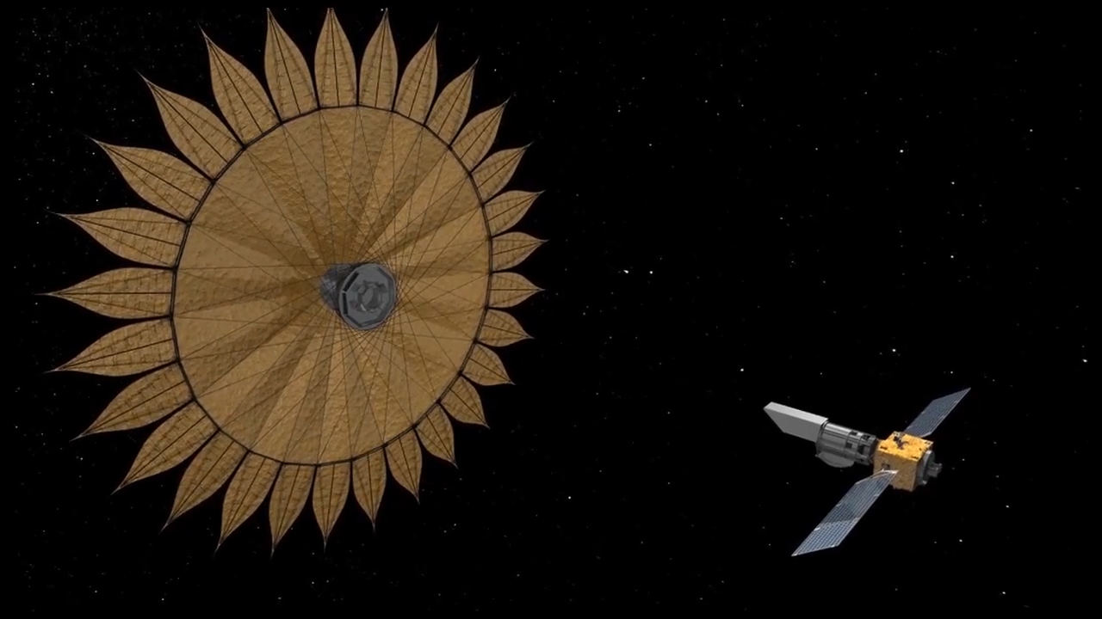
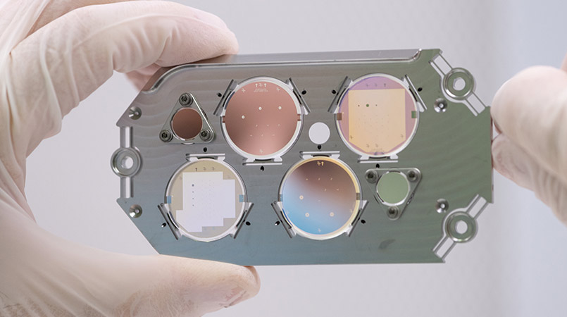
Starlight removal
A
The context of coronagraphy
The coronagraph is part of a family of optics that can remove on-axis light.
Nulling interferometry
External occulter
Coronagraph
A&B are outside the scope.
LIFE INITIATIVE / ETH ZURICH.
B
Credit: NASA/JPL-Caltech
C
Credits: NASA/JPL-Caltech
David Doelman
SSW 2024 - Coronagraphy

Slide 9
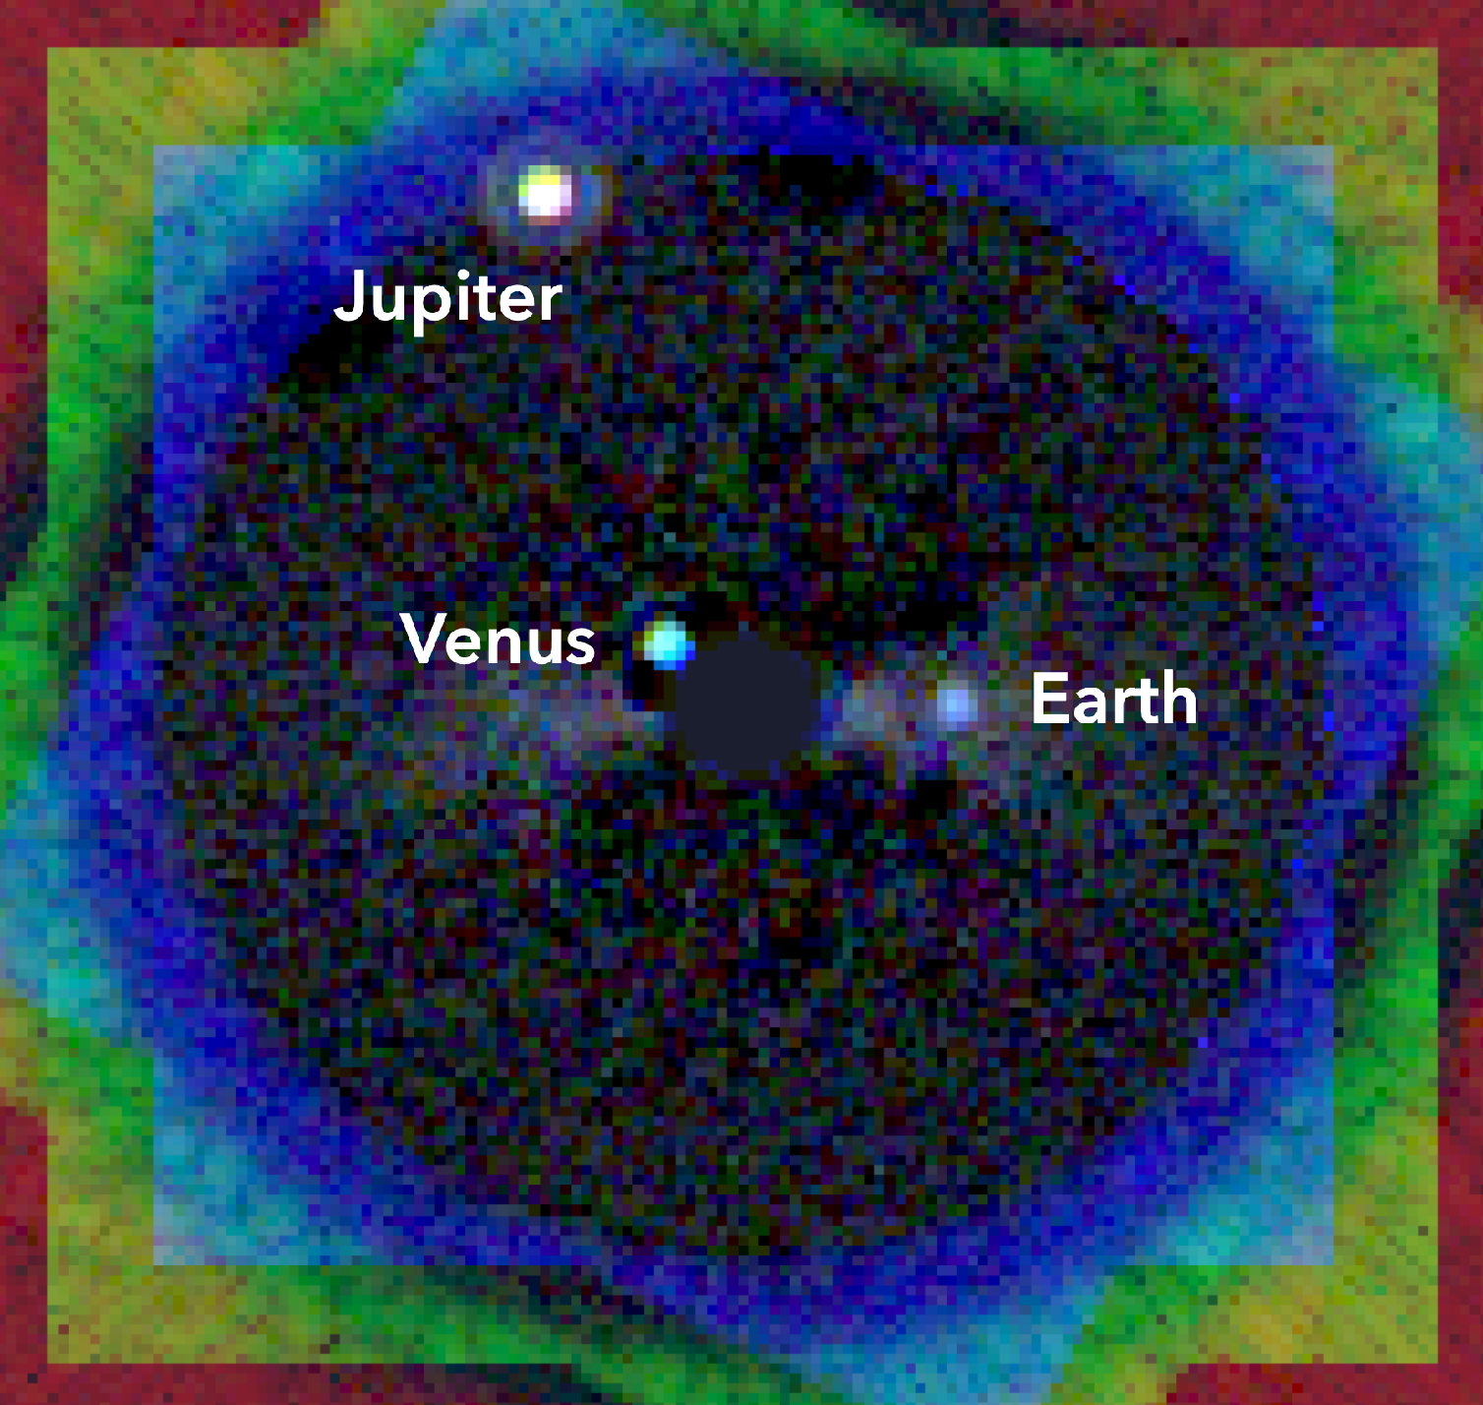
How can we remove the light of the star?
Planet 1
10⁻⁹
?
Planet 2
10⁻⁹
Planet 3
10⁻¹⁰
Credit: R. Juanola Parramon, N. Zimmerman, A. Roberge (NASA GSFC)
Telescope image without coronagraph
Telescope image with coronagraph
David Doelman
SSW 2024 - Coronagraphy

Slide 10
Use a coronagraph!
David Doelman
SSW 2024 - Coronagraphy

Slide 11
My definition of a coronagraph
A coronagraph is an optical system that blocks on-axis (star) light while transmitting off-axis (planet) light.
David Doelman
SSW 2024 - Coronagraphy

Slide 12
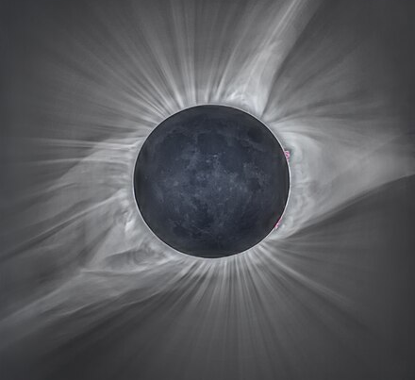
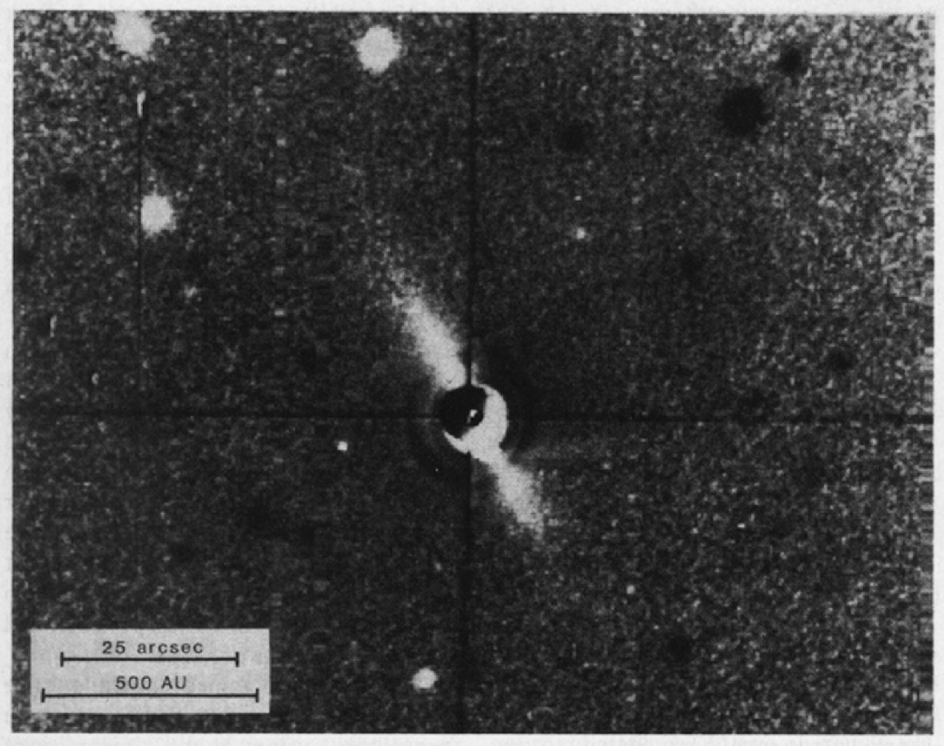
History of the coronagraph
Solar corona
Named after the masks used to image the Sun’s corona
Is the moon the first coronagraph?
Developed by Bernard Lyot in 1930
-> Lyot coronagraph
First extra-solar system astronomy by Smith and Terrile.
Used for observations of circumstellar disks around Beta Pictoris
Image by Michael Adler
Beta Pictoris disk
(Smith & Terrile 1984)
David Doelman
SSW 2024 - Coronagraphy

Slide 13
Clear aperture
Simple
Rotational symmetry
Enables 1D optimization
Ideal for coronagraphy
Need off-axis telescope
(Smith & Terrile 1984)
David Doelman
SSW 2024 - Coronagraphy

Slide 14
High-contrast imaging instrument Layout
A
B
C
D
Pre-apodizer
Focal plane mask
Lyot Plane
Science camera
Apodization: purposely changing the input intensity profile of an optical system
(Smith & Terile 1984)
David Doelman
SSW 2024 - Coronagraphy

Slide 15
The Lyot coronagraph
A
B
C
D
David Doelman
SSW 2024 - Coronagraphy

Slide 16
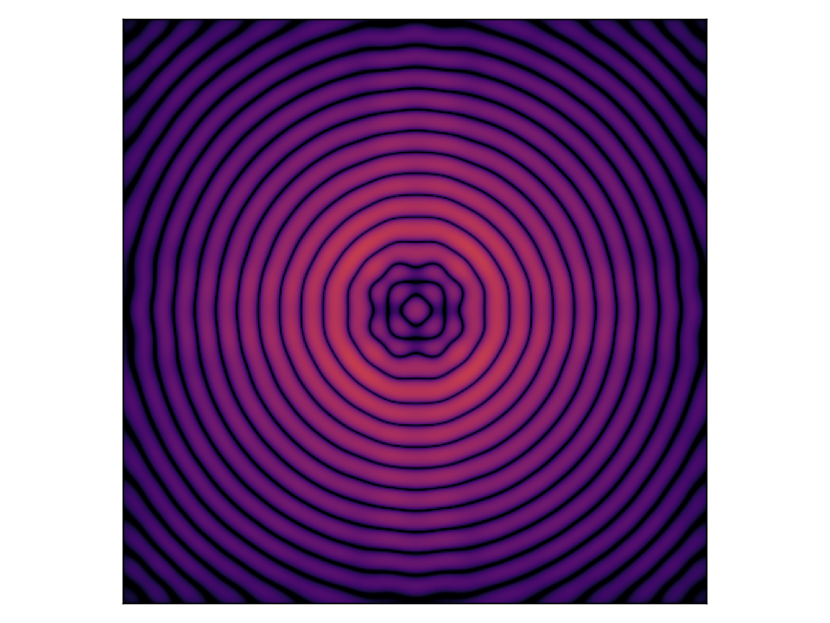
The Lyot coronagraph
A
B
C
D
David Doelman
SSW 2024 - Coronagraphy

Slide 17
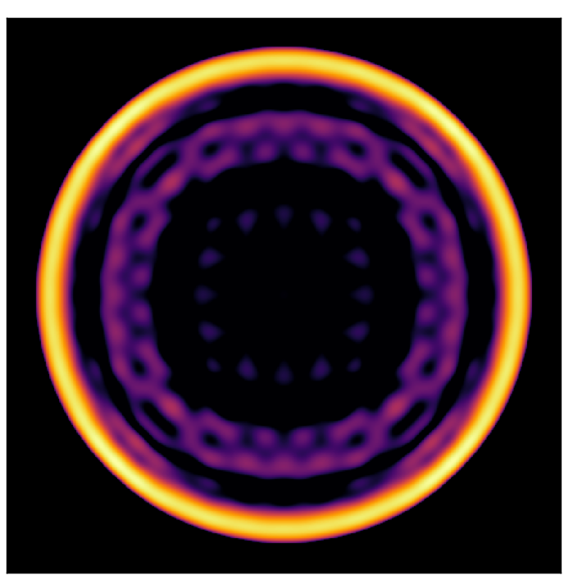
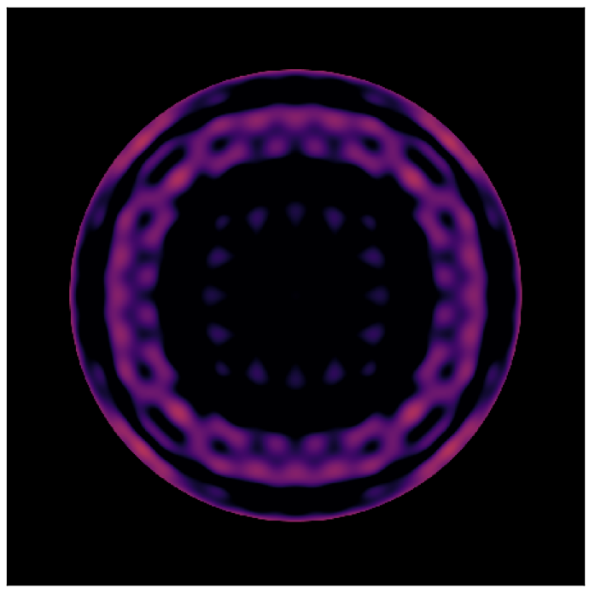
The Lyot coronagraph
A
B
C
D
David Doelman
SSW 2024 - Coronagraphy

Slide 18
The Lyot coronagraph
A
B
C
D
David Doelman
SSW 2024 - Coronagraphy

Slide 19
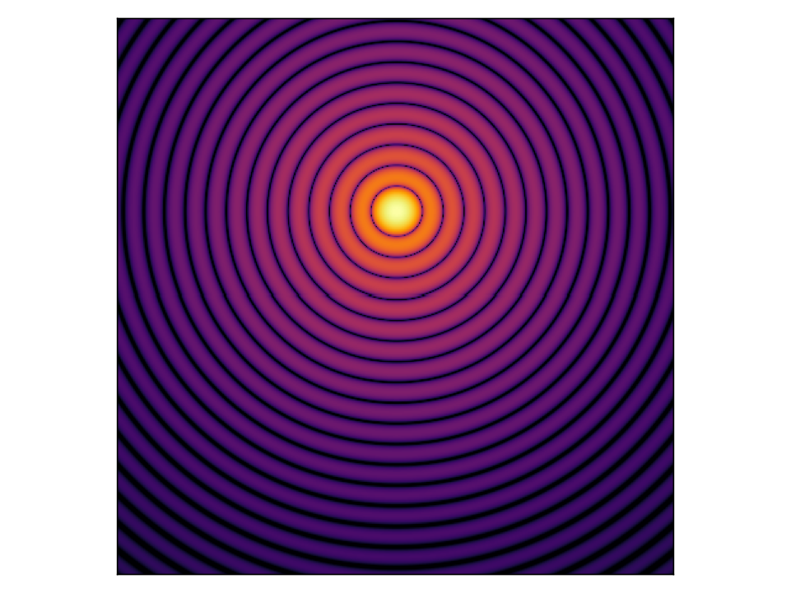
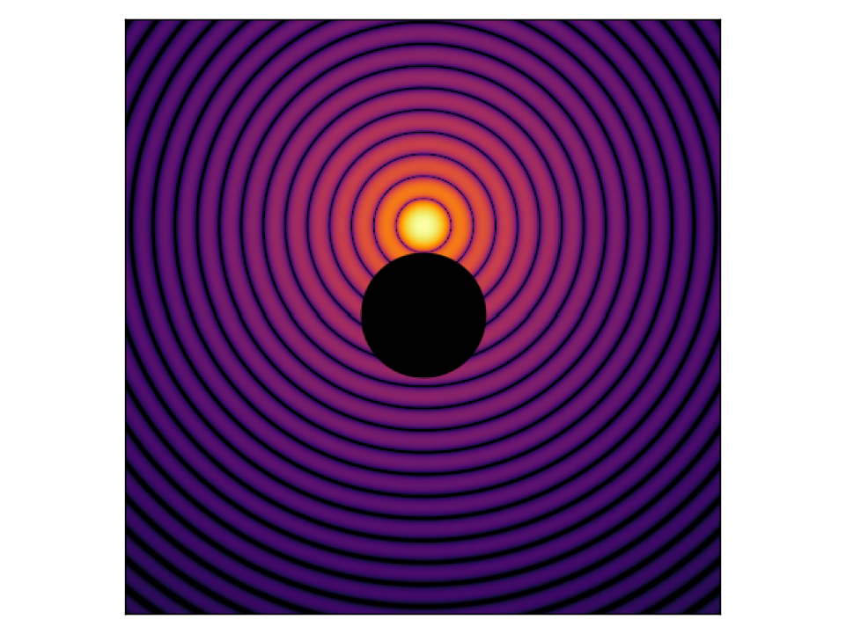
The Lyot coronagraph
A
B
C
D
David Doelman
SSW 2024 - Coronagraphy

Slide 20
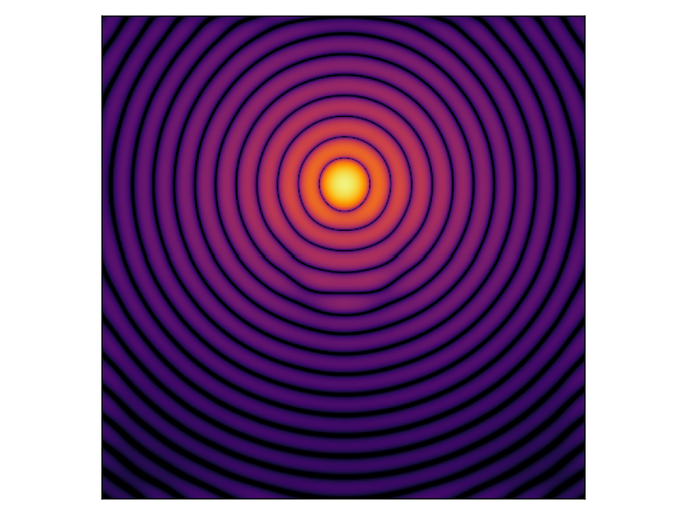
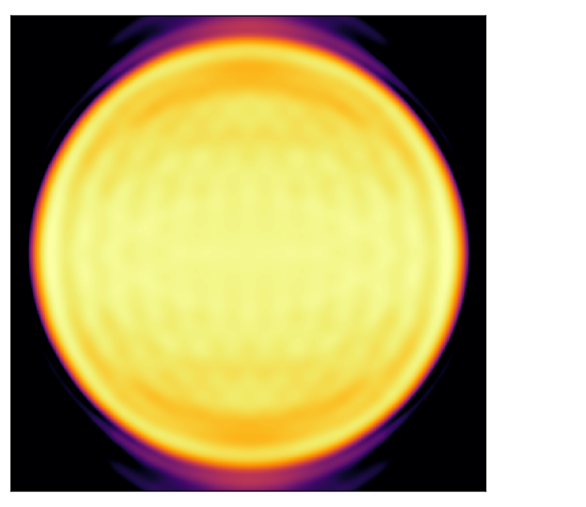
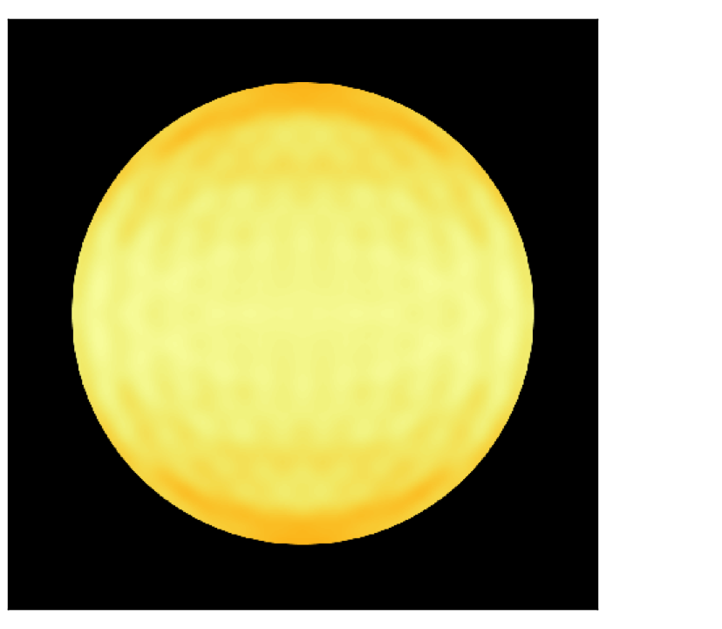
The Lyot coronagraph
A
B
C
D
David Doelman
SSW 2024 - Coronagraphy

Slide 21
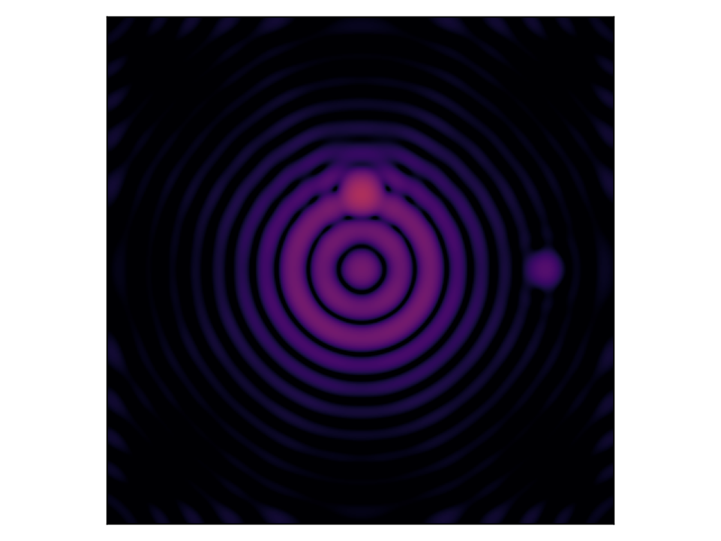
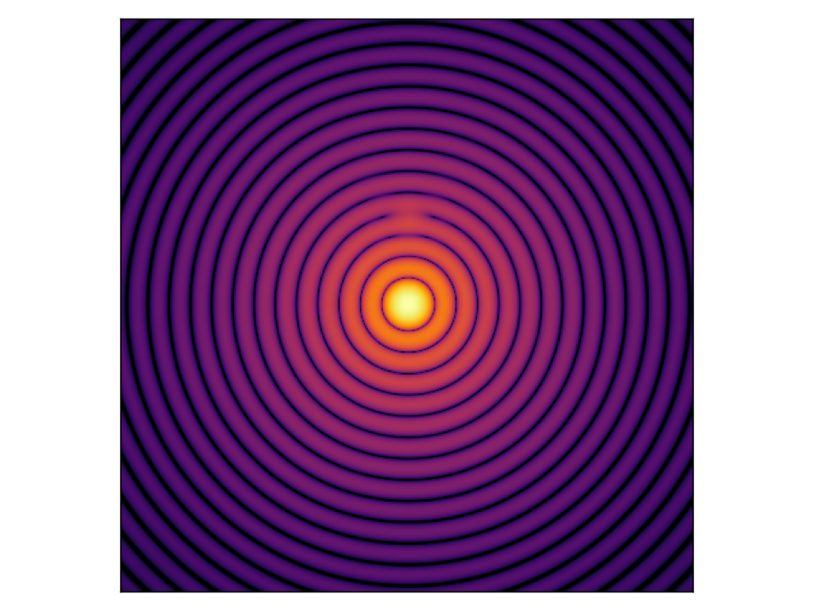
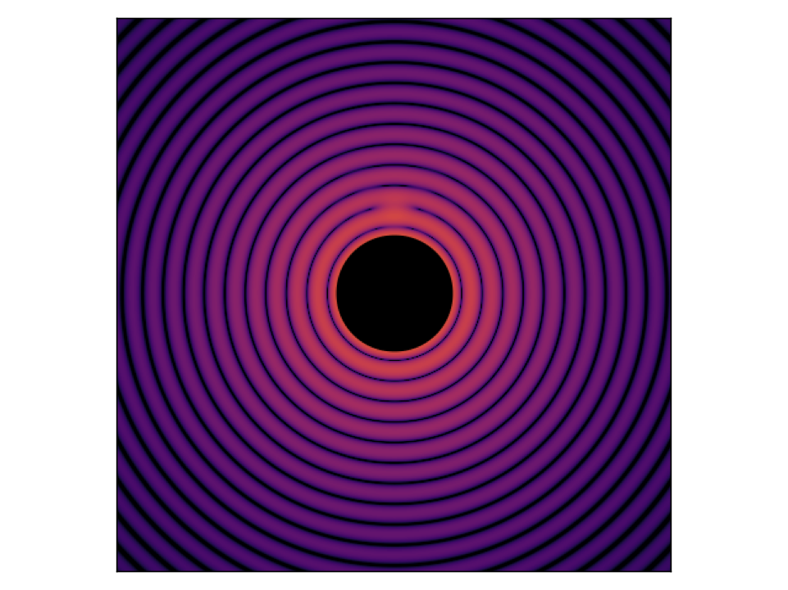
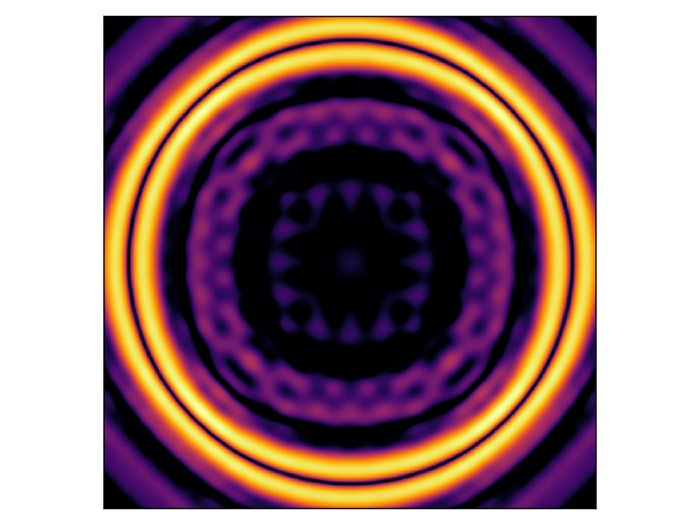
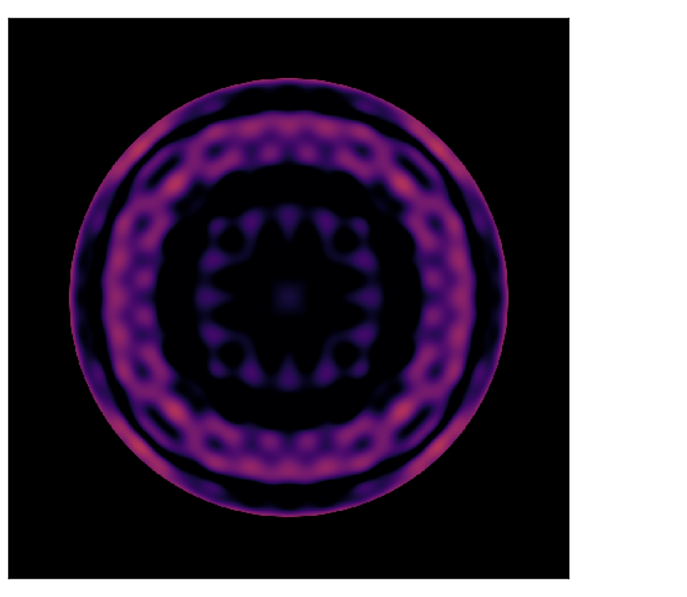
The Lyot coronagraph
A
B
C
D
David Doelman
SSW 2024 - Coronagraphy

Slide 22
Five general performance metrics
Raw contrast -> how much is the starlight suppressed?
Planet throughput -> how much planet light comes through?
Contrast -> What is the signal to noise ratio of an off-axis planet?
Inner working angle -> how close can you find planets to a star?
Robustness -> how robust is the coronagraph to aberrations or stellar diameter
David Doelman
SSW 2024 - Coronagraphy

Slide 23
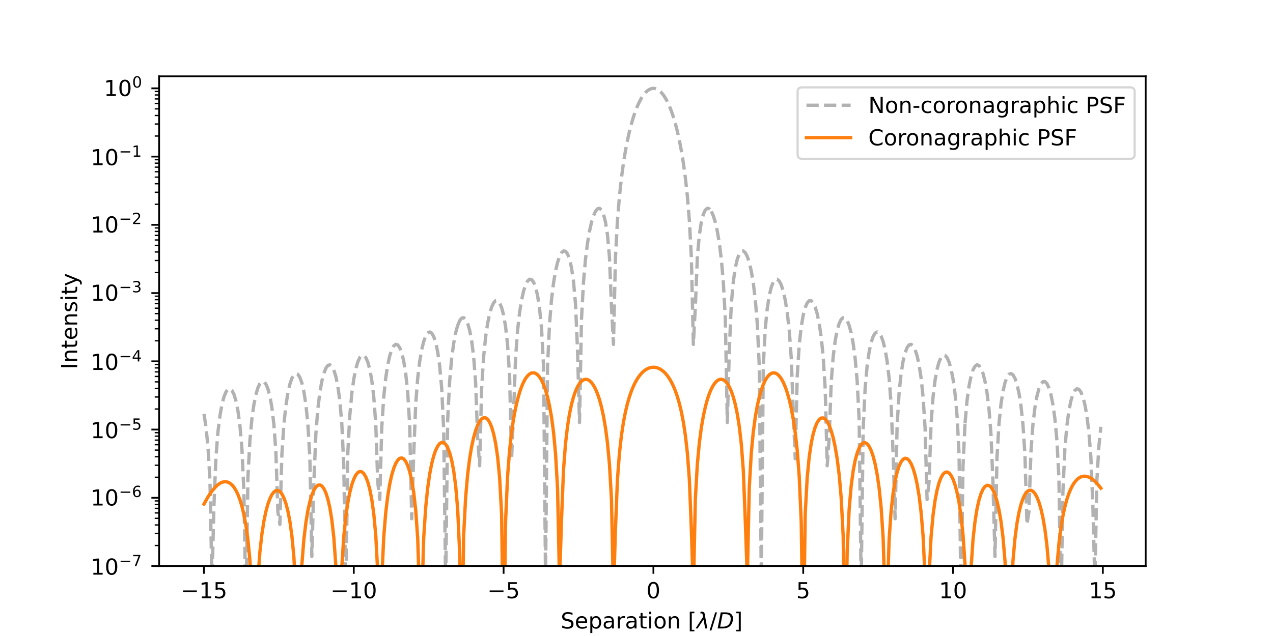
Raw contrast: my definition
how much is the starlight suppressed?
Raw contrast is the normalized intensity of the residual starlight after the coronagraph as function of position.
Raw contrast
10⁻⁴
10⁻⁵
David Doelman
SSW 2024 - Coronagraphy
Notes:
Take a slice: Suppression is different per location. Center the difference is big, outside it is less. The maximum flux is helpful because we can now integrate longer on the detector without saturation. So next question is, how can we detect planets using this raw contrast

Slide 24
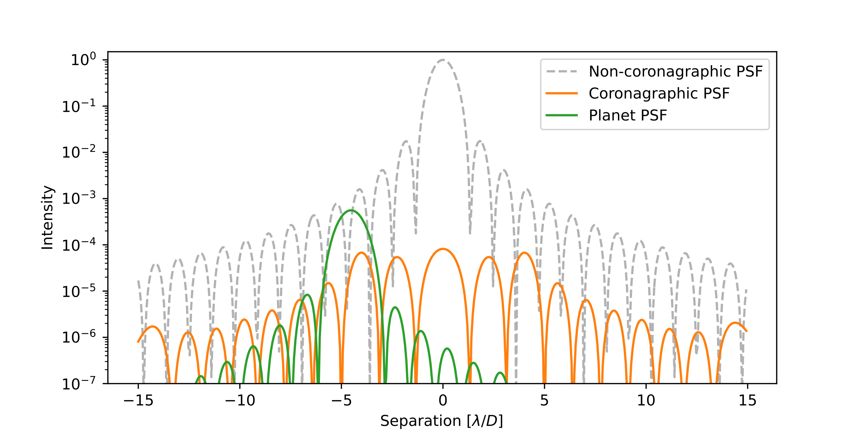
Raw contrast: my definition
how much is the starlight suppressed?
Planets have a finite size (core diameter ~2λ/DLyot) -> relative intensity per pixel is not a useful metric. Sum over all pixels with planet light in circular aperture.
David Doelman
SSW 2024 - Coronagraphy

Slide 25
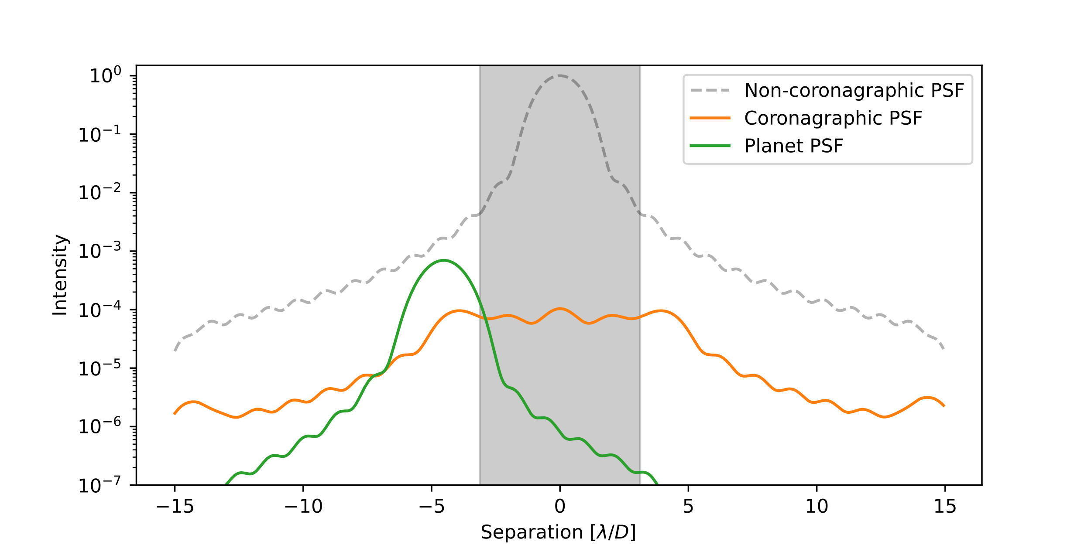
Raw contrast: my definition
Photometric aperture
how much did you suppress your starlight?
Raw contrast
10⁻⁶
10⁻⁴
Photometric aperture
Lyot mask
David Doelman
SSW 2024 - Coronagraphy

Slide 26
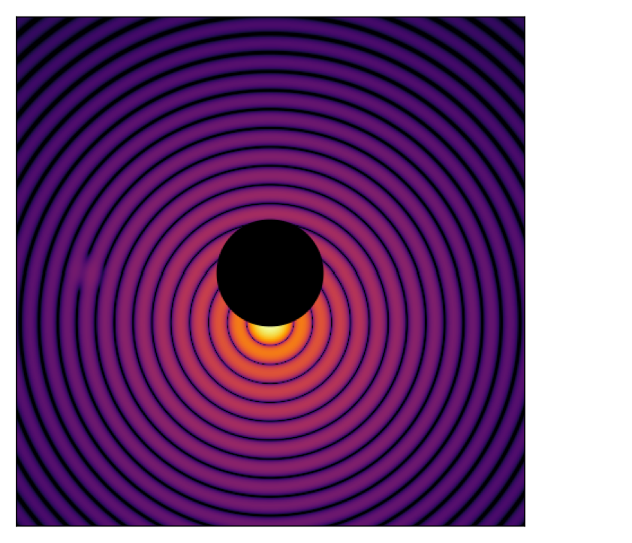
Planet throughput
How much planet light comes through?
To remove the starlight we are also removing light from the planet
We have reduced the diameter of the Lyot stop
Off-axis planet light is blocked by the focal plane mask
To understand coronagraph performance, we need to calculate its off-axis throughput
It is easy to remove all starlight, it is difficult to do so while maximizing planet throughput
Pupil
Lyot stop
David Doelman
SSW 2024 - Coronagraphy

Slide 27
Planet throughput
How much planet light comes through?
Mask focal plane
Lyot Stop
Coronagraphic PSF
David Doelman
SSW 2024 - Coronagraphy

Slide 28
Planet throughput
Coronagraph introduces PSF deformation -> astrometric error
David Doelman
SSW 2024 - Coronagraphy

Slide 29
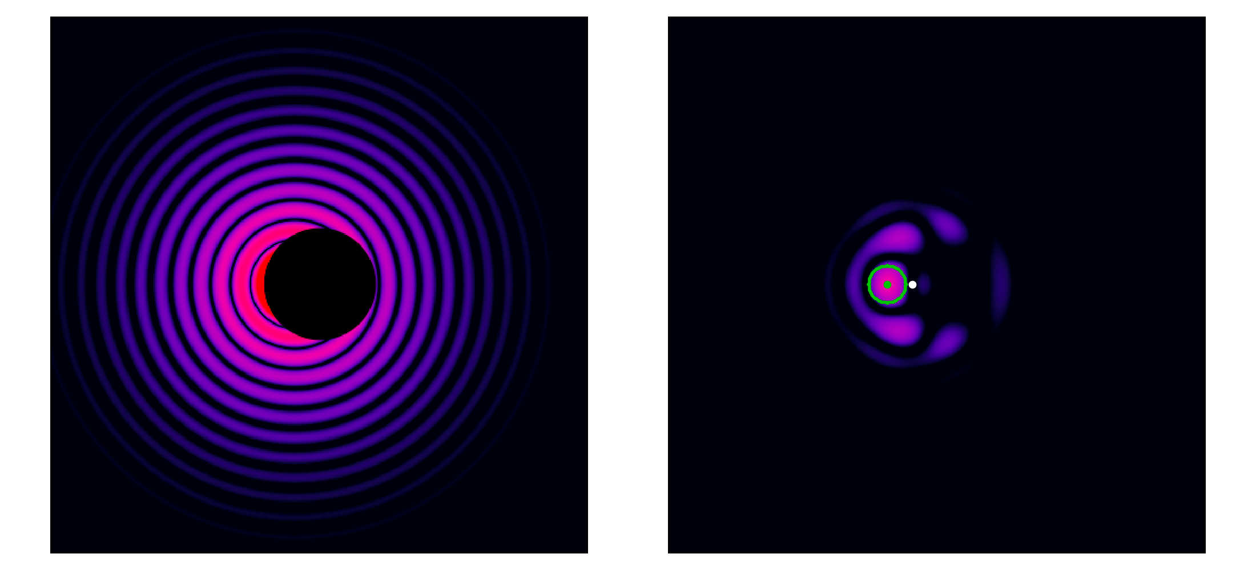
Planet throughput
Coronagraph introduces PSF deformation -> astrometric error
Detection inside mask radius?
David Doelman
SSW 2024 - Coronagraphy

Slide 30
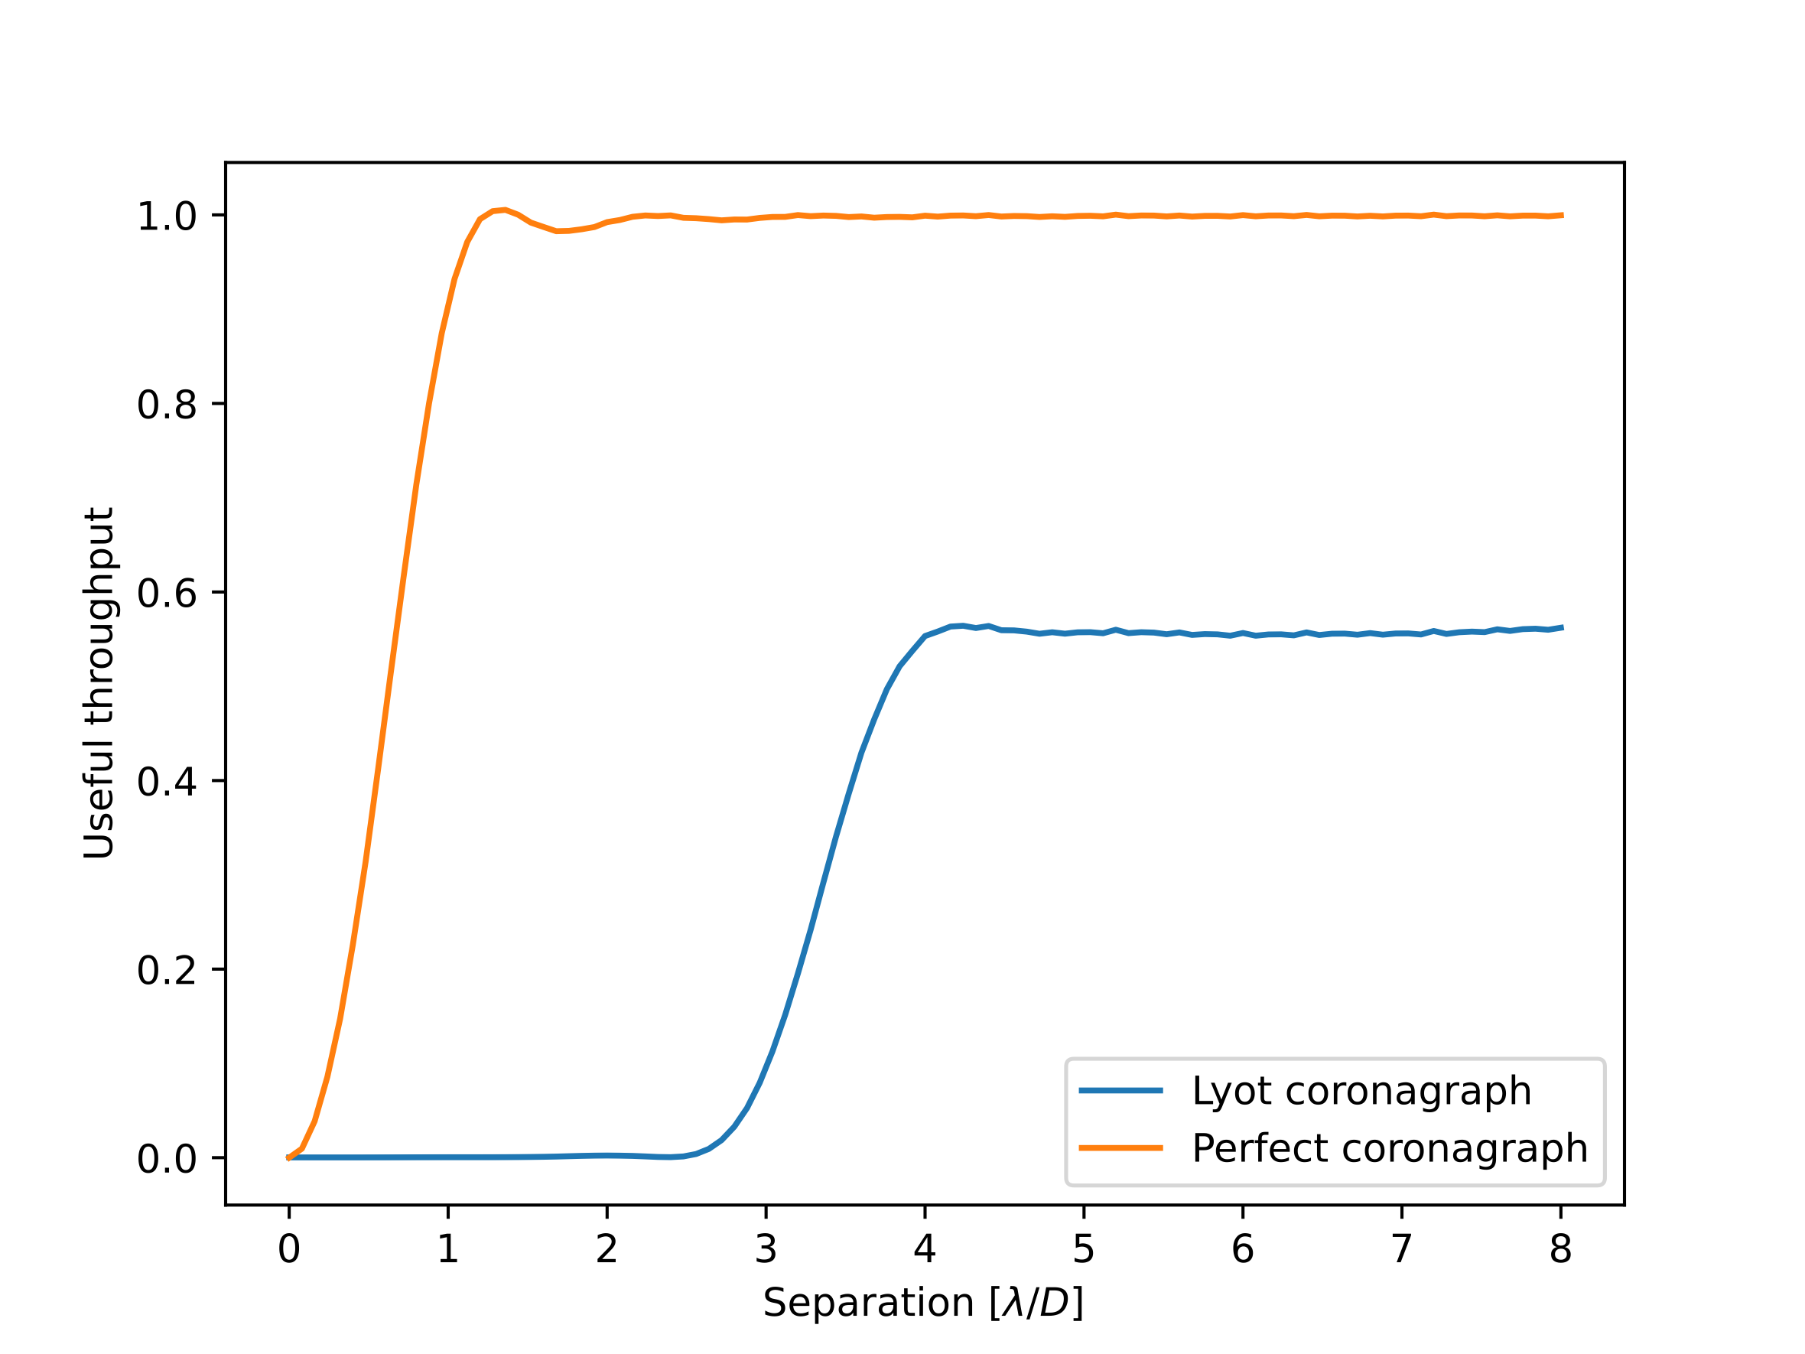
Planet throughput
How much planet light comes through?
Performance far away from ideal.
Off-axis throughput limited by Lyot stop
Perfect
Lyot
David Doelman
SSW 2024 - Coronagraphy

Slide 31
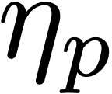
Contrast
A
B
B
A
David Doelman
SSW 2024 - Coronagraphy

Slide 32
Contrast
A
B
B
Contrast, or the contrast gain, takes into account the off-axis throughput
If gain in contrast is 10, but off-axis throughput is 1/10, you don’t gain anything!
A
David Doelman
SSW 2024 - Coronagraphy

Slide 33
The inner working angle
How close can you find planets to a star?
The common definition. For the inner working angle (IWA) is: The separation where the throughput is 50% of the maximum off-axis throughput
Depends on how you define throughput!
We used flux inside 2*λ/D aperture
IWA
0.6 λ/D
IWA
3.3 λ/D
David Doelman
SSW 2024 - Coronagraphy

Slide 34
The inner working angle
How close can you find planets to a star?
The common definition. For the inner working angle (IWA) is: The separation where the throughput is 50% of the maximum off-axis throughput
There is still useful throughput -> It is possible to detect planets inside the IWA!
And what about the local slope? Same IWA, but which one detects planets closer in?
IWA
3.3 λ/D
Unspecified coronagraph
David Doelman
SSW 2024 - Coronagraphy

Slide 35
Robustness
How robust is the coronagraph to aberrations or stellar diameter
Which coronagraph is most sensitive to off-axis sources?
Which coronagraph is most robust against telescope pointing errors? other aberrations?
Which coronagraph is most robust against stellar diameter?
IWA is always a trade-off with robustness against aberrations.
IWA
3.3 λ/D
Unspecified coronagraph
David Doelman
SSW 2024 - Coronagraphy

Slide 36
Robustness
Lyot robustness to aberrations
Decreased robustness to aberrations with a smaller mask
Aggressive masks that minimise the IWA will be more sensitive to aberrations
Every coronagraph has a different trade-off
Different coronagraphs is sensitive to different aberrations
David Doelman
SSW 2024 - Coronagraphy

Slide 37
Five general performance metrics
Raw contrast -> how much did you suppress your starlight?
Planet throughput -> how much planet light comes through?
Contrast -> What is the signal to noise ratio of an off-axis planet?
Inner working angle -> how close can you find planets to a star?
Robustness -> how robust is the coronagraph to aberrations or stellar diameter
David Doelman
SSW 2024 - Coronagraphy

Slide 38
The Lyot coronagraph, design options
Can we optimize the performance?
FPM
The Lyot coronagraph does not filter all the starlight
Can we change the design of the masks to improve the performance?
No -> perfect null is not achievable!
The FPM introduces diffraction identical to a black mask with a hole of the same diameter (Babinet’s principle)
We are not removing/correcting this diffraction
Lyot
Dtel
David Doelman
SSW 2024 - Coronagraphy

Slide 39
How to make a better coronagraph
Modifying the electric field: E = A * e^{(i φ)}
Amplitude apodization
Removing light only
Residuals can destructively interfere
Phase apodization
Change the phase locally
Can relocate and destructively interfere light
Light can have an amplitude of -1
Imag
A
A
φ
Real
Imag
A
φ
φ
Real
David Doelman
SSW 2024 - Coronagraphy

Slide 40
Pupil plane apodization
Star and planet light different angle but same position
Apodizing the light modifies both star and companion!
Any pupil plane apodization reduces the planet throughput
Physical size of the beam is large
Easier to manufacture
Destructively interfere starlight in a region (= Dark zone)
A
David Doelman
SSW 2024 - Coronagraphy

Slide 41
Pupil plane apodization
Shaped pupil coronagraph (SPC)
Amplitude apodization: two-sided dark zones only (Fourier Theory)
Phase apodization: one-sided dark zones
Apodized phase plate (APP)
David Doelman
SSW 2024 - Coronagraphy

Slide 42
Pupil plane apodization
Por. 2017
Amplitude apodization: two-sided dark zones only (Fourier Theory)
Phase apodization: one-sided dark zones
Optimization of single plane is solved!
Phase-only is always (slightly) better (Por. 2017)
Transmission
But phase is chromatic!* And amplitude mask manufacturing is ‘easy’.
David Doelman
SSW 2024 - Coronagraphy

Slide 43
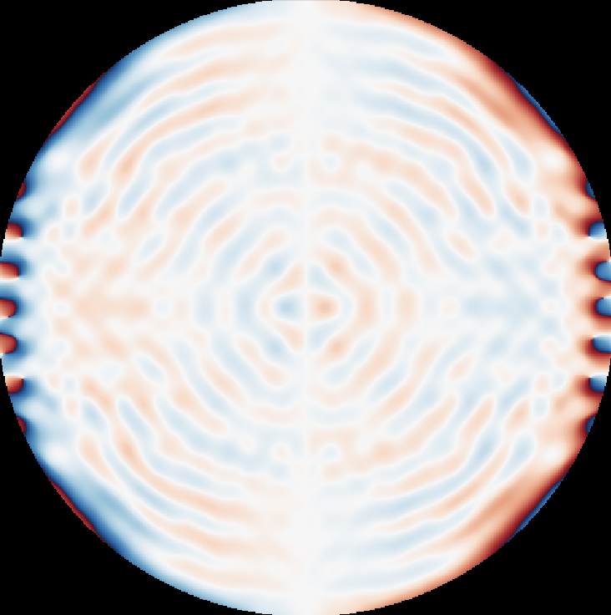
Pupil plane apodization
Amplitude apodization: two-sided dark zones only (Fourier Theory)
Phase apodization: one-sided dark zones
Optimisation of single plane is solved!
Phase-only is always (slightly) better (Por. 2017)
But phase is chromatic!* And amplitude mask manufacturing is ‘easy’.
How to define IWA? What about throughput?
Apodizing the light modifies both star and companion!
David Doelman
SSW 2024 - Coronagraphy

Slide 44
Focal plane apodization
Star and planet different location
Can apodize the star and planet separately!
Goal: diffract starlight out of the beam
B
C
David Doelman
SSW 2024 - Coronagraphy

Slide 45
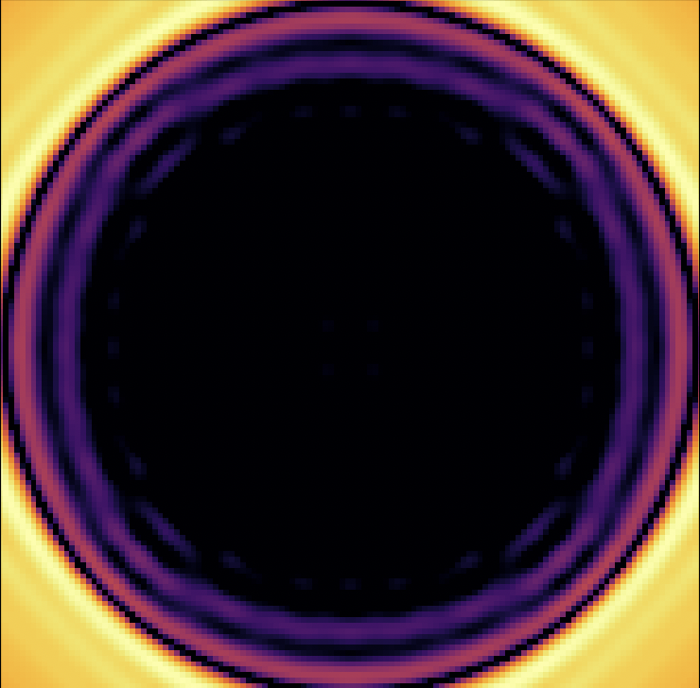
Focal plane apodization: Roddier&Roddier mask
Change to phase apodization
Roddier & Roddier mask
More efficient
‘Amplitude’ mask of -1
Still no optimal solution
Chromatic*
Lyot
R&R
B
C
David Doelman
SSW 2024 - Coronagraphy

Slide 46
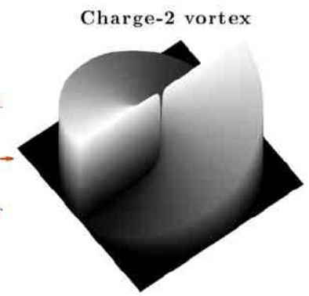
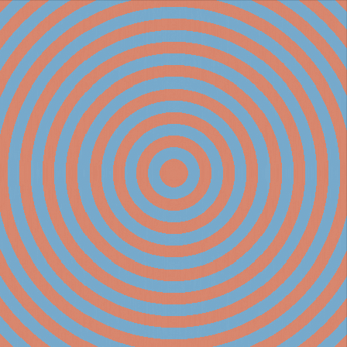
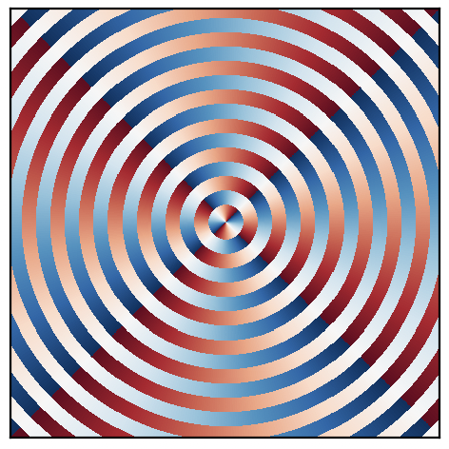
Vortex coronagraph
Azimuthal phase pattern
Charge is the amount the phase goes through 0
Even charges deliver optimal performance for clear apertures
Perfect rejection proof: see Mawet et al. 2005, Appendix C
Delacroix et al. 2014
A
B
Phase
PSF
PSF
Phase
David Doelman
SSW 2024 - Coronagraphy

Slide 47
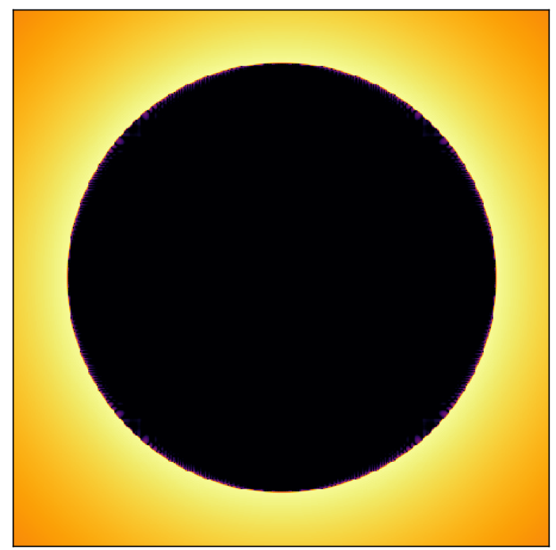
Vortex coronagraph
A
B
C
D
Phase
David Doelman
SSW 2024 - Coronagraphy

Slide 48
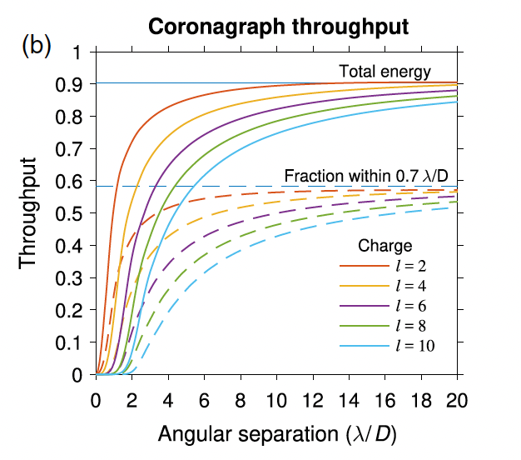
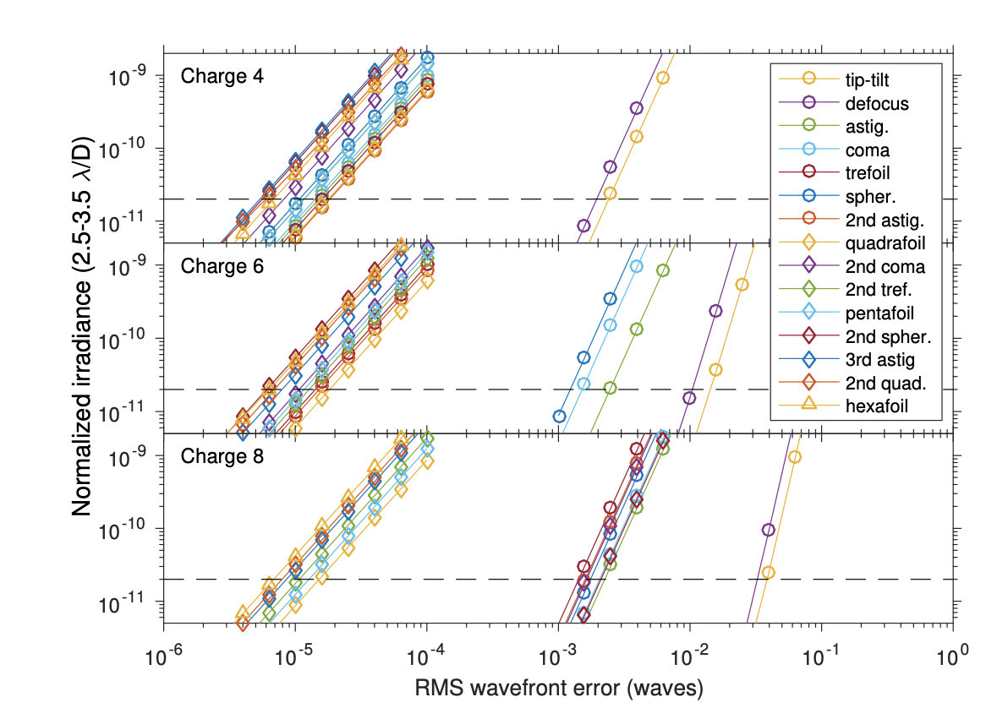
Vortex coronagraph
Ruane et al. 2017
David Doelman
SSW 2024 - Coronagraphy

Slide 49
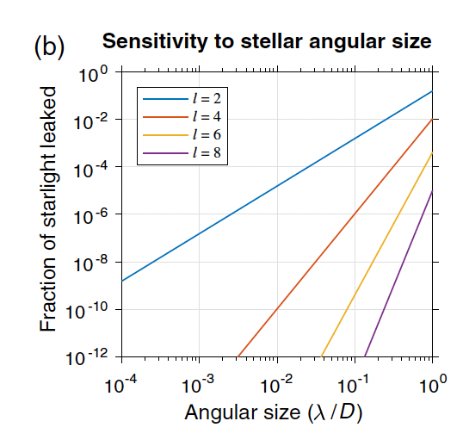
Vortex coronagraph
Impact of stellar diameter can be huge
Even a diameter 10⁻⁴ diffraction limit creates a signal for charge 2
Nearby targets are ideal -> resolve the habitable zone
Might be difficult due to stellar angular size!
Ruane et al. 2017
David Doelman
SSW 2024 - Coronagraphy

Slide 50
Vortex coronagraph
Chromaticity
David Doelman
SSW 2024 - Coronagraphy

Slide 51
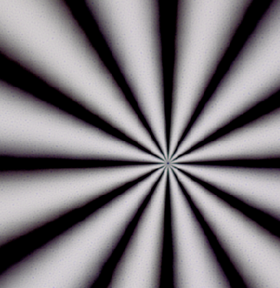
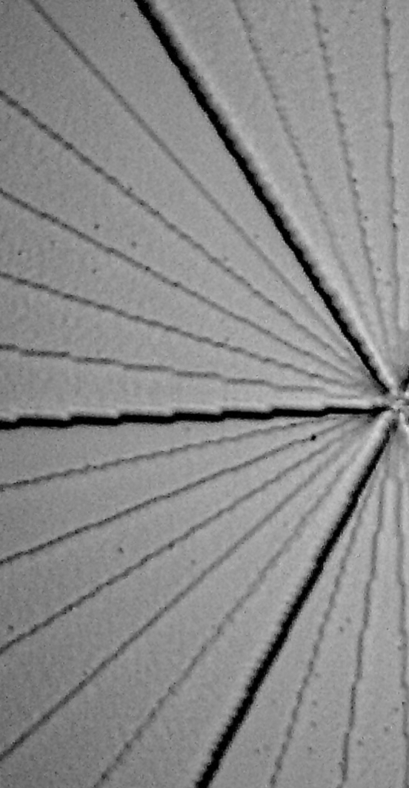
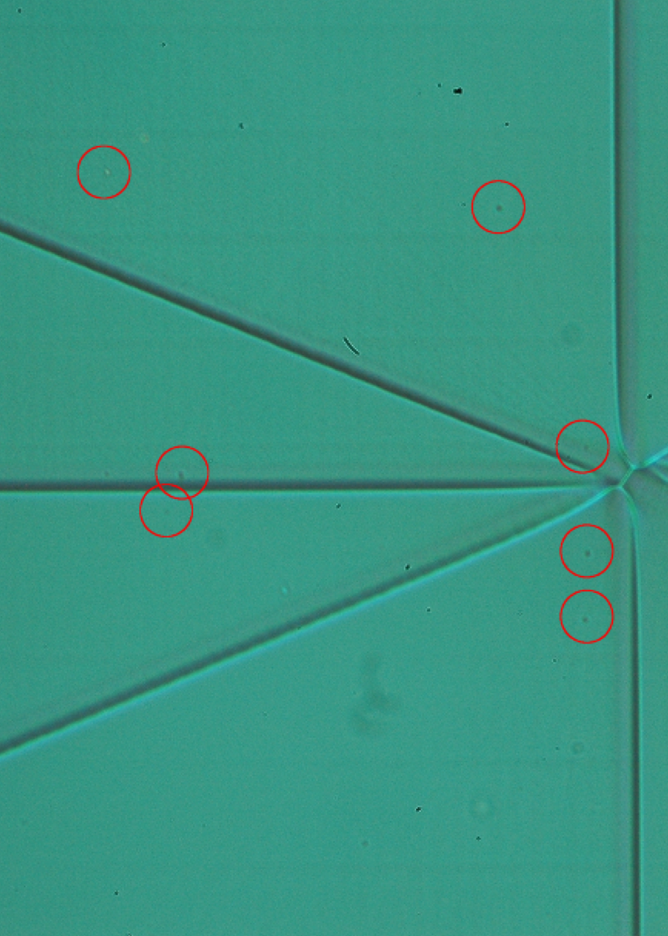
Engineering achromatic vortex masks
Scalar vortex Vector vortex
Desai et al. 2021,2023
Galicher et al. 2020
Mawet et al. 2009
Vargas Catalan et al. 2018
Stepped vortex
Wrapped vortex
Liquid-crystal retarder
Sub- wavelength gratings
+phase dimple
König et al. 2023
Palatnick et al. 2023
Doelman et al. 2020
Meta-surfaces
Liquid-crystal vortex grating mask
Chromatic phase*
No polarization effects
Achromatic phase
Chromatic polarization effects
David Doelman
SSW 2024 - Coronagraphy

Slide 52
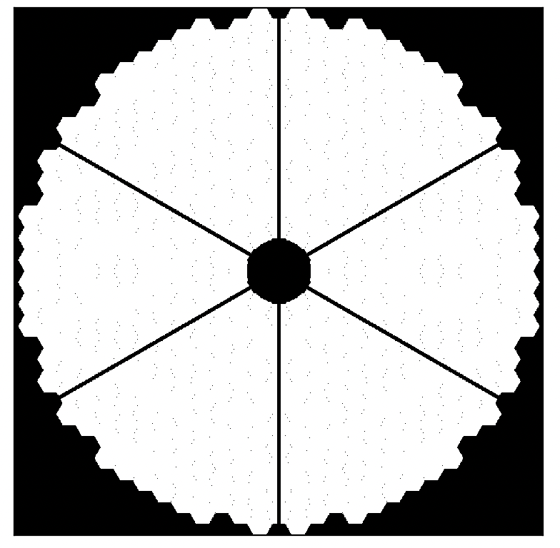
On-axis telescope
Secondary obscuration and spiders block light coming into the telescope
Fundamentally reduces the performance of coronagraphs
Numerical optimization only
All 8-m class telescopes have different pupils with secondary.
Warning: many solutions for many different telescopes and instrument architectures!
A
David Doelman
SSW 2024 - Coronagraphy

Slide 53
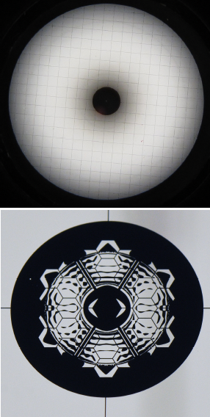
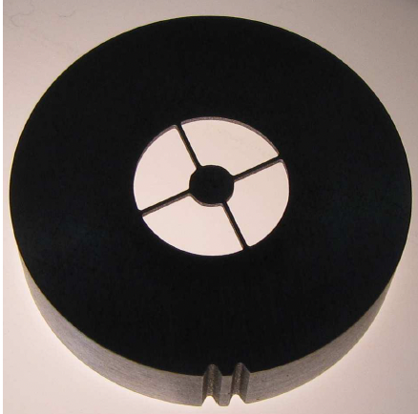
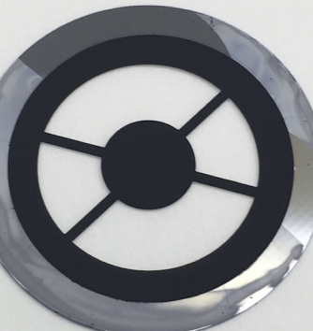
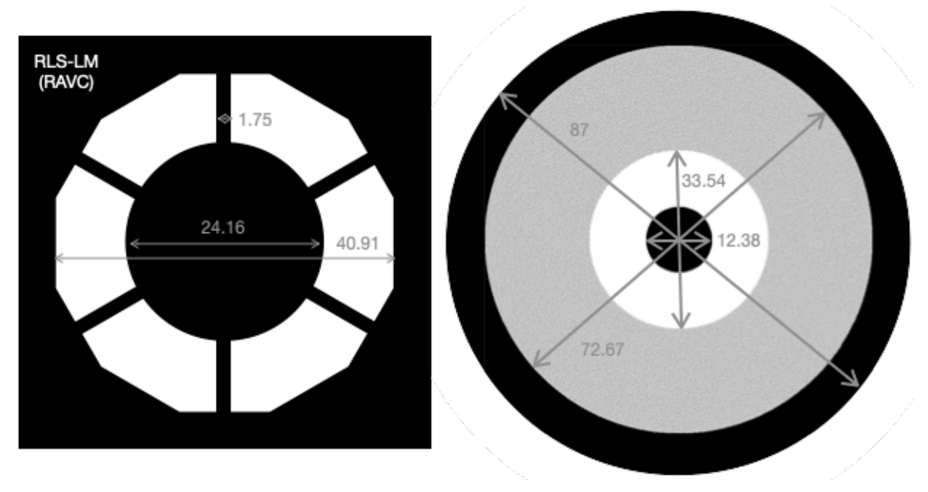
Amplitude apodization
Gray-scale APLC
Sivaramakrishnan
et al. (2010),
Binary APLC
Soummer
et al. (2018)
RAVC
Absil et al. (2024)
A
B
C
D
David Doelman
SSW 2024 - Coronagraphy

Slide 54
DM assisted - apodized vortex coronagraph
Deformable mirrors
Relay optics
A
B
C
D
Ruane et al. 2017
David Doelman
SSW 2024 - Coronagraphy

Slide 55
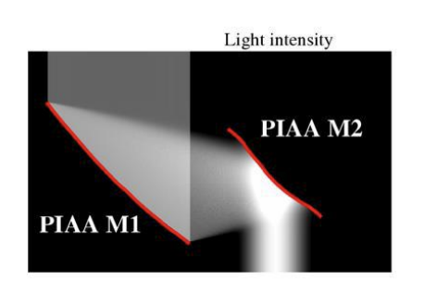
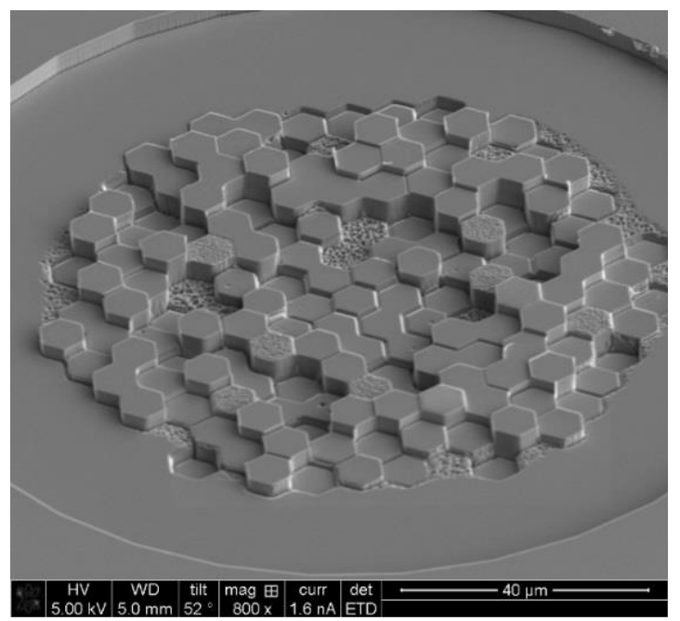
Phase Induced Amplitude Apodization
Credit Olivier Guyon
PIAA - Complex Mask Coronagraph
Knight et al. 2018
PIAA
D
A
B
C
David Doelman
SSW 2024 - Coronagraphy

Slide 56
David Doelman
SSW 2024 - Coronagraphy

Slide 57
Guyon et al. 2006
David Doelman
SSW 2024 - Coronagraphy

Slide 58
Why are there sooo many coronagraphs?
Too many acronyms
Current coronagraphs are part of an imperfect, active system that is not optimized for the coronagraph
Continuous development for the last 25 years
Theory and optimization keep improving
Manufacturability and timeline is major driver
What to do for HWO?
Need fair theoretical and laboratory comparison
David Doelman
SSW 2024 - Coronagraphy

Slide 59
Why are there sooo many coronagraphs?
Exoplanet yield calculations
Coronagraph parameters
Create a fake population of exoplanets
Simulate observing sequence
Take into account noises, aberrations, and coronagraph parameters
How many exoplanets did you find?
Can we optimize the observatory for the coronagraph?
David Doelman
SSW 2024 - Coronagraphy

Slide 60
(Fair?) Laboratory comparison
CDS team - adapted from Mennesson et al. 2024
David Doelman
SSW 2024 - Coronagraphy

Slide 61
CLC: simply the best
Exoplanet yield calculations
CLC (DM-apodized) has the best laboratory performance
360 dark hole: 10% bandwidth, 3 to 8 λ/D 3.82 x 10⁻¹⁰
180 dark hole: 20% bandwidth, 5 to 13.5 λ/D 3.97 x 10⁻¹⁰
Contrast only: simple is better! Understand + model system-level interactions
Inner working angle is not great.
David Doelman
SSW 2024 - Coronagraphy

Slide 62
Final thoughts and takeaways
A coronagraph is an optical system that blocks on-axis starlight while transmitting off-axis light.
Current coronagraph designs do not reach the theoretical limit.
In the laboratory, coronagraphs do not reach the simulated performance
The coronagraph is part of a system, need to optimize as a whole.
The coronagraph design space is extremely complex
Many parameters impact end-to-end performance (exoplanet yield)
David Doelman
SSW 2024 - Coronagraphy

Slide 63
Final thoughts and takeaways
A coronagraph is an optical system that blocks on-axis starlight while transmitting off-axis light.
Current coronagraph designs do not reach the theoretical limit.
In the laboratory, coronagraphs do not reach the simulated performance.
The coronagraph is part of a system, need to optimize as a whole.
The coronagraph design space is extremely complex
Many parameters impact end-to-end performance (exoplanet yield)
We need you to realize the Habitable Worlds Observatory!
David Doelman
SSW 2024 - Coronagraphy

Slide 64
Back-up slides

Slide 65
The perfect coronagraph
Cavarroc et al. 2006, Guyon et al. 2006
Star
On-axis star without aberrations has a uniform intensity and flat wavefront.
Off-axis companion has tilted wavefront
A perfect coronagraph would remove all on-axis light = light with flat wavefront
…
Space
Companion

Slide 66
The perfect coronagraph
The perfect coronagraph
Cavarroc et al. 2006, Guyon et al. 2006
Star
Mathematically: Project incoming light on flat wavefront (Z0) and subtract
Simulation: Project/fit incoming light on flat wavefront and subtract
HCIPy: perfect coronagraph is implemented
…
Space
Companion

Slide 67
The perfect coronagraph
What about aberrations and resolving the star?
Perfect order 2
Perfect order 6
Aberrations are not subtracted and result in residual starlight
A resolved star is not described by a flat wavefront -> residual starlight
Extend the perfect coronagraph to higher orders
The cost is sensitivity close in.
Every mode increases the blindspot by (λ/D)²

Slide 68
The perfect coronagraph
Guyon et al. 2006
How do we make the perfect coronagraph?
Example solution for a square aperture and 16 pixels using beamsplitters and interference.
-> Not practical!
The perfect coronagraph: knowing the theoretical limit
Photonics (e.g. mode sorters) could be the solution.

