Slide 1
Estimating Planet Parameters from the Lightcurve

Slide 2
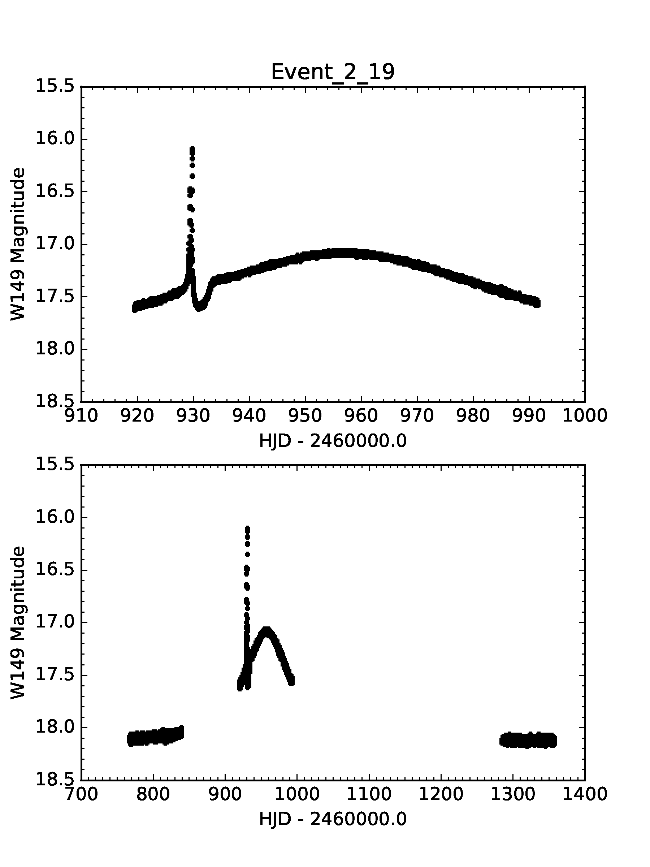
0. Choose your lightcurve (a GLPlanet)
Assumptions:
a Gould & Loeb planetary (GLPlanet) caustic crossing perturbation
No parallax
No blending

Slide 3
Goal: Estimate 7 Parameters of a 2L1S Model
t₀ = time of closest approach b/w source and lens
u₀ = impact parameter
t_{E} = Einstein timescale
s = planet-star separation
q = planet-star mass ratio
ρ = source radius
α = angle of source trajectory
relative to Einstein ring size

Slide 4
Goal: Estimate 7 Parameters of a 2L1S Model
t₀ = time of closest approach b/w source and lens
u₀ = impact parameter
t_{E} = Einstein timescale
s = planet-star separation
q = planet-star mass ratio
ρ = source radius
α = angle of source trajectory
Parameters of the Stellar Event
Parameters of the Planet
Other Parameters

Slide 5
Point Lens Parameters: t₀, u₀, t_{E}
t₀ time
@ u(t) = u₀
Source
u₀ = impact parameter
Lens
t_{E} = Einstein timescale/Einstein crossing time
Einstein Ring

Slide 6
Position of the Source: u(t)
u₀
u(t)

Slide 7
Planet Parameters: s, q, α
Binary axis
α = angle b/w binary axis and source trajectory
s = separation (projected, as a fraction of the Einstein ring)
planet

Slide 8
7th Parameter: ρ
Source radius (scaled to the Einstein ring)

Slide 9

2 Observables: Time & Magnitude

Slide 10
Relating Magnitude to Magnification
f_{blend} = 0

Slide 11
Relating Magnification to Time

Slide 12
1. Parameters of the Stellar Event: t₀
t₀ ~ 957

Slide 13
2. Parameters of the Stellar Event: u₀
0

Slide 14
2. Parameters of the Stellar Event: u₀
Δm = 18.1-17.05 = 1.05 magnitudes

Slide 15
2. Parameters of the Stellar Event: u₀
How many magnitudes (Δm) brighter does the event get? 1.05 magnitudes
What magnification (A) does that imply? 2.63
What is u₀? 0.38

Slide 16
3. Parameters of the Stellar Event: t_{E}
Use the same equations to find t_{E.}
1. u₁ = 1 → A₁ = 1.34
2. →Δm = 0.3177

Slide 17
3. Parameters of the Stellar Event: t_{E}
Notes:
delta m = 0.3177
base = 18.1
m = 17.78
t = 900
tE=57

Slide 18
4. Parameters of the Planet: s
Where is the planet?
When is the planet?
Notes:
930.15

Slide 19
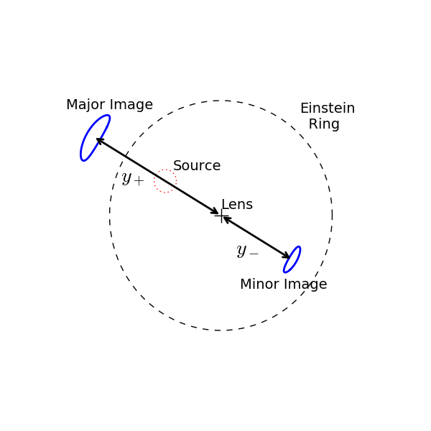
4. Parameters of the Planet: s
The planet perturbs one of the images.
Possible Planet Locations
X

Slide 20
4. Parameters of the Planet: s
Where is the source at t_{planet} = 930.15?
Notes:
930.15

Slide 21
4. Parameters of the Planet: s
u₀
Notes:
tau = -0.47105

Slide 22
4. Parameters of the Planet: s
τ → u = 0.605
y₊ = 1.35
y₋ = 0.742
Notes:
u = 0.6052

Slide 23
4. Parameters of the Planet: s
Is this a major or a minor image perturbation?

Slide 24
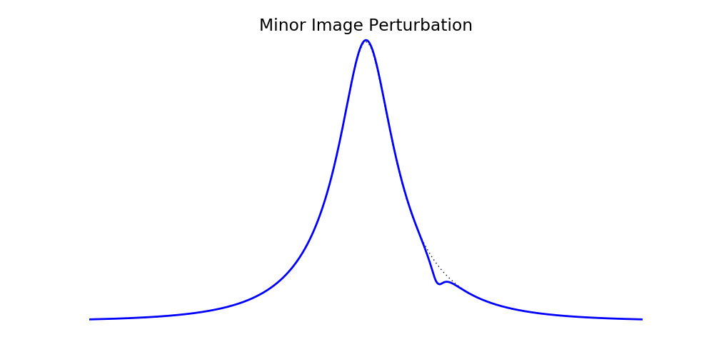

Slide 25
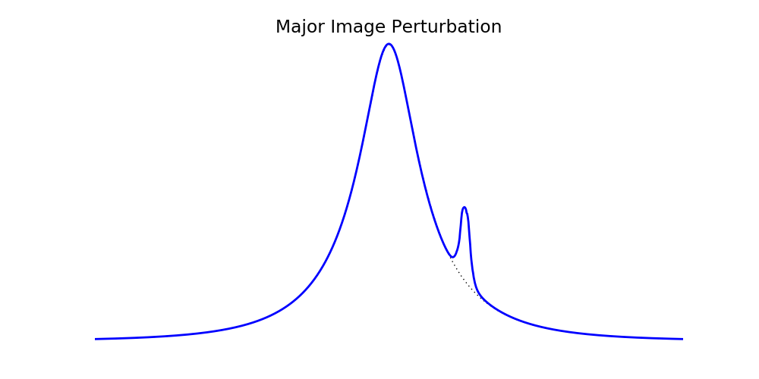
Not a dip!

Slide 26
4. Parameters of the Planet: s
Dip!
minor → s = y₋ = 0.742

Slide 27
5. Other Parameters: α
Source Trajectory
α
Binary Axis

Slide 28
5. Other Parameters: α
u₀
α = -51.1 deg = -0.892 rad
Notes:
alpha = tan-1(-0.471/0.38) = -0.892 rad = -51.10 degrees

Slide 29
5. Other Parameters: α
α
Due to different geometric conventions, the correct value of α may be π/2 or π from the value you calculate

Slide 30
What’s left? ρ and q

Slide 31
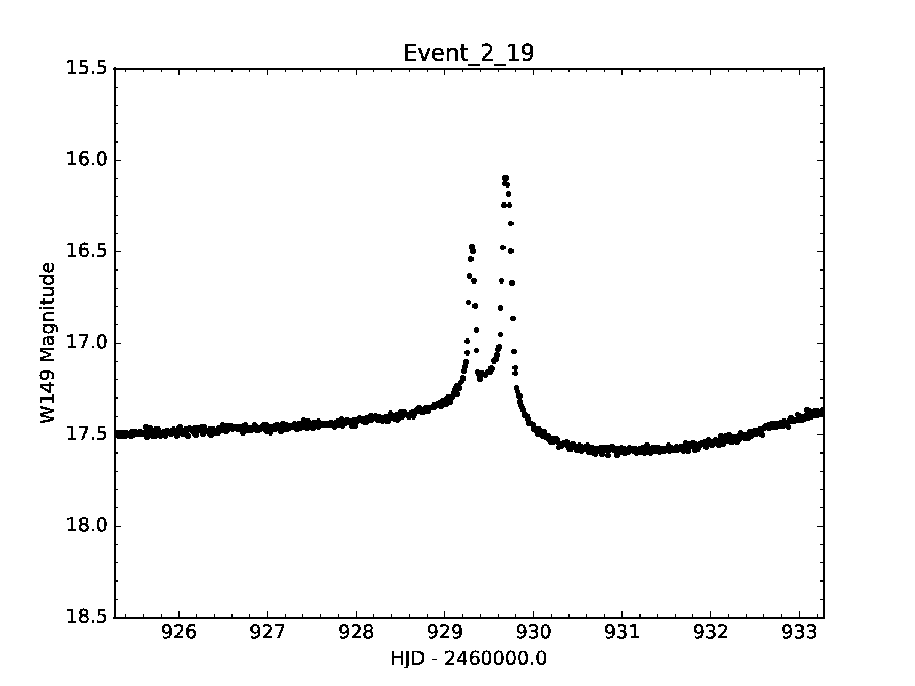
3 regimes:
minor image
ρ < caustic
major image
ρ < caustic
major image
ρ > caustic
merged peaks
distinct peaks

Slide 32
6. Major Image, ρ > caustic: ρ
Δt = 2t*
ρ = t* / t_{E}
Gould & Gaucherel 1994
Notes:
delta_t = 0.4 days
tE = 41.
rho = 0.005

Slide 33
7. Major Image, ρ > caustic: q
Δm_{p} → A_{p}
A_{p} = 2(q / ρ²)
Gould & Gaucherel 1994
Notes:
delta_mag = 0.7 magnitudes
Ap = 2.
0.005^2 → 2.5*10^(-5) → log_q ~-4.6
True log q= -4.8

Slide 34
6. Major Image, ρ < caustic: ρ
Δt = 2t*
Notes:
delta_t = 0.2 days
tE = 24.8 days
→ rho = 0.004

Slide 35
7. Major Image, ρ < caustic: q
2 caustic crossings
α = 165 deg
Notes:
delta_t = 0.2 days
tE = 24.8 days
→ rho = 0.004

Slide 36
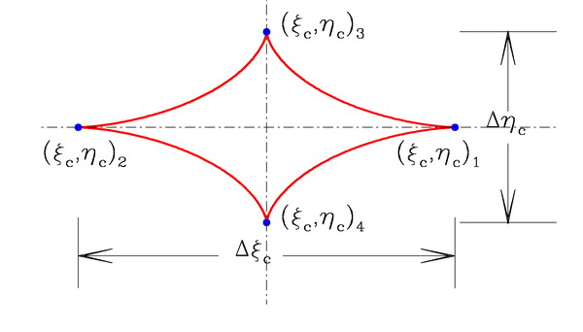
Han 2006: Major Image Caustic
Han 2006 ApJ 638, 1080

Slide 37
7. Major Image, ρ < caustic: q
Notes:
delta_t = 0.2 days
tE = 24.8 days
→ rho = 0.004

Slide 38
Minor Image, ρ < caustic
2 caustic crossings
Trough

Slide 39
6. Minor Image, ρ < caustic: ρ
2t* ~ 0.2 days → ρ = 0.00175

Slide 40
7. Minor Image, ρ < caustic: q

Slide 41
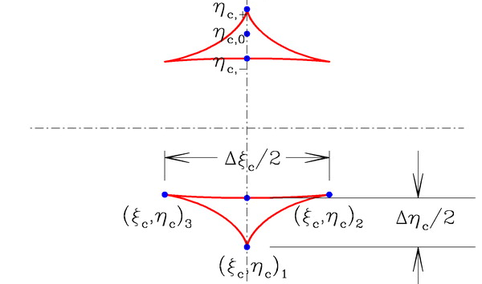
Han 2006: Minor Image Caustic
Han 2006 ApJ 638, 1080

Slide 42
7. Minor Image, ρ < caustic: q
~ 0.0579
Δt = 3.3 days
→ q ~ 0.00022
Notes:
dt = 3.3 days
tE = 57 days
dt/tE = 0.0579 ~ 2*eta_c0
eta_c0 = 0.0290
s = 0.742
q = 0.00022
True s, q = (0.7404, 0.0001575)

