Slide 1
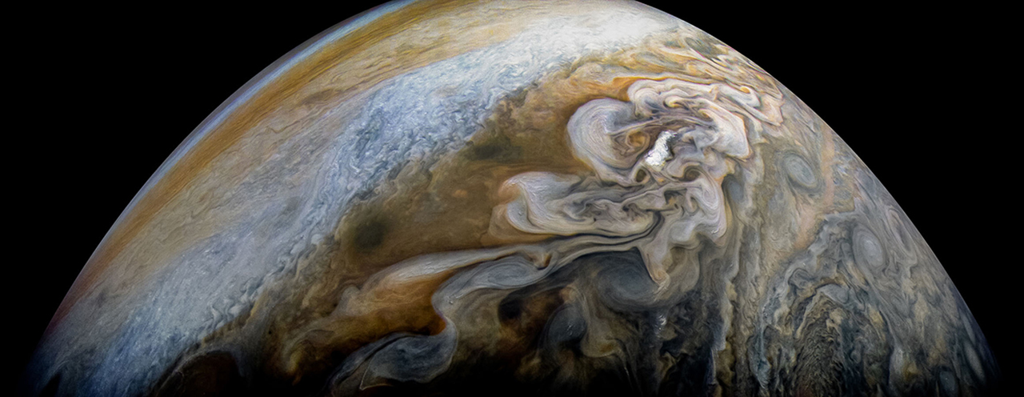
Let’s hear it for the citizen scientists!
Jessie Christiansen, IPAC
Rob Zellem, JPL
Moderator: Liz Landau, JPL

Slide 2
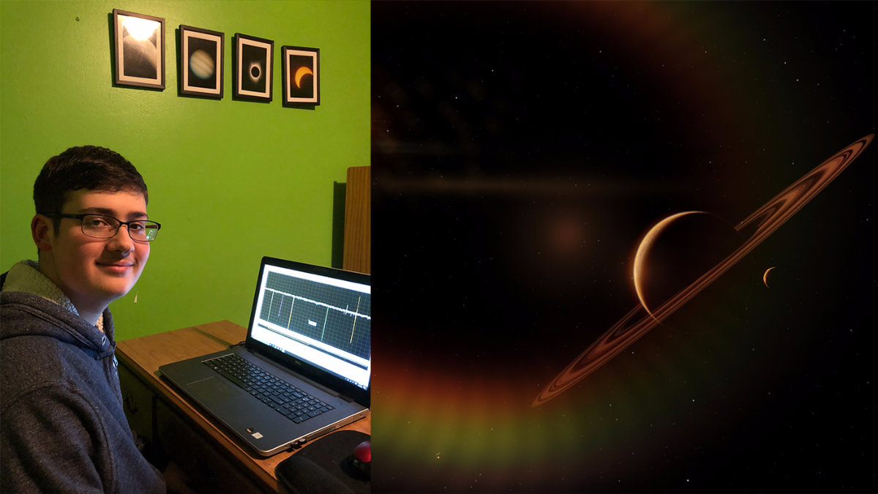
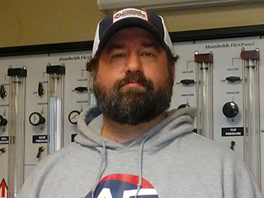
Who does citizen science?
Judy Schmidt, image processing
Alton Spencer, finding exoplanets
More “people” stories:
solarsystem.nasa.gov/citizenscience
Les Hamlet, finding brown dwarfs

Slide 3
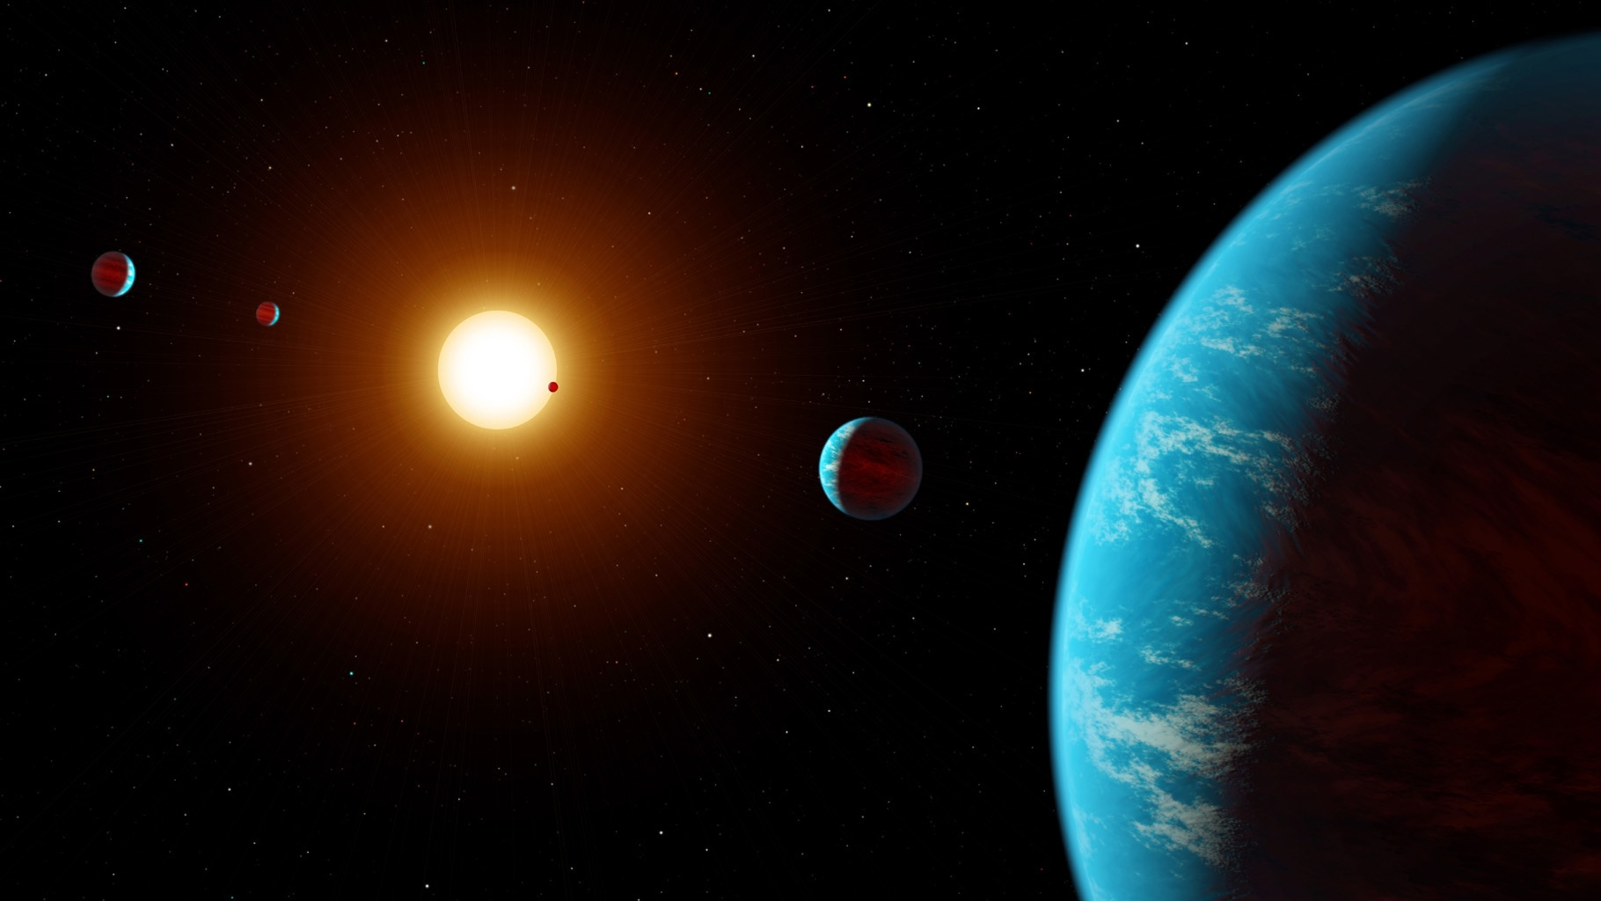
Real discoveries are made via citizen science
Exoplanet Explorers
Artist concept, K2-138 system

Slide 4
Citizen science projects we’re talking about
NASA’S UNIVERSE OF LEARNING
MicroObservatory
http://microobservatory.org
GORT/GTN
http://gtn.sonoma.edu
PANOPTES
http://projectpanoptes.org
ZOONIVERSE
Exoplanet Explorers
http://exoplanetexplorers.org
Exoplanet Explorers

Slide 5
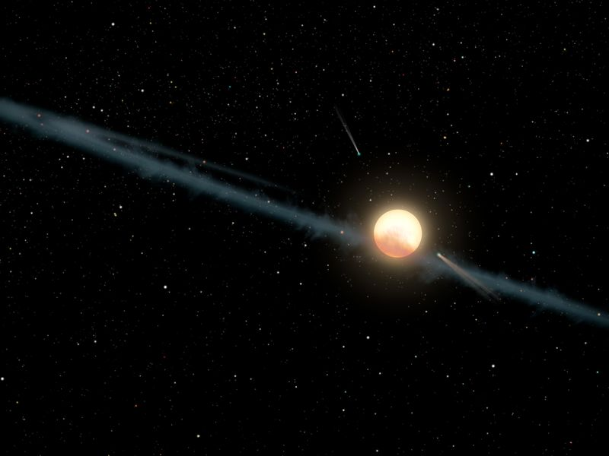
Contacts
Jessie:
christia@ipac.caltech.edu
Rob:
Robert.T.Zellem@jpl.nasa.gov
Liz:
Elizabeth.Landau@jpl.nasa.gov

