Slide 1
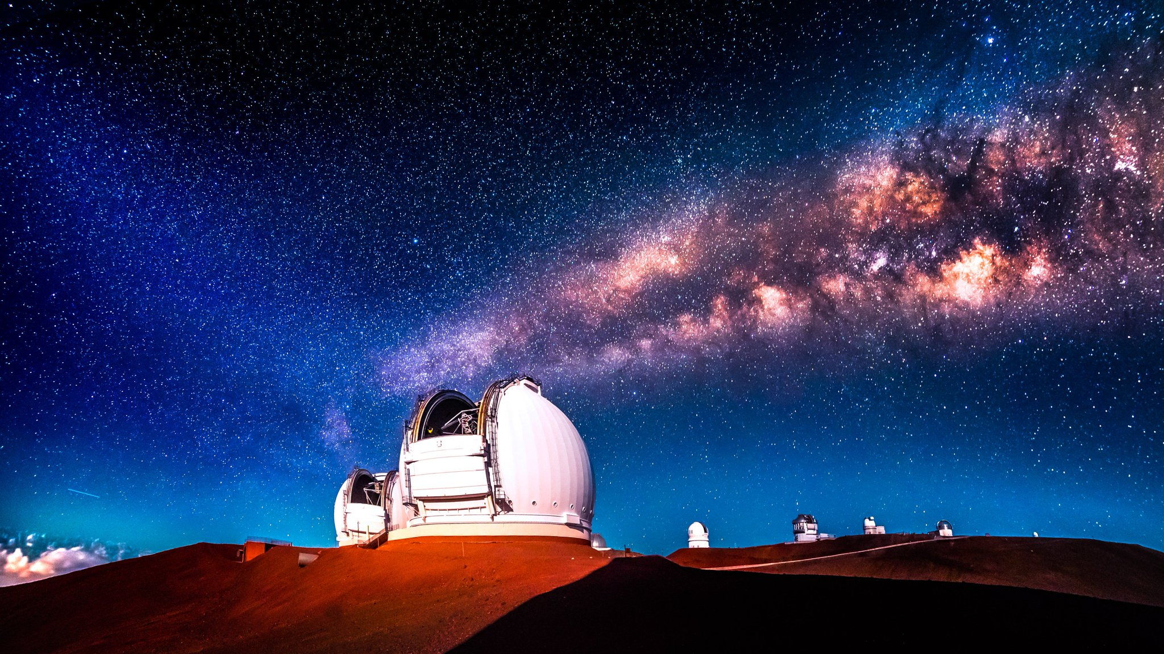
Demonstrating Predictive Wavefront Control at Keck II
Rebecca Jensen-Clem
Miller Fellow, UC Berkeley
ExSoCal 2018
Photo Credit: Andrew Richard Hara
Notes:
Hi everyone, I feel so lucky to have been able to join you all here this week, and today I’m here to talk to you about a new project that I’ve just gotten started with the support of the Heising-Simons Foundation on demonstrating predictive wavefront control at the Keck II telescope. Now, if this sounds like just a piece of boring instrumentation jargon, DON’T BE FOOLED. This is a game-changing technique that will allow us to image faint planets at solar system separations with Keck and other 8-10 meter class telescopes, and later allow us to probe deep into the habitzble zones of nearby M dwarfs with 30 meter class telescopes. Before I define predictive wavefront control in more detail, I want to back up a little bit.

Slide 2
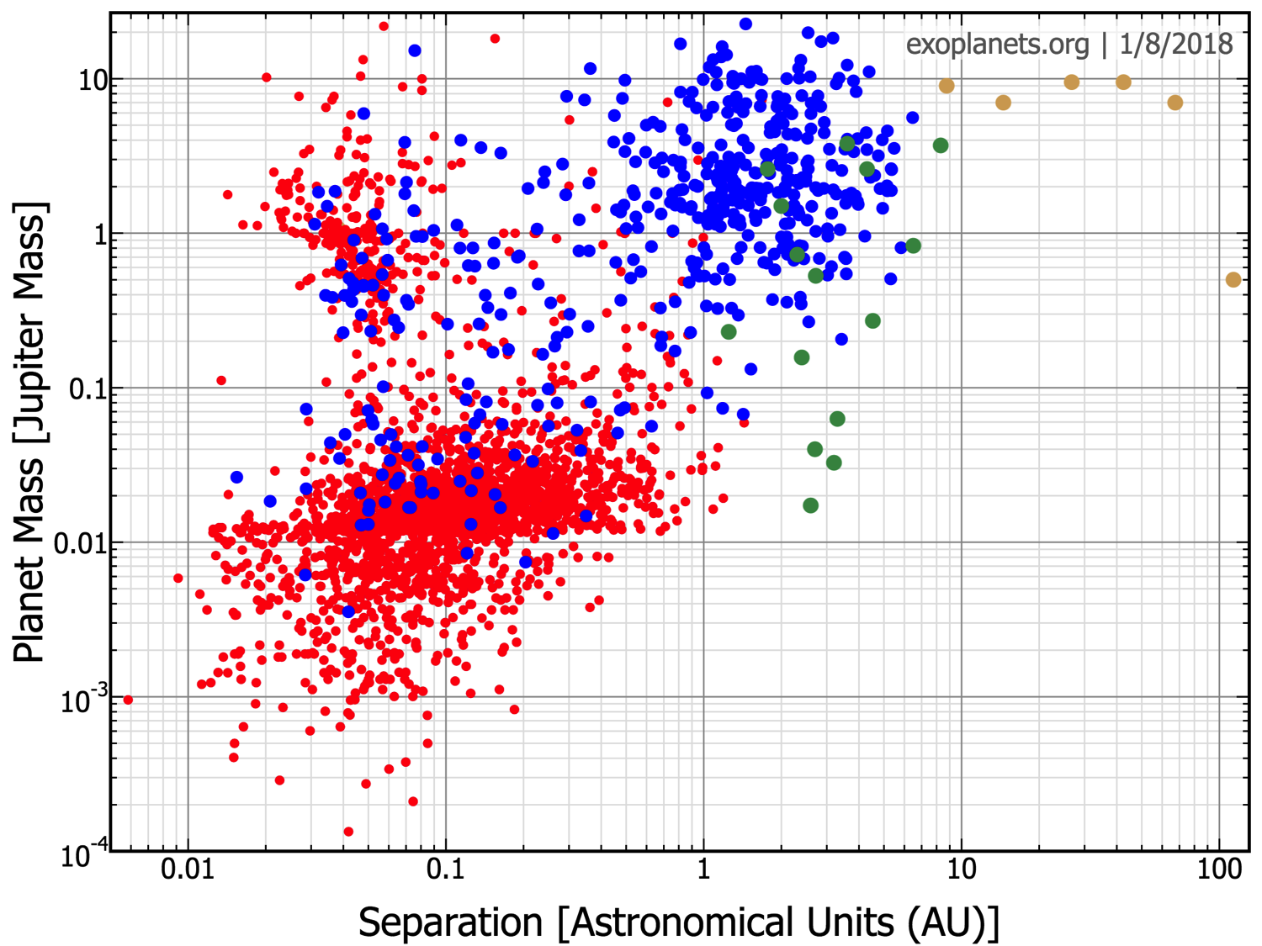
The occurrence rate of 5–13 M_{Jup} planets at orbital distances of 30–300 au from single, 5–300 Myr, 0.1–3.0 M stars is aaaaaaaa(Bowler 2016)
Notes:
Say that we’re doing pWFC cuttig edge, groundwork being laied at Subaru
Solar system scales rather than RV planets per se
Why bother? Spectra, mass

Slide 3


Slide 4
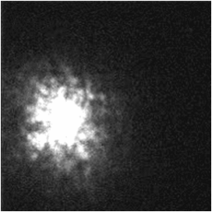
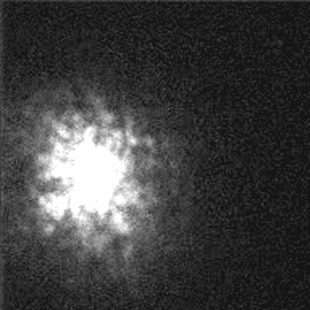

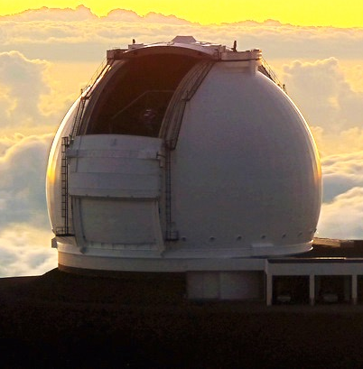
Notes:
Make sure to say that these are fast exposures

Slide 5
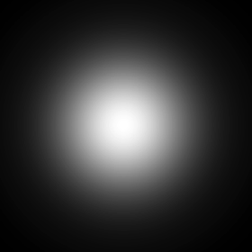
r₀ = characteristic turbulence cell size
λ/r₀
Notes:
Remember to define D, mention the equation at least

Slide 6
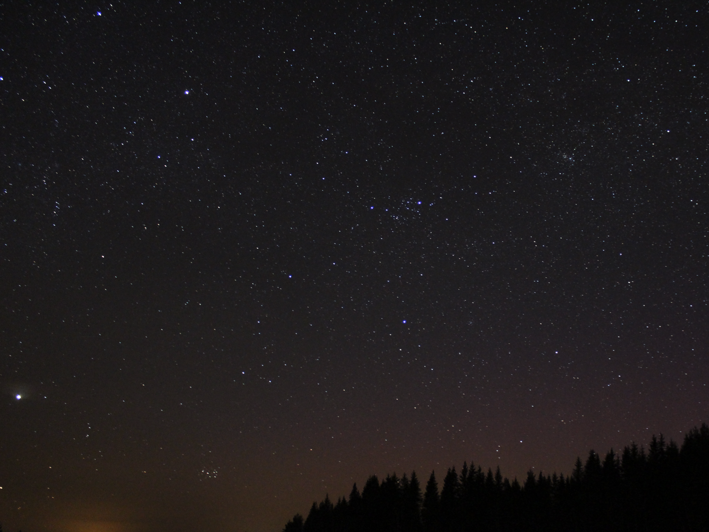
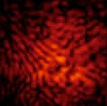

Adaptive Optics
Science light
Wavefront sensing light
WFS

Slide 7
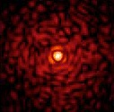
Adaptive Optics
Science light
Wavefront sensing light
WFS

Slide 8
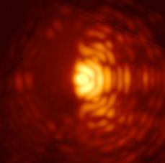
Adaptive Optics & Coronagraphy
Science light
Focal plane mask
Lyot plane mask
Wavefront sensing light
WFS
Notes:
Slow down, talk more about coronagraph

Slide 9
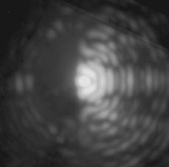
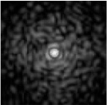

Adaptive Optics & Coronagraphy
Science light
Focal plane mask
Lyot plane mask
Wavefront sensing light
WFS
Time delay δt

Slide 10
: Guyon & Males 2017
Compensating for δt with predictive WFC

Slide 11
Notes:
1) A single wavefront consists of m measurements. Let’s put the last n wavefronts into a history vector:

Slide 12
Notes:
2) We want to find the filter that minimizes the distance between the predicted and actual future wavefront:

Slide 13
Notes:
3) Solve for F using a training set of history vectors D and its copy P, δt away:

Slide 14
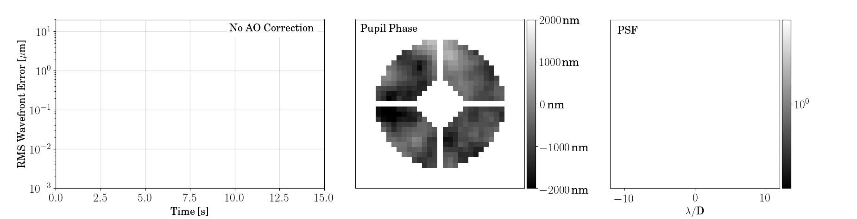
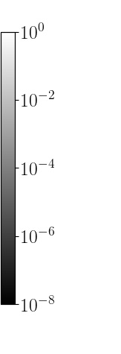

Slide 15


Slide 16
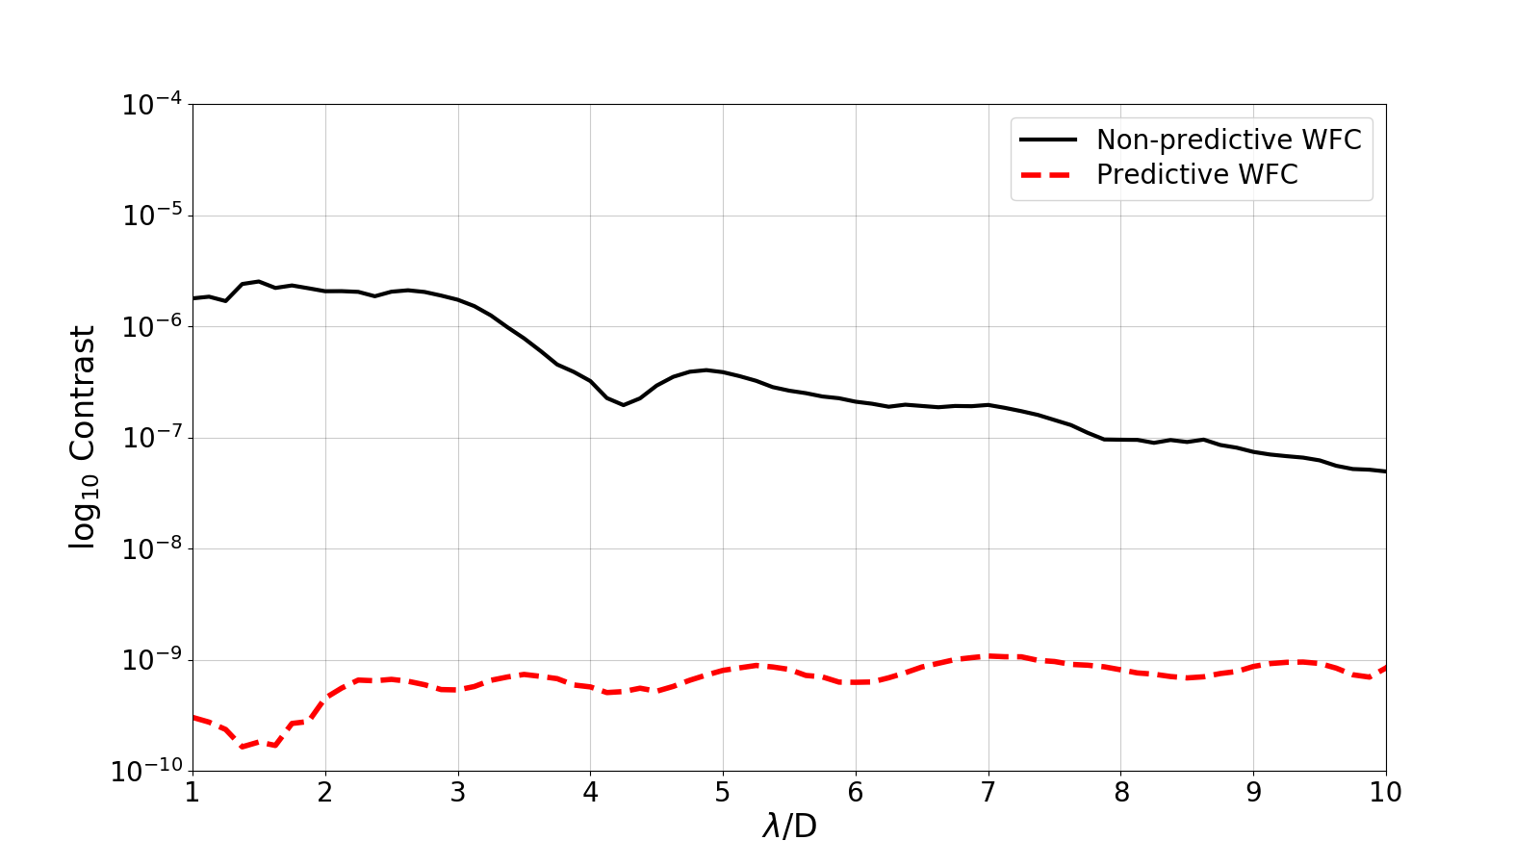
Notes:
Say something about ideal case
Mention that the top isn’t crazy for real things

Slide 17
Demonstrating Predictive Wavefront Control at Keck II
PI: R. Jensen-Clem (UCB)
Co-Is: D. Mawet (Caltech), P. Wizinowich (WMKO), J. Graham (UCB)
Collaborators: S. Cetre, S. Ragland, E. Wetherell (WMKO)
UCB Undergraduates: E. McEwen, S. Dehghani, A. Sengupta
Supported by the Heising-Simons Foundation

Slide 18
OAP
K-mirror
HODM
NIRSPEC
BS
TTM
OAP
FIU
BS
VIS SH WFS
BS
NIRC2
KPIC
Keck II AO
LODM

Slide 19
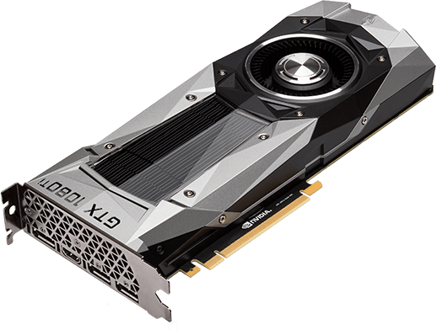
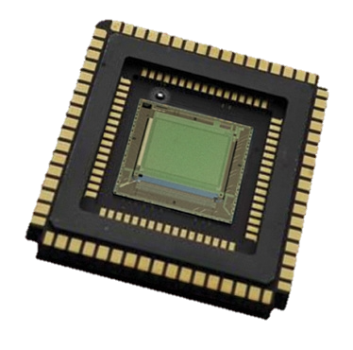
The Near-IR Pyramid WFS at Keck II
Enabling pWFC via RTC and low-noise, high-speed detectors
New RTC: Nvidia Geforce GTX 1080 Ti
(2x 7168 cores)
New WFS detector:
Selex SAPHIRA array
(<1e⁻ read noise)
Notes:
Give relative improvements
Computationally intensive operations are moved to GPUs.

Slide 20
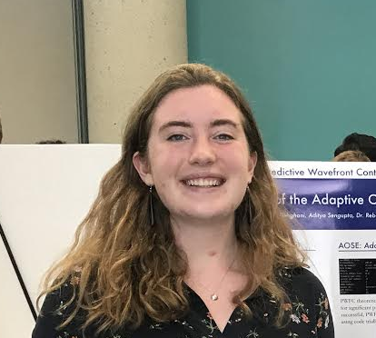
The adaptive optics simulation engine (AOSE)
Eden McEwen
Notes:
AOSE is a clone of the PYWFS real time control computer
x86 architecture linux server
Dual Processors with multiple cores Intel Xeon Gold 6126 CPU @ 2.60GHz (48 cores total)
2 Nvidia Geforce GTX 1080 GPUs

Slide 21

The adaptive optics simulation engine (AOSE)
Eden McEwen
CACAO
Notes:
AOSE includes CACAO, a C-language, open-source toolkit for AO control optimized for multi-core CPUs and GPUs, in use at SCExAO (see Guyon+18, SPIE, for details)
We’re at a unique point with three AO systems using CACAO

Slide 22
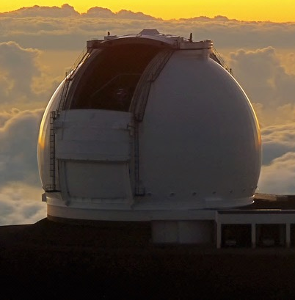
Eden McEwen
CACAO
Notes:
Status: the hardware is set up, and CACAO is installed. The SCExAO version of pWFC is being implemented and tested.
Next step: day time and night time at Keck

Slide 23
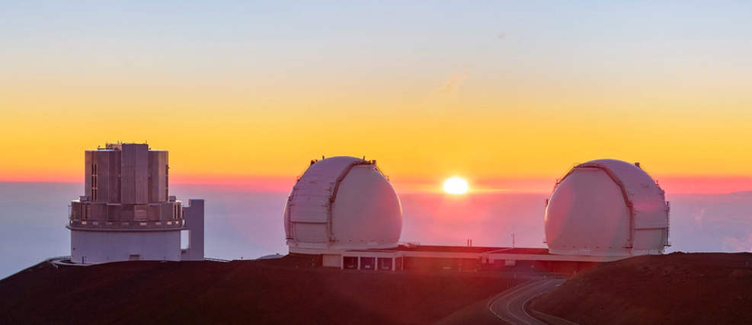
Time: the final frontier

Slide 24
Thank you!

Slide 25
Extra Slides

Slide 26
Adaptive Optics & Coronagraphy
Science light
Focal plane mask
Lyot plane mask
Wavefront sensing light
WFS
Notes:
Maybe put the star here

Slide 27
Adaptive Optics & Coronagraphy
Science light
Focal plane mask
Lyot plane mask
Wavefront sensing light
WFS
Notes:
Maybe put the star here

Slide 28
Brown dwarf
mass objects
Imaged PMCs
RV planets
Bowler 2016
Notes:
, Why the gap? Transits? Consider replacing?

Slide 29
Brown dwarf
mass objects
The occurrence rate of 5–13 M_{Jup} planets at orbital distances of 30–300 au from single, 5–300 Myr, 0.1–3.0 M stars is aaaaaaaa(Bowler 2016)
Bowler 2016

Slide 30
The Near-IR Pyramid WFS at Keck II
Prism
Flat wavefront
Tilted wavefront
Re-imaging lens
Optical axis
Focal plane
Pupil plane
Image credits: Bond et al. 2018
Notes:
Backup slide?

